Slide 1

Keeping the Channels Open
How a Small Town Played a Big Role in Keeping the Chesapeake and Delaware Canal Open

Slide 2
Speakers
Joseph Zang III, Mayor – Town of Cecilton, MD
Chris Rogers, AICP – AECOM
Kristen Keene – Maryland Port Administration
Gavin Kaiser, P.E., Project Manager – U.S. Corps of Engineers, Philadelphia District
Valerie Woodruff, Resident – West View Shores

Slide 3
Presentation Outline
Project Background
Need for Dredging and Importance of the Port of Baltimore and the role of the Maryland Port Administration
Role of Corps of Engineers Relative to Navigable Channels
Why is the Mayor here?
Environmental Impacts and Monitoring
Public Outreach
Conclusion/Discussion

Slide 4
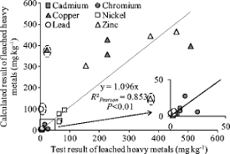
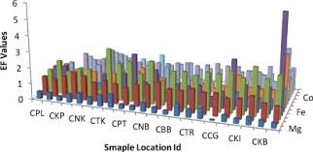

Slide 5
Corps of Engineers and MPA
Corps relationship with MPA
Prioritization process
Relationship on Pearce Creek Project, e.g., confirm if same as described or describe anything unique

Slide 6
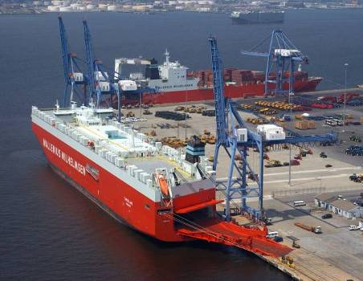
Maryland Port Administration
Responsible for increasing the flow of waterborne commerce through the State of Maryland in a manner that provides benefit to the citizens of the State

Slide 7

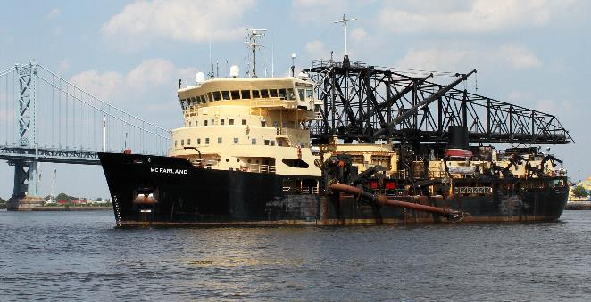
US Army Corps of Engineers Philadelphia District
Responsible for maintaining navigability in the C&D Canal via routine maintenance dredging, which allows shipping vessels to go from the Delaware River to the Chesapeake Bay, and ultimately to the Port of Baltimore.
Notes:
Most of us are not soldiers
Many of us are not engineers
We contract for construction
We don't work just for the Army
Our boundaries are based on watersheds
Most of our own projects are water-related
And projects drive the Corps (not vice versa)
Deliver vital engineering solutions
in collaboration with our partners
to secure our Nation,
energize our economy,
and reduce risk from disaster.

Slide 8
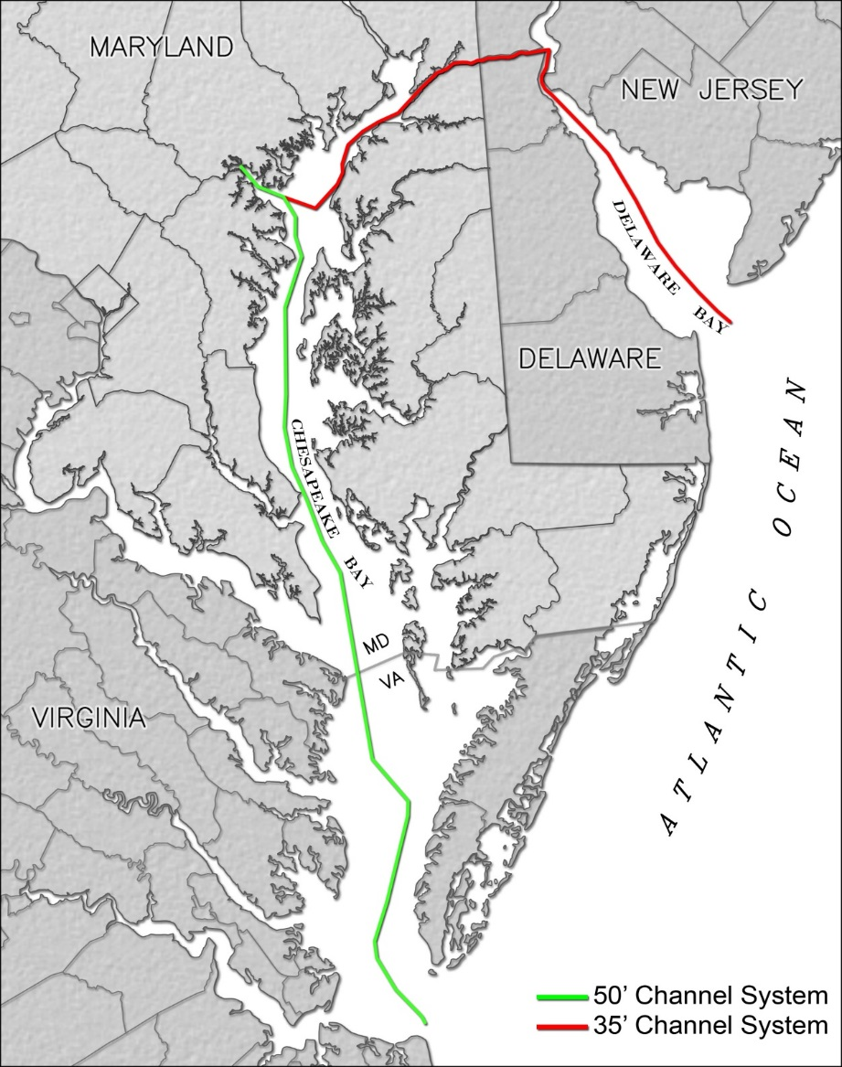
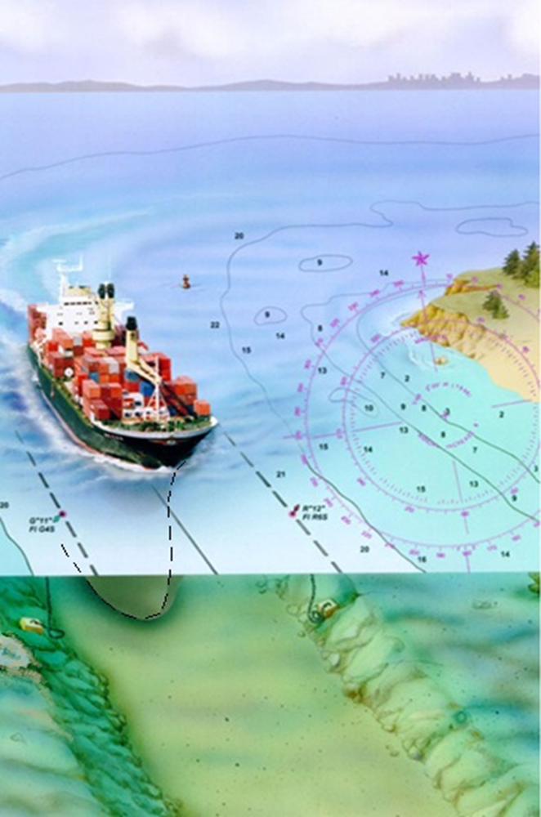
Dredging Shipping Channels
8
Notes:
And to keep our marine highway safe, efficient and open for business we must ensure, along with our partners at the Army Corps of Engineers, that the federal navigation channels are “dredged” periodically. Here at the Port of Baltimore we have a 50’ channel system, positioning us well and competitively with other East Coast ports to receive those post-Panamax vessels coming through the expanded Panama Canal.

Slide 9
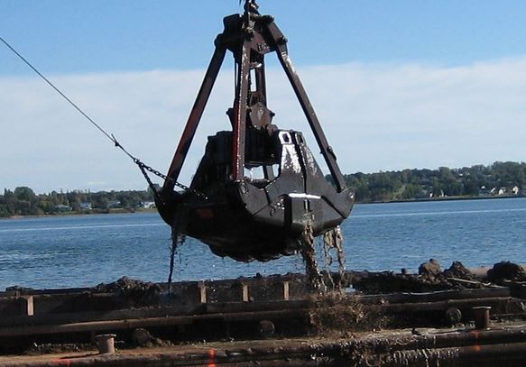
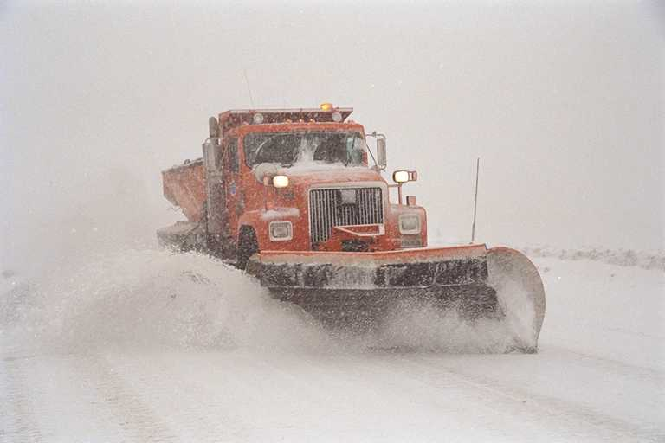
Dredging
Port of Baltimore Shipping Channels
Maintenance Dredging
Port of Baltimore’s shipping channel
  Maintaining a 50’depth keeps channels safe and open and the Port competitive.
Annual maintenance of the State’s marine highway
  136 miles of dredged channels/yr
4.7mcy of material is dredged annually
  Harbor channel material: 1mcy/yr
  Bay channel material
  C&D Canal approach channel material
Notes:
So just like our sister agency State Highway Administration is responsible for keeping the roadways and highways safe, efficient and open for business by plowing the snow each winter, we must work to remove the sediment that has been deposited in our channels – however, unlike SHA, our snow comes year round, and must be placed somewhere – but never melts!
With over 130 miles of dredged channels that can amount to almost 5 million cubic yards of sediment dredged each year – that would fill Ravens stadium more than two times – in just one year!

Slide 10
Economic Impacts of Port of Baltimore
Overall Description with map/aerial; size, depth, etc
Regional transportation access – will be DOT people in audience
Administration – MDOT Secretary…

Slide 11
Economic Impacts of Port of Baltimore
Jobs
Tons
Products
$$$$
Several slides

Slide 12
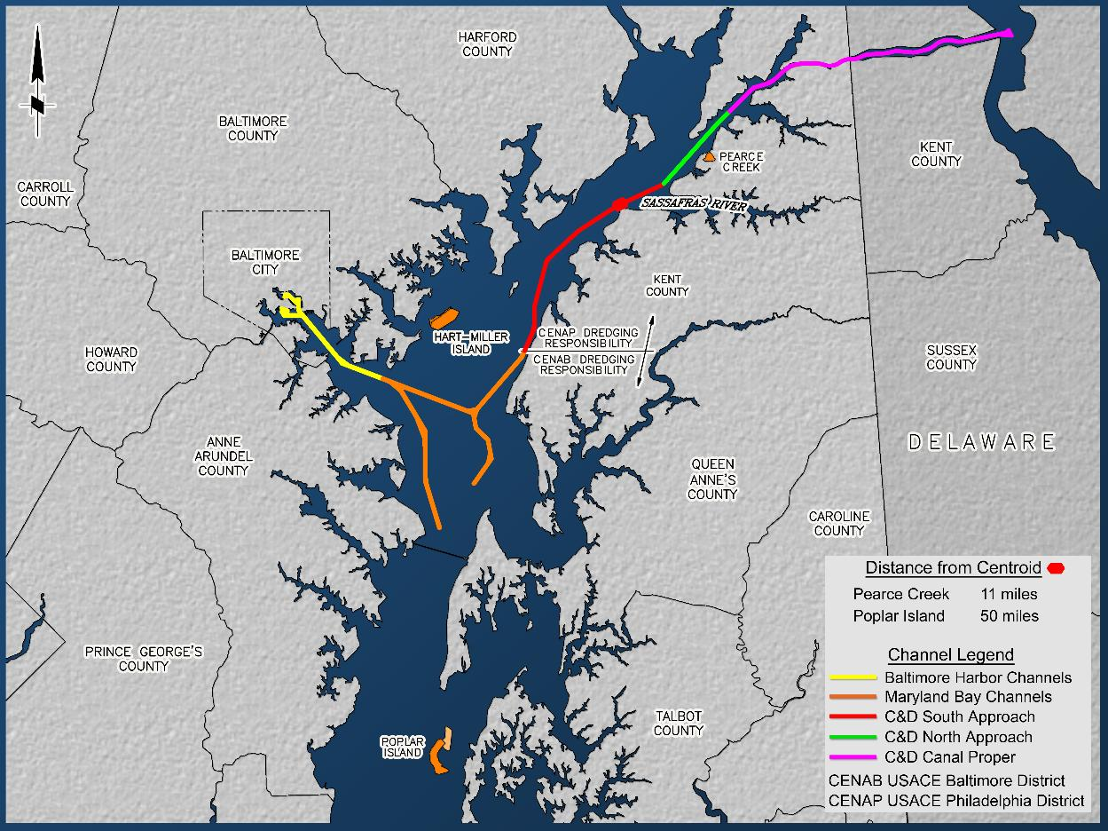
Cox Creek Expanded
C&D Canal Approach
Placement Options
Notes:
Base Dike Widening –contractor, Bowen and Kron executed the contract on July 19th, with MES for final execution, $29.4 million.
Construction is estimated to start in Fall 2018. (current schedule anticipates mobilization in September 2018)
+60’ Dike Raising 30% design plans received for review on July 18, 2018.
Phase I of the Upland Remediation has been completed and was approved by MDE as complete on July 11, 2018.
In case needed:
Upland Remediation Phase I total - $5.93M
Upland Remediation Phase II has started and is – Estimated $4.40M

Slide 13
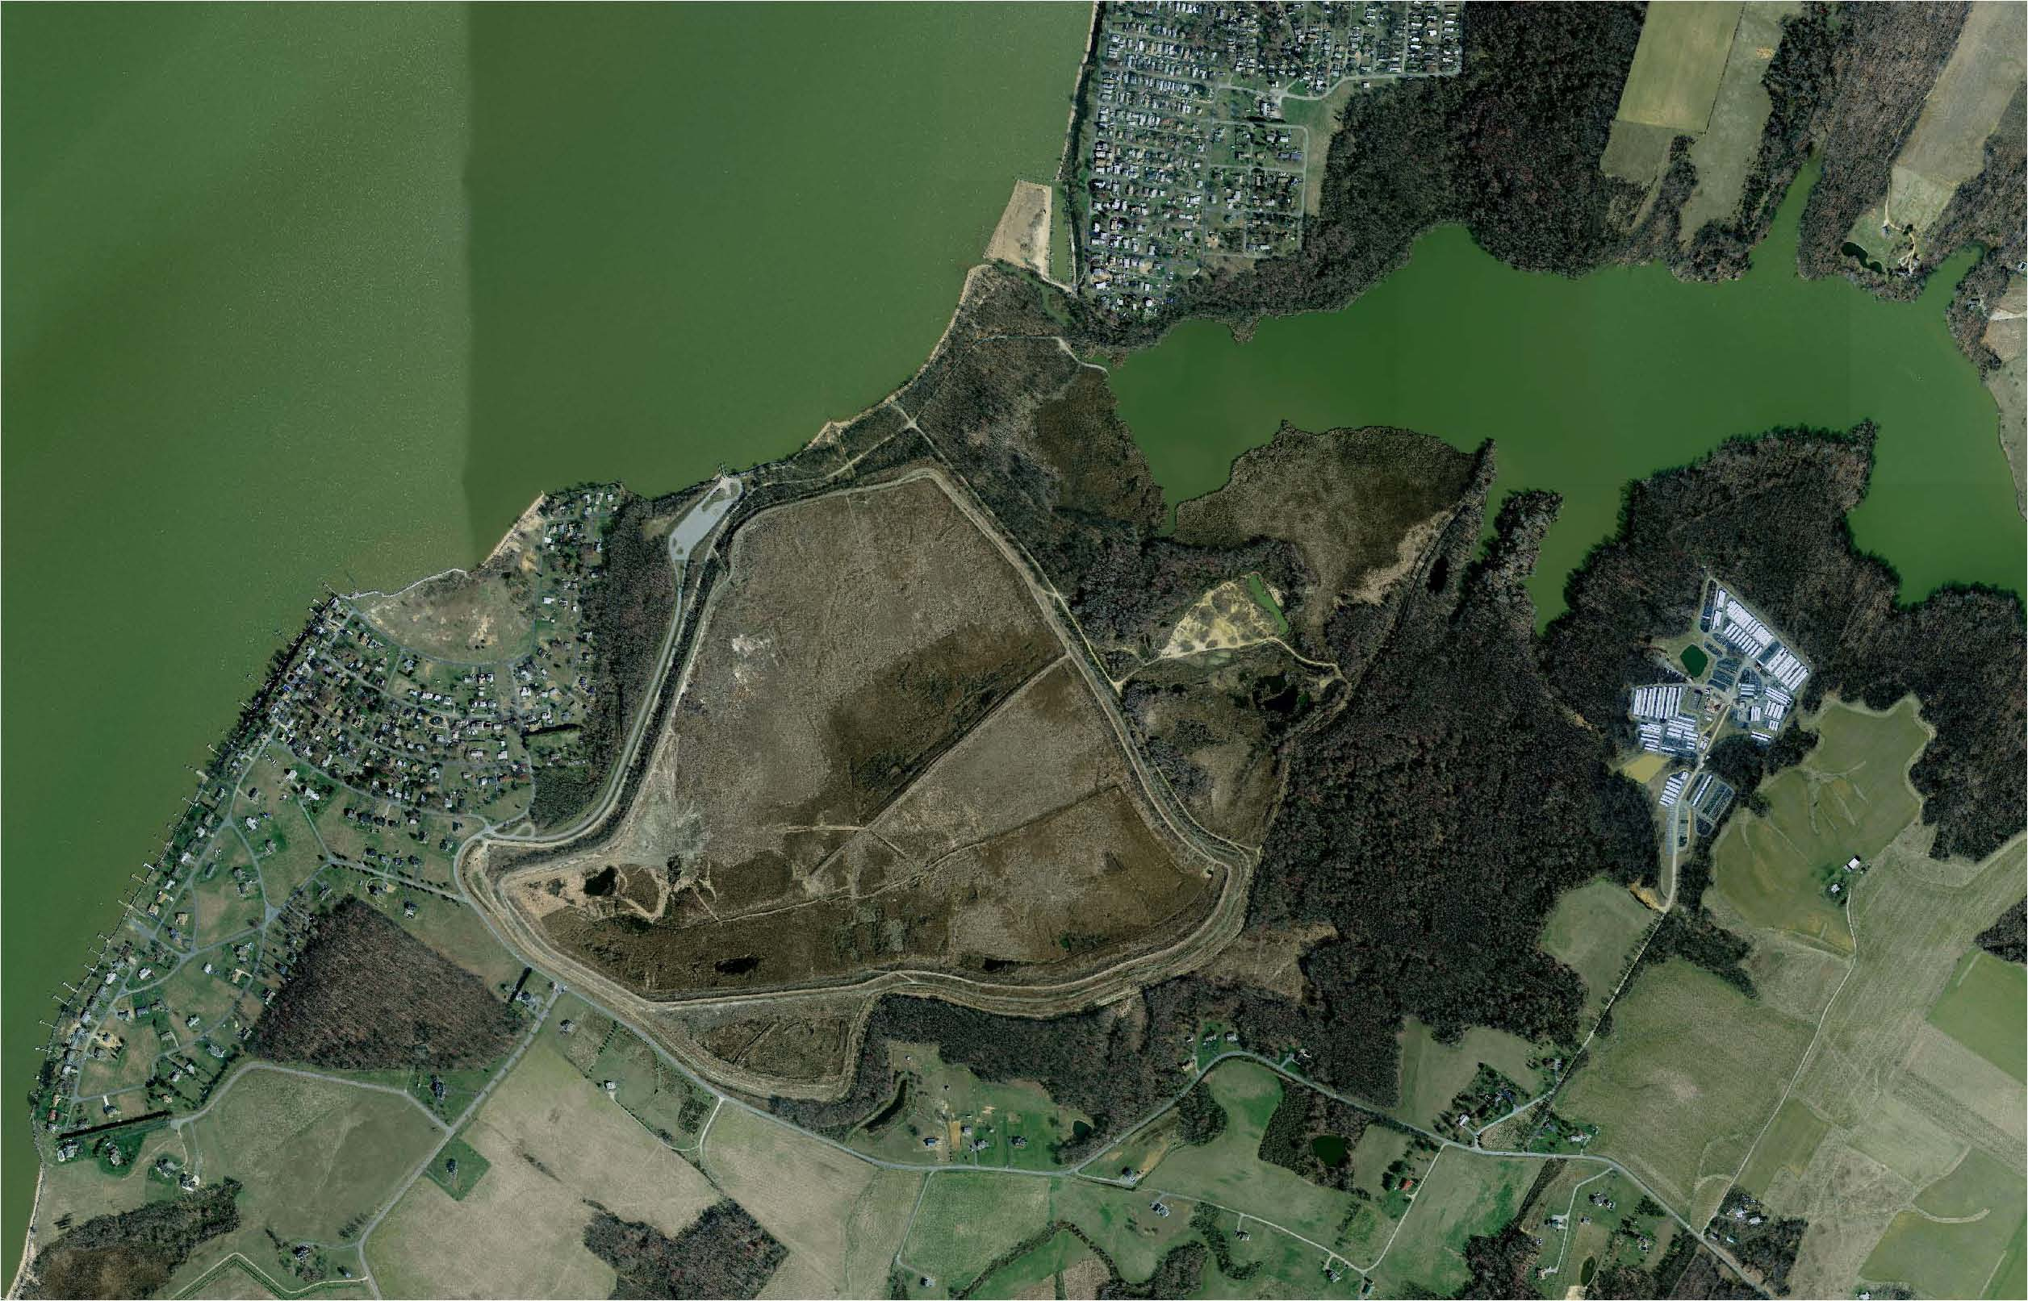
Elk River
Pearce Creek Lake
West View Shores
Pearce Creek Dredged Material Containment Facility
DMCF= 260 acres
Dike height = 50 ft NAVD
Placement History: 1937-1938; early 1960s; 1993; and 2017/2018
Remaining Capacity: 5mcy
Bay View Estates
Sunset Pointe
Notes:
The US Army Corps of Engineers Philadelphia District (CENAP) is the agency responsible nationwide for dredging navigation channels, including the Chesapeake & Delaware (C&D) Canal. The C&D Canal is an important transit route to and from the Port of Baltimore, one of Maryland's leading economic engines. In 1937 the USACE purchased nearly 1,000 acres of farmland bordering Pearce Creek for use as a containment site for dredged material from the C&D Canal approach channels.

Slide 14
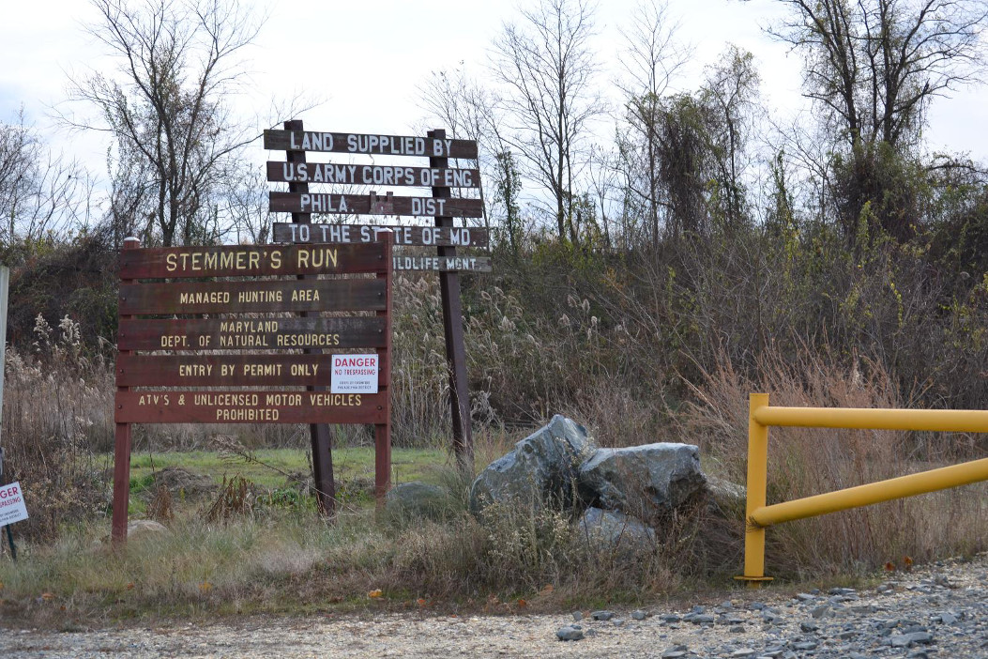
Pearce Creek DMCF Reactivation
Reactivation of the Pearce Creek DMCF is needed due to:
  The elimination of open water placement in Maryland in 2010;
  The high costs associated with transporting the southern C&D Approach Channel material to Poplar Island; and
  Helps to meet Federal and State dredged material placement needs.

Slide 15

So how do you get placement capacity???
Successful dredged material management option
Political support
Sound engineering & science
Citizen & other stakeholder support
contaminant stigma
NIMBY
starts here

Slide 16
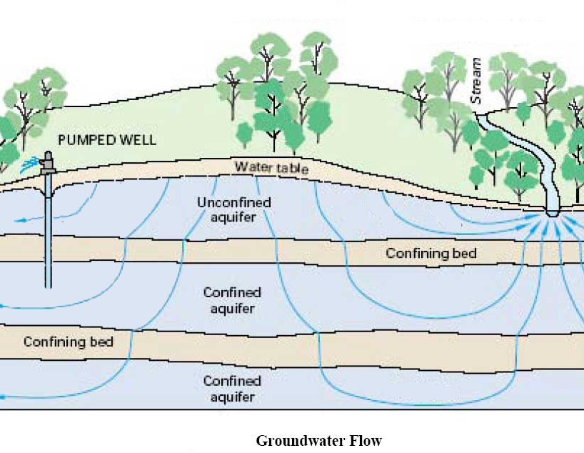
Pearce Creek Groundwater
The Pearce Creek site has experienced issues with groundwater in the vicinity of the DMCF, which ultimately prompted the need for a potable water supply in conjunction with the reactivation process.

Slide 17
Groundwater Investigations
The USGS 2012 report on groundwater in the vicinity of the Pearce Creek DMCF indicated high levels of various contaminants influenced by past operations at the Pearce Creek DMCF.
Following the USGS report, CENAP modeling verified the direction of groundwater flow and identified the “zone of influence.”
Due to the potential for continued long-term movement of groundwater away from the DMCF and toward the homeowner wells, the MPA agreed to fund a waterline to provide a potable water supply to those residents in the identified zone of influence.
Subsequent to these reports being issued, the Cecil County Health Department conducted more extensive well sampling and analysis within the zone of influence.
Notes:
MES study (1995): prepared for MPA and CENAP - initial investigations on groundwater in the PC area based on concern expressed by WVS residents to MDE. Study indicated low Ph, high sulfate & metal concentrations. Cause of these groundwater conditions is inconclusive.
USACE study (1996): In response to MDE concerns of groundwater impacts from the PC DMCF, USACE conducted a study to address concerns of possible groundwater contamination. Findings indicated that the Elk River/Chesapeake Bay is the primary recharge source for the local aquifers and water quality was low at all locations sampled. Due to the low vertical hydraulic conductivity observed during the pump tests, USACE does not believe the DMCF poses a threat to local groundwater quality.
USGS study (2012): included the observation of 52 wells, which included both monitoring wells and domestic wells. Data indicated that the DMCF has influenced groundwater contamination in the Magothy and upper Patapsco aquifers (shallow water-bearing zone) where the confining unit is thin or missing. The DMCF serves as a recharge area for the underlying aquifers and contributes to elevated concentrations of dissolved solids but also a geochemical driver of redox processes, which enable the mobilization and transport of redox-sensitive metals and nutrients. No evidence that the upper Patapsco aquifer in the deep water-bearing zone has been impacted by the DMCF.
- Secondary drinking water regulations exceedances: manganese, sulfate, pH, turbidity, TDS, chloride, aluminum, & iron
- Health Advisory Levels exceedances: manganese, nickel, sodium, sulfate, strontium, & zinc
- Max Contaminant Levels exceedances: beryllium, arsenic, thallium, & cadmium
Study also indicated low pH and high TDS in the aquifers, which can contribute to the mobilization of metals that naturally exist in the soil, bringing them into solution in the groundwater.
3. Following USGS report, CENAP conducted a groundwater modeling study to determine the direction of groundwater flow and identified the “zone of influence” – groundwater flows away from the DMCF towards the south, west, and southwest directions.
CCHD sampling (2013): included sampling of 152 domestic wells and tested for same constituents as the USGS study, with the addition of Gross Alpha Particle Activity (GAPA).
13% of samples exceeded MCL for beryllium
17% of samples exceeded MCL for arsenic or cadmium
32% of samples exceeded MCL for GAPA (low pH and high TDS is associated with mobilization of radium in groundwater, which releases gross alpha radiation.)
54% of samples exceeded HAL for nickel or sodium
38% of samples exceeded secondary drinking water standards for aluminum
CCHD also investigated the household water treatment systems. CCHD found that the treatment systems were generally effective in reducing constituent concentrations to acceptable levels; however, not all treatment systems proved to be effective. Most common treatment system = ion exchange unit, which causes elevated sodium levels in treated drinking water; CCHD found that 81% of treated samples exceeded EPA HAL for sodium.

Slide 18
MDE Coordination
MDE determined that the Pearce Creek DMCF may only receive and retain a WQC for placement of dredged material if:
  The DMCF is fully lined and;
  Corrective measures are undertaken to address the water supply that is provided to residents in the Service Area. The Corps committed to providing a liner for the DMCF and after extensive coordination and input with the communities, the MDOT MPA committed to providing a potable water supply to the 232 homes in the Service Area.

Slide 19
Pearce Creek WQC
The MDE WQC was issued December 2014 to allow the Pearce Creek DMCF to receive material.
WQC requires the following special conditions:
  Installation of a liner in the DMCF prior to the placement of dredged material;
  Commencement of public water supply system prior to the placement of dredging material; and
  Groundwater monitoring (Patapsco and Magothy aquifers) and discharge monitoring requirements.
CENAP submitted an application for an extension of the WQC, which was approved by MDE and extended to March 31, 2019.

Slide 20
Pearce Creek DMCF: Liner Construction

Slide 21
Pearce Creek Construction MOVIE

Slide 22
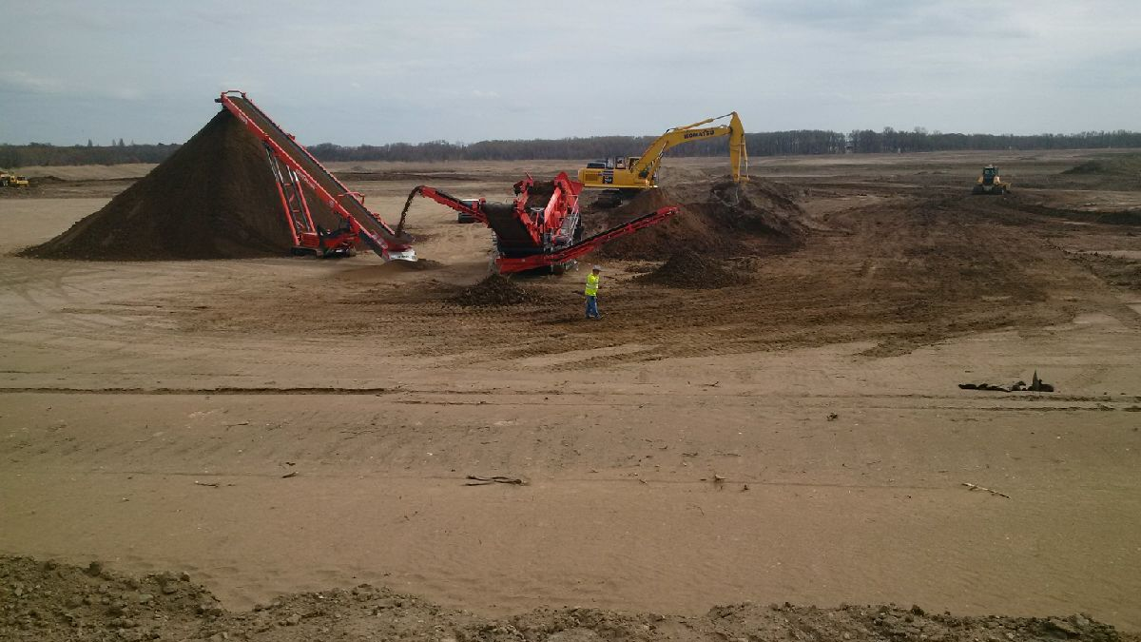
Pearce Creek Construction Sieve

Slide 23
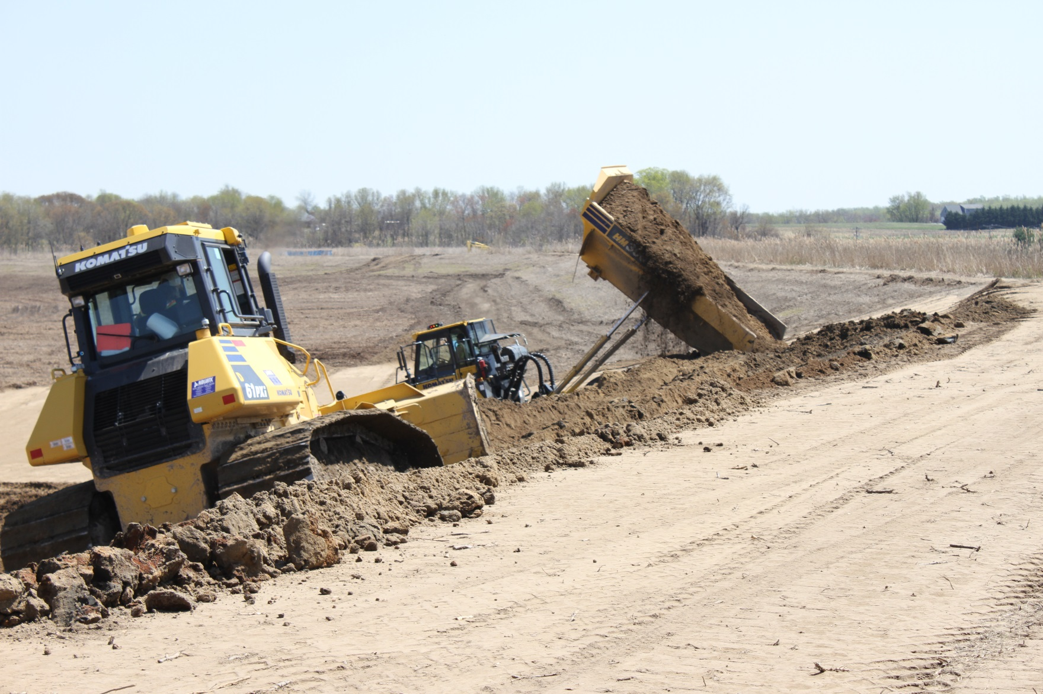
Pearce Creek Construction

Slide 24
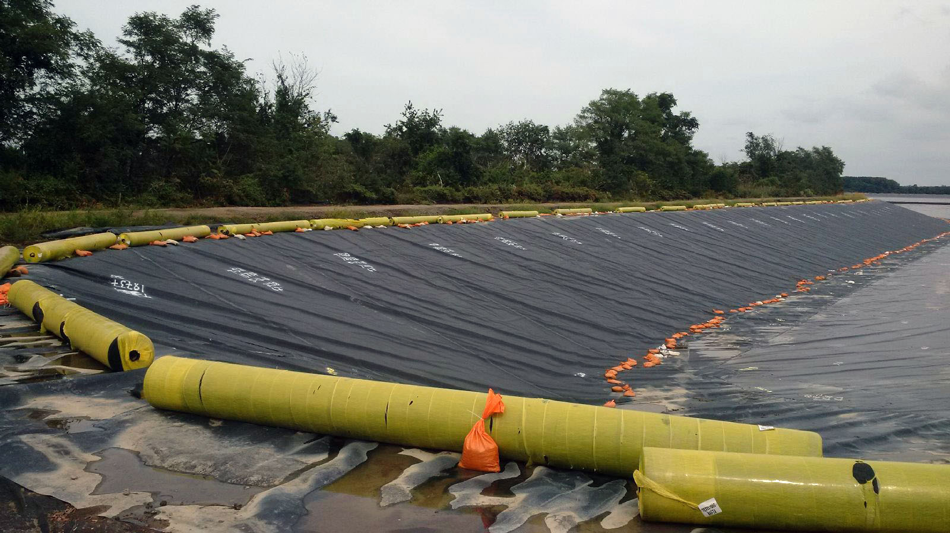
Pearce Creek Construction

Slide 25
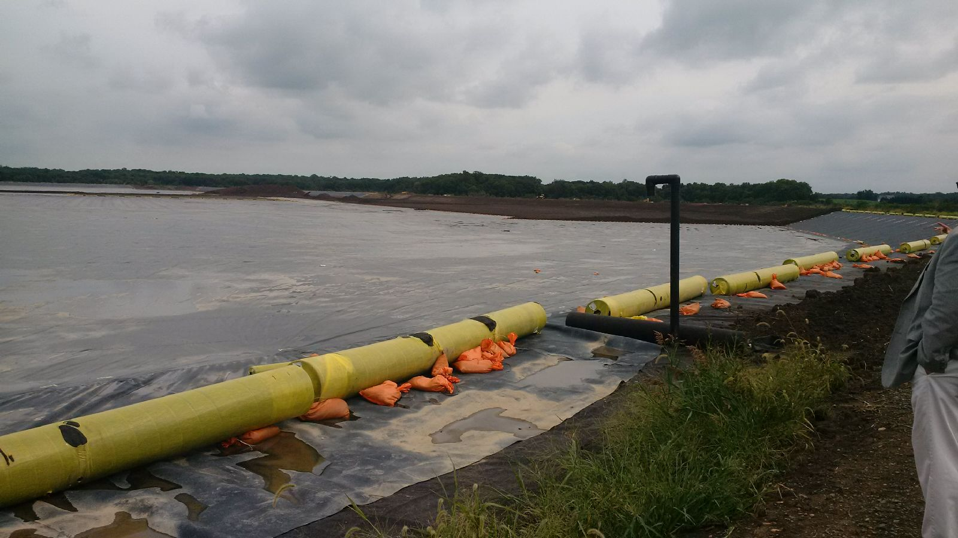
Pearce Creek Construction

Slide 26
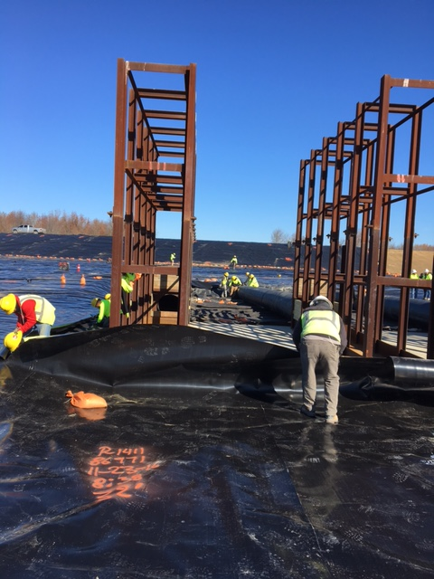
Pearce Creek Construction

Slide 27
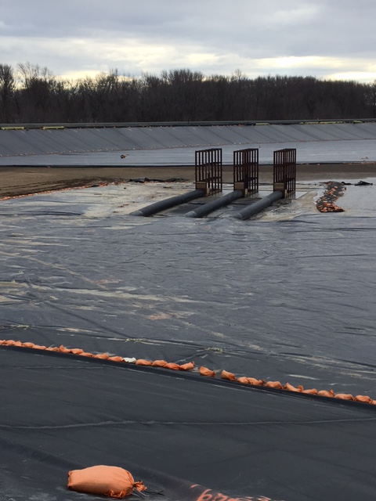
Pearce Creek Construction

Slide 28
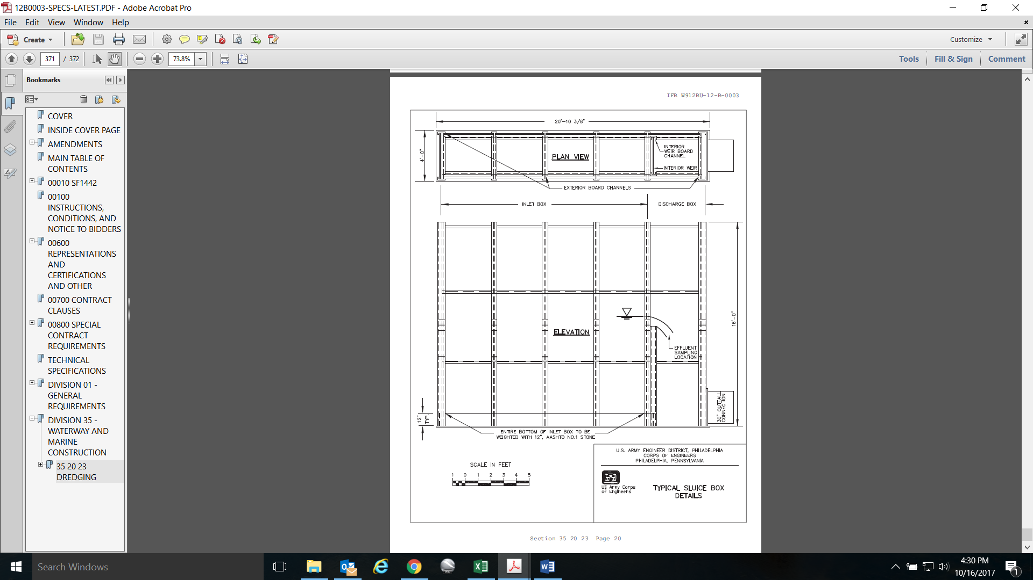
Pearce Creek Sluice Box

Slide 29
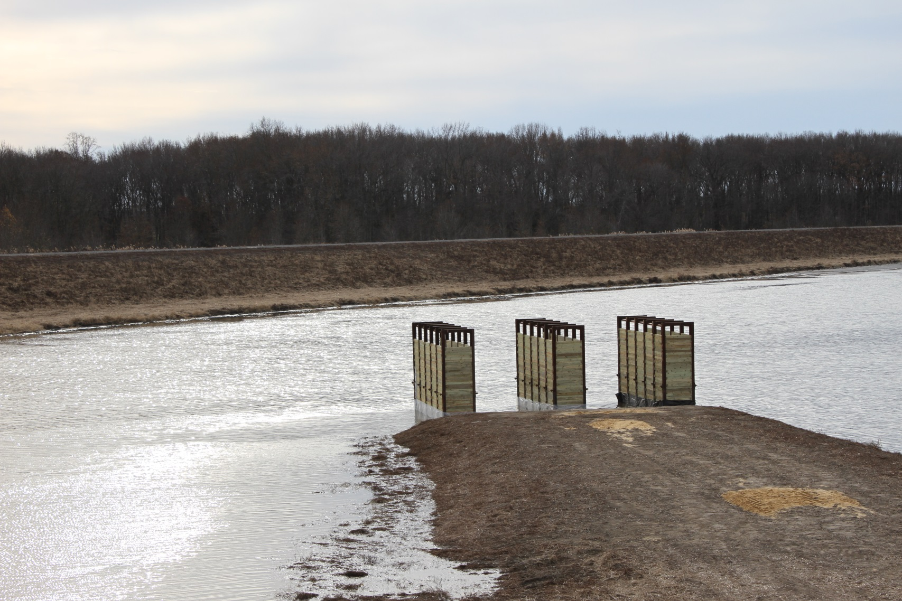
Sluice Box at Pearce Creek DMCF During Dredging Contract

Slide 30
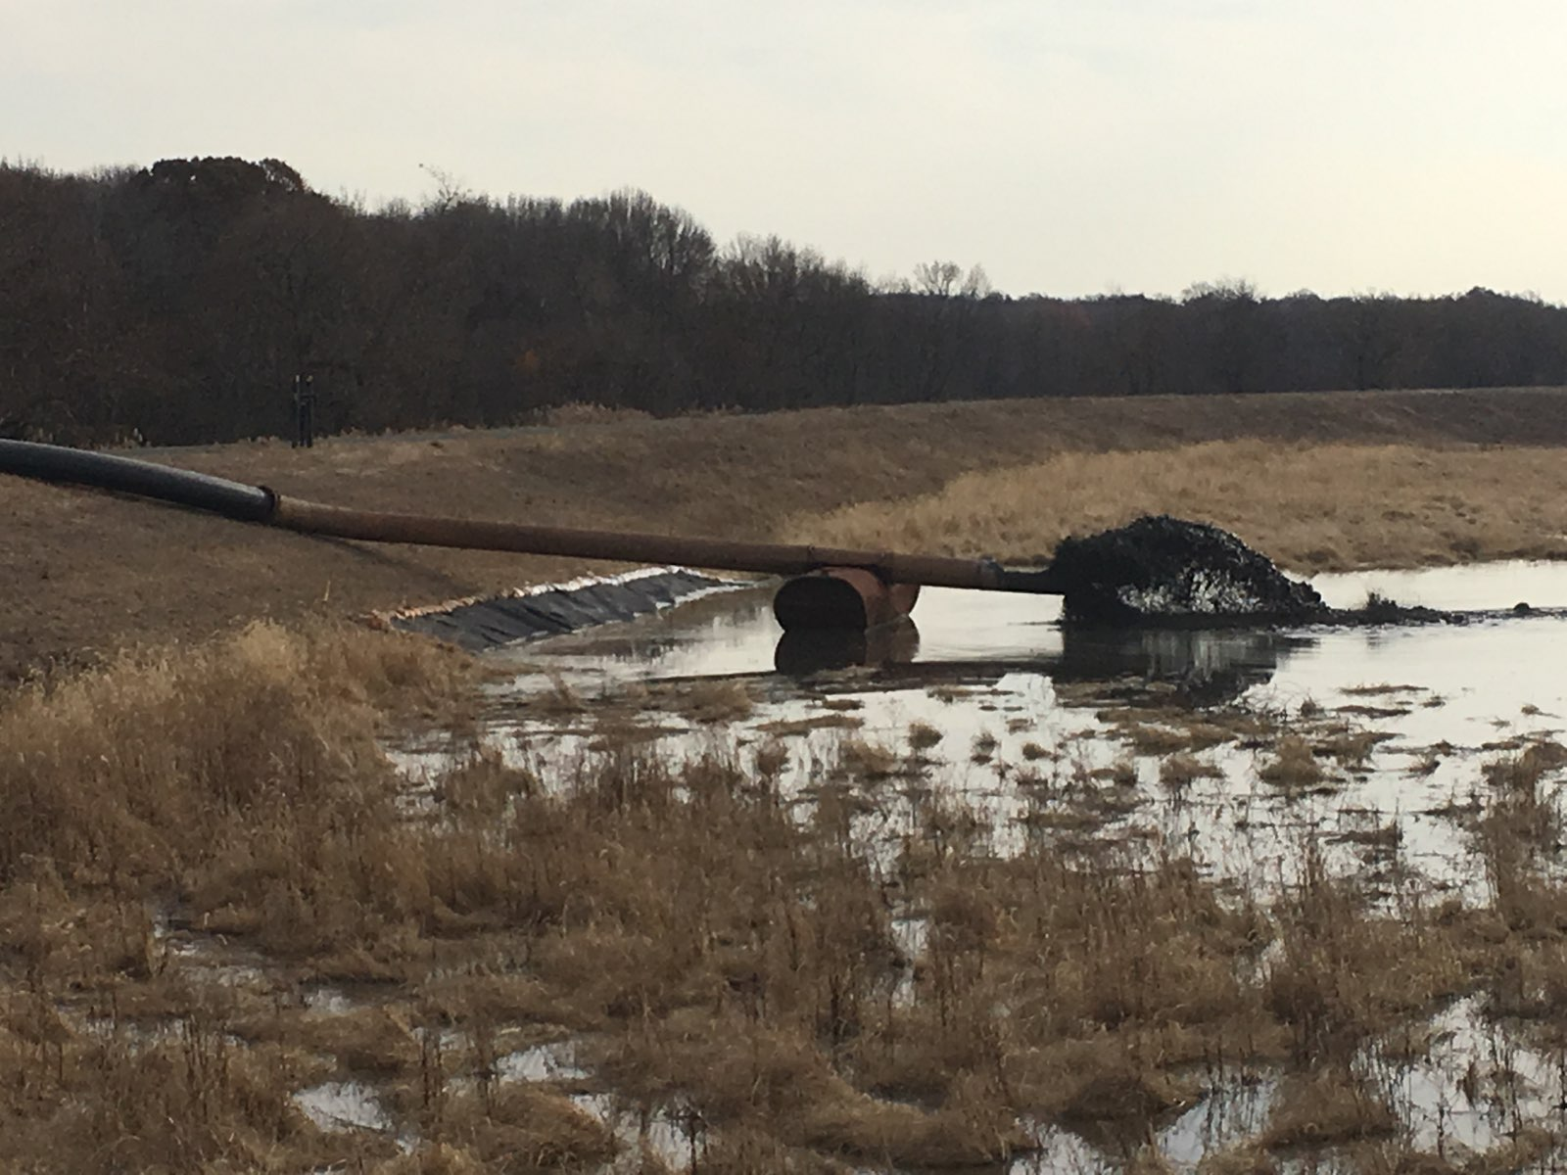
Dredging Inflow into Pearce Creek DMCF

Slide 31
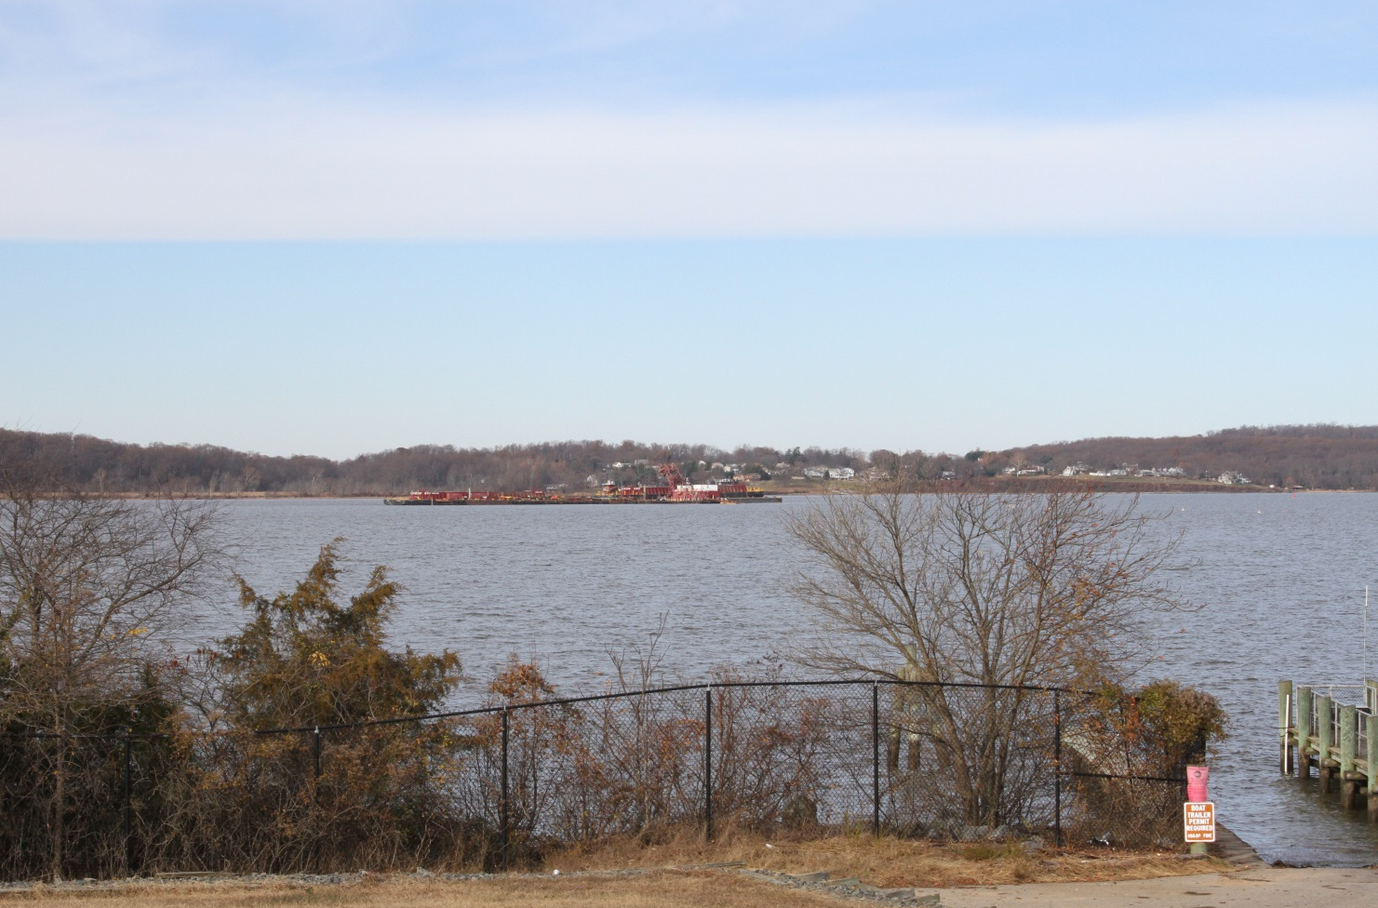
Offloading Operation outside of Pearce Creek DMCF

Slide 32
Pearce Creek DMCF Operations
Include text here about the current status of DMCF operations
Recent inflow & volume
Crust management

Slide 33
Degraded Wells: Finding a Solution

Slide 34
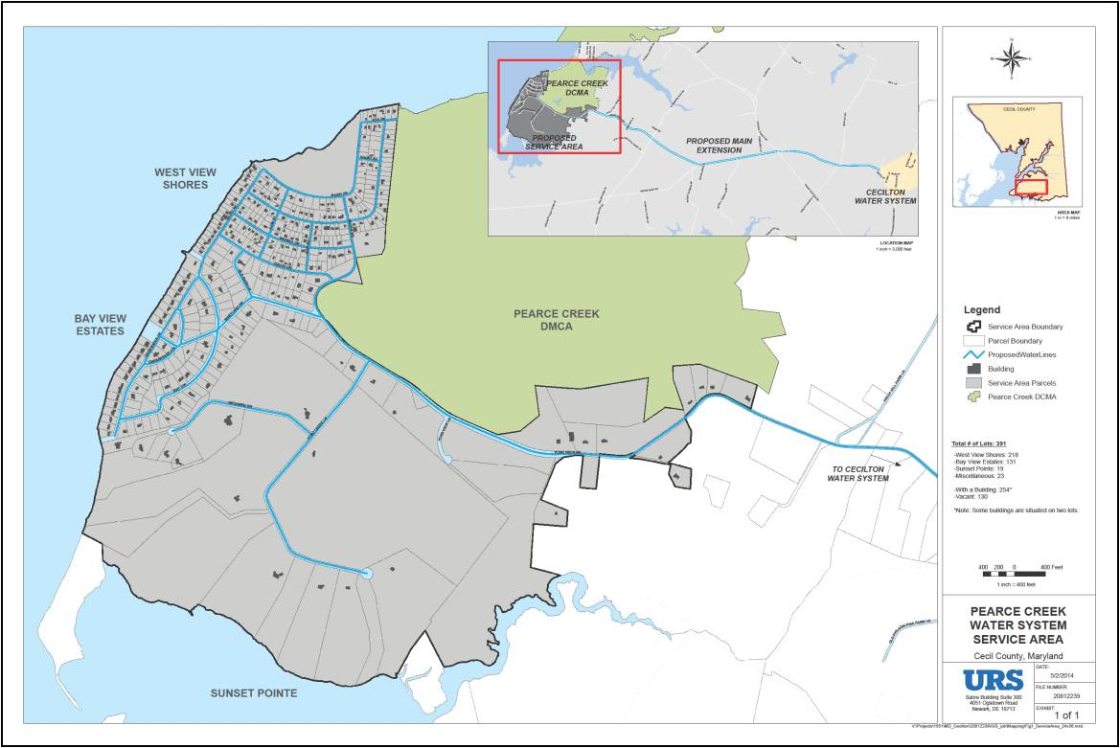
Pearce Creek Service Area

Slide 35
MDE’s Role – WQC condition in addition to other water quality monitoring
Not in outline but it’s worth noting.
Re-state condition of WQC, even quote from or have pdf highlighted.
How can a State Agency tell the COE’s What to DO?
Cite Clean Water Act specific reference and any important cases that upheld authority.

Slide 36
How to Address Degraded Wells?
Alternatives
Community System
Individual Treatment Systems for each Well/Dwelling
Drill New Individual Wells
One slide for each with pros and cons; mostly cons that discounted alternative
Did residents have a say?

Slide 37
Water Supply Alternatives
Community System (Community Well and Private Distribution System)
Designated Authority
Private Water Utilities not Interested
Geology not Conducive

Slide 38
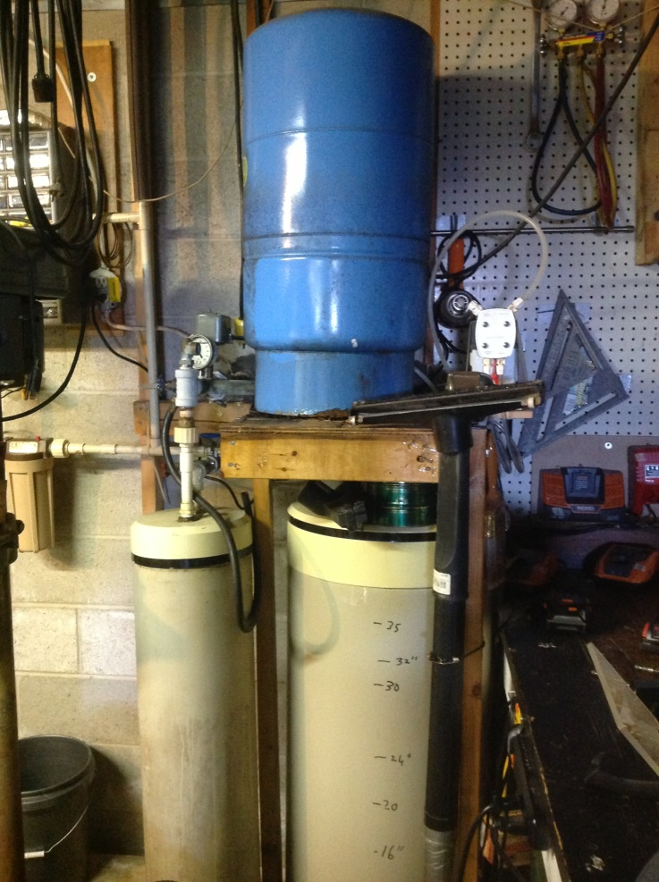
Water Supply Alternatives
New Individual Treatment Systems for Each Well/Dwelling

Slide 39
Water Supply Alternatives
Drill New Individual Wells
Geology not Conducive

Slide 40
This is Why the Mayor is Here

Slide 41
Water Supply Alternatives
Town of Cecilton
https://www.youtube.com/watch?v=3HPdBxpJ0Pc

Slide 42
Town of Cecilton Water System
How Could the Town System Service the Pearce Creek Service Area?
Vicinity Map –Town relative to Service Area

Slide 43
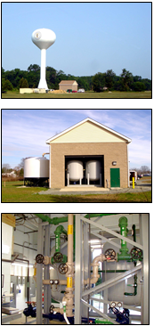
Town of Cecilton Water System
Cecilton Water System
Water Treatment Plant for Iron and Manganese
Two Wells in Magothy Aquifer
400,000 Gallon Storage Tank
Distribution System
2014 Population ~ 700 Residents

Slide 44
Town of Cecilton Water System
Feasibility Analysis
Planning Parameters
  235 Existing Residences
  135 Undeveloped Lots of Record
  7 Miles to Service Area
  7 Miles of Internal Roads
  Include On-Lot Connections
  Achieve Minimum 35 psi at Residences (2 story)
  Maintain Adequate Chlorine Residual

Slide 45
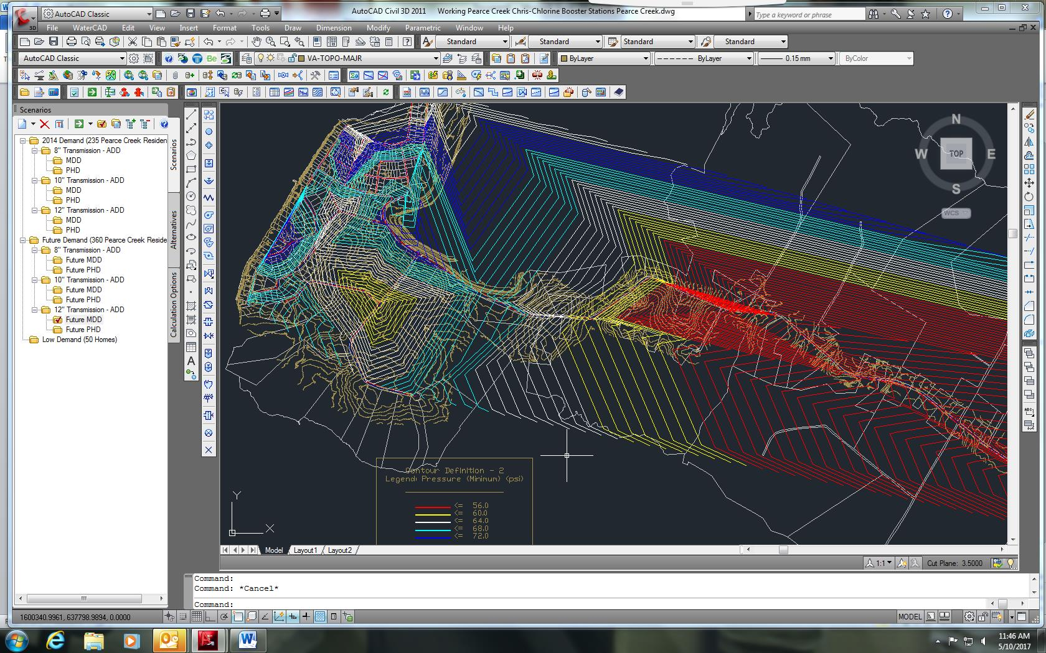
Town of Cecilton Water System Preconstruction Pressure Contours

Slide 46
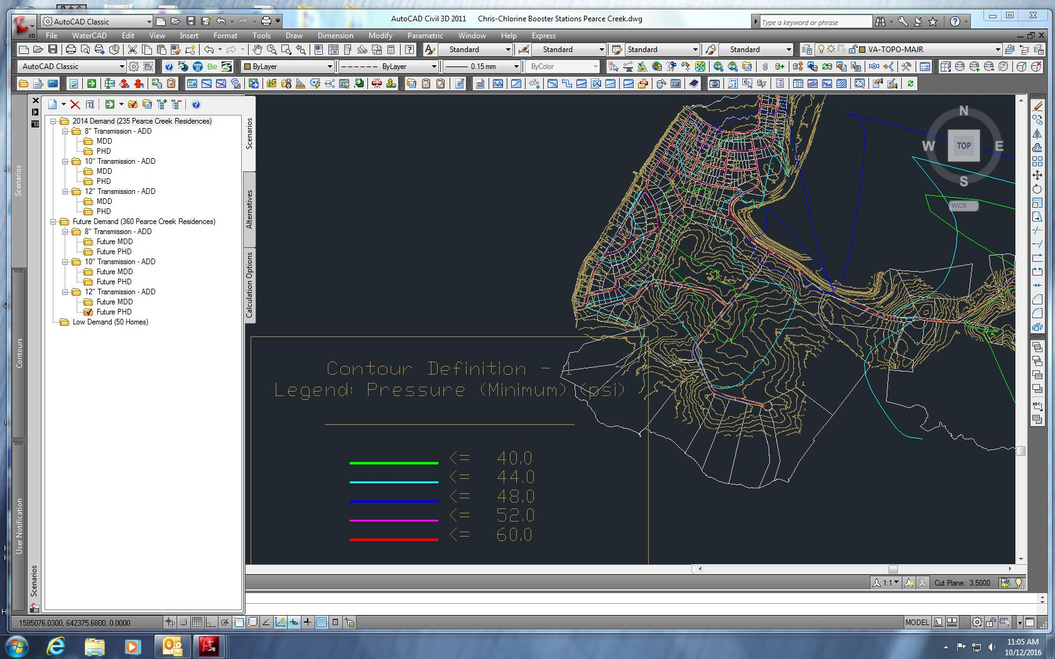
Town of Cecilton Water System Pressure Contours at Buildout

Slide 47
Town of Cecilton Water System
Groundwater Appropriate Permit Increase
Approval from County to Serve Outside Municipal Limits
Water and Sewer Plan Amendment
Wetland Permit
Stormwater Management
Utility Easements
SHA and County Road Utility Permits
Notes:
Groundwater Appropriation Permit for 98,000 gallons per day (gpd)
2014 Usage ~ 55,000 gpd
Groundwater Appropriation Permit for 98,000 gallons per day (gpd)
2014 Water Usage ~ 55,000
Needed to Increase GAP to Serve Pearce Creek Service Area

Slide 48
Water System Construction

Slide 49
Construction Phases
Phase I: Transmission Main
  Exterior installation of the water meter, a portion of the service line, and on-lot shut-off valve
Phase II: Distribution System
  Interior plumbing as necessary to make the final connection to the indoor piping
Phase II: On-lot Work
  In-home connections and abandonment of the existing residential wells

Slide 50
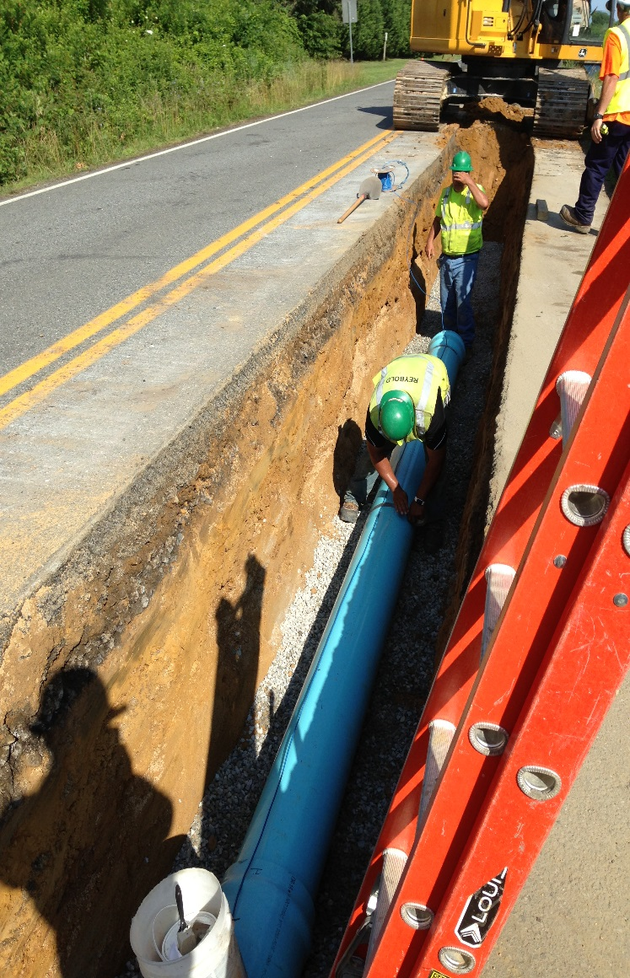
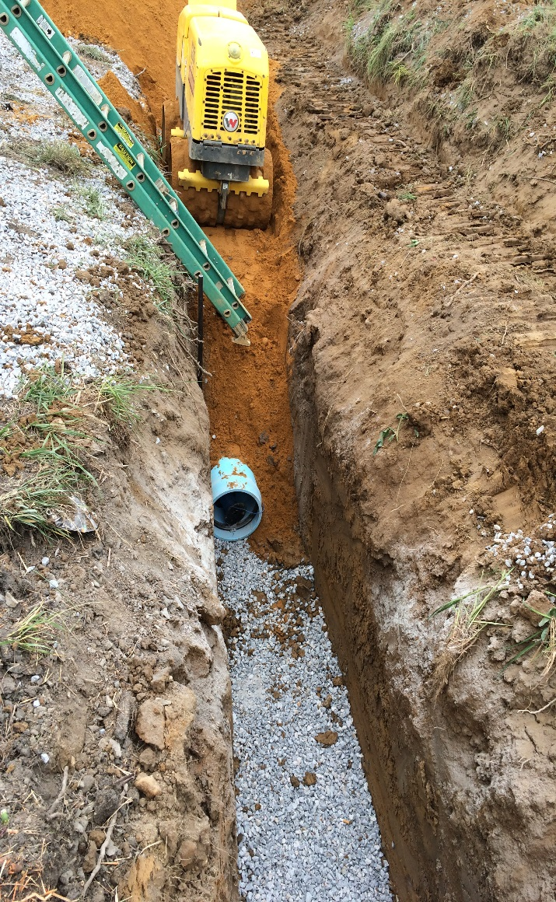
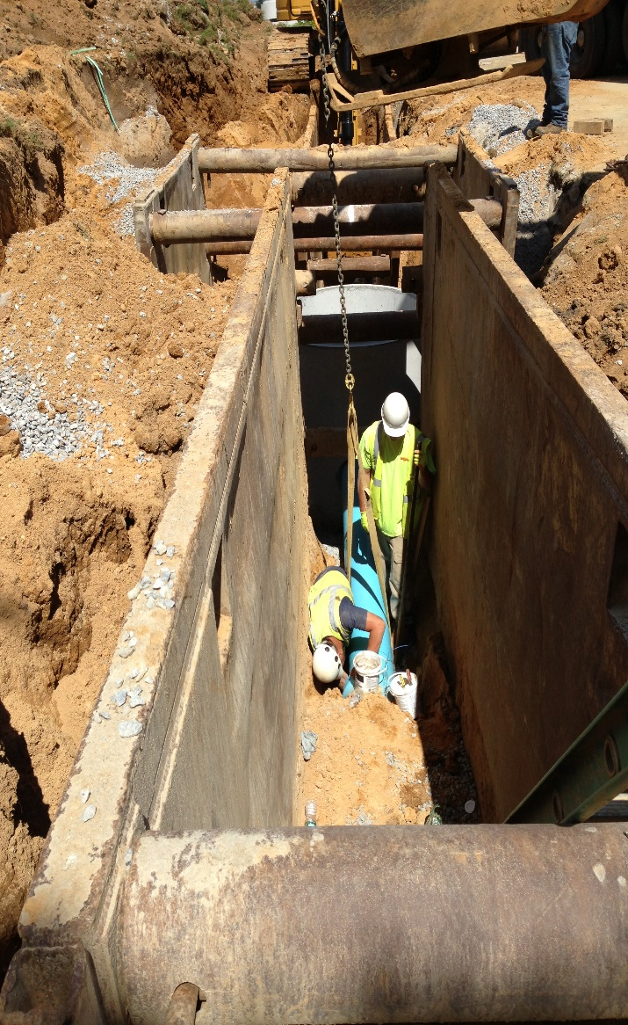
Phase I: Transmission Main

Slide 51
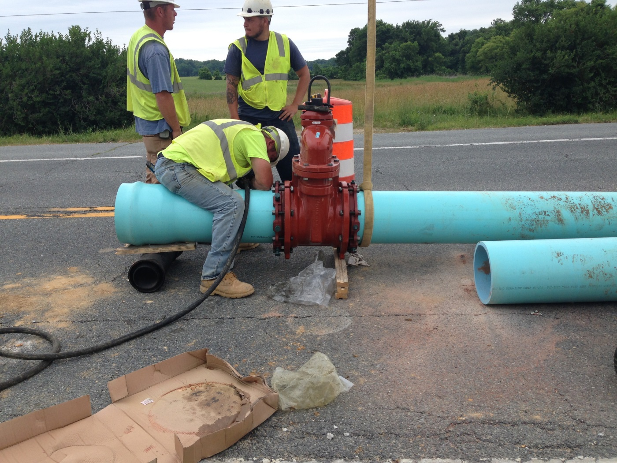
Phase I

Slide 52
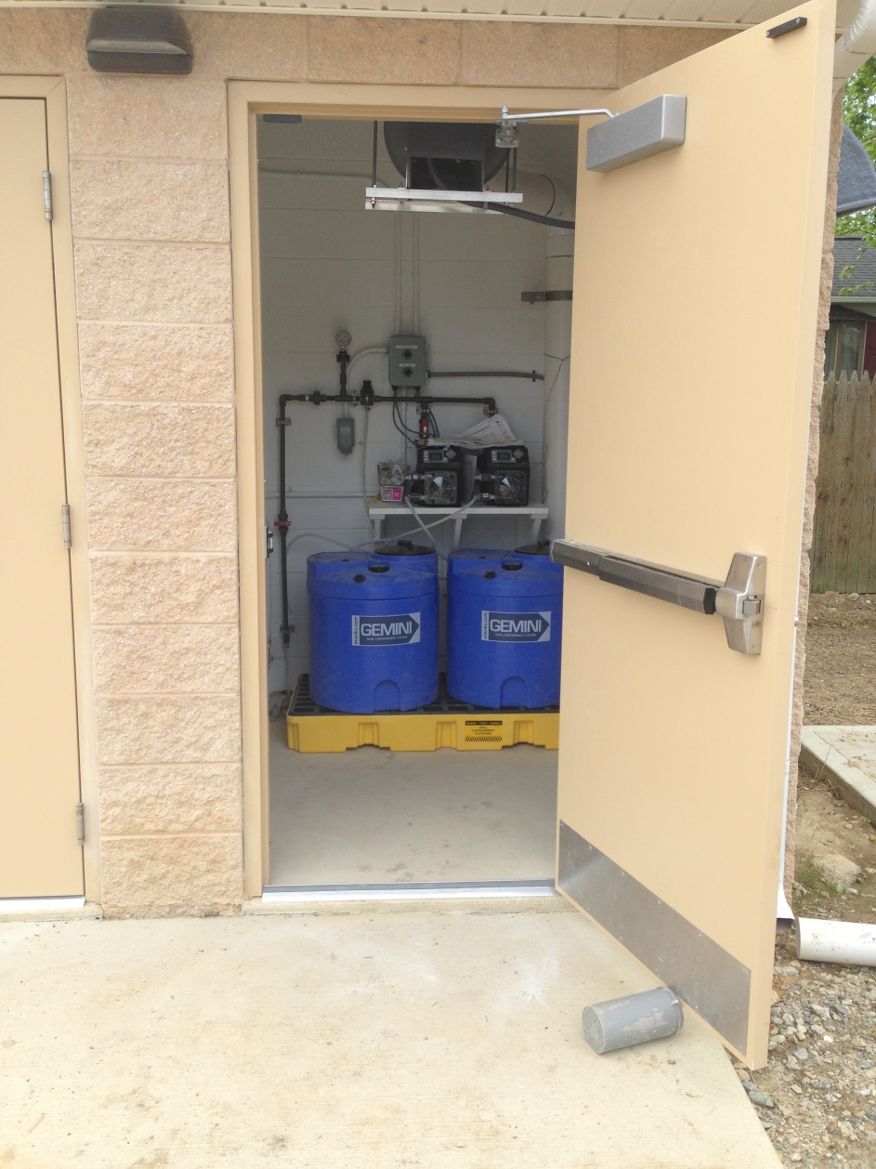
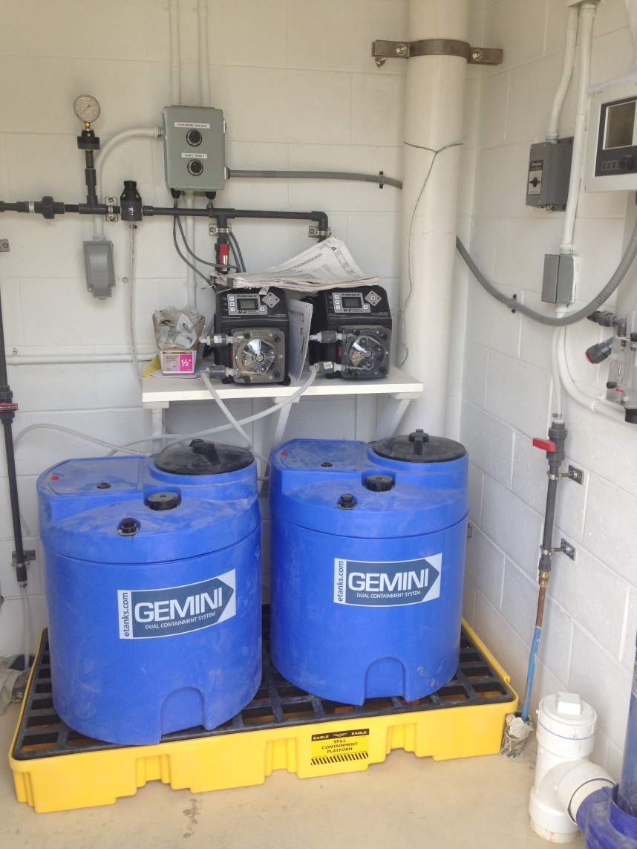
Phase I

Slide 53
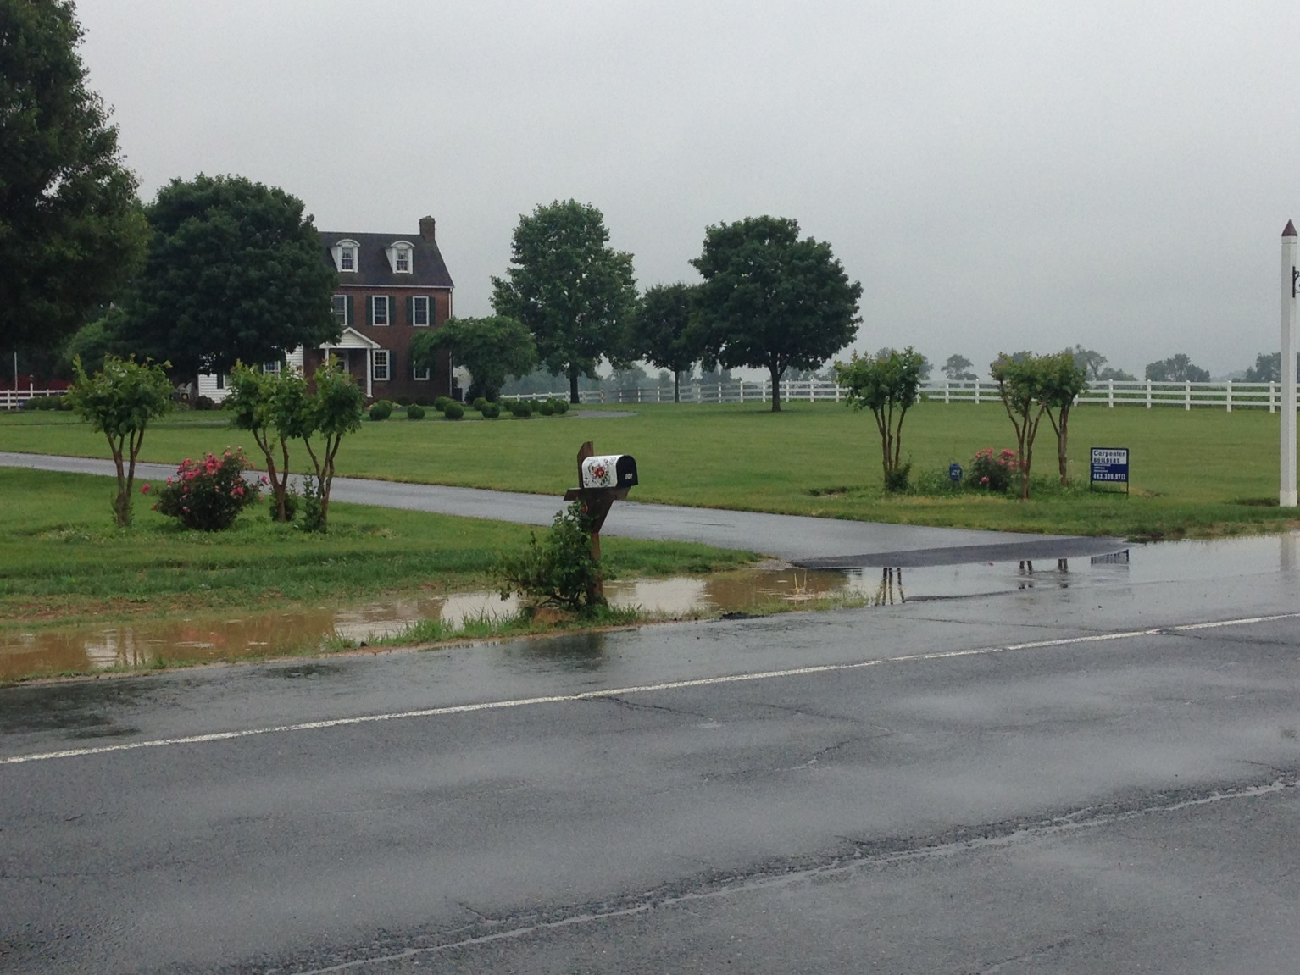
Town of Cecilton Water System

Slide 54
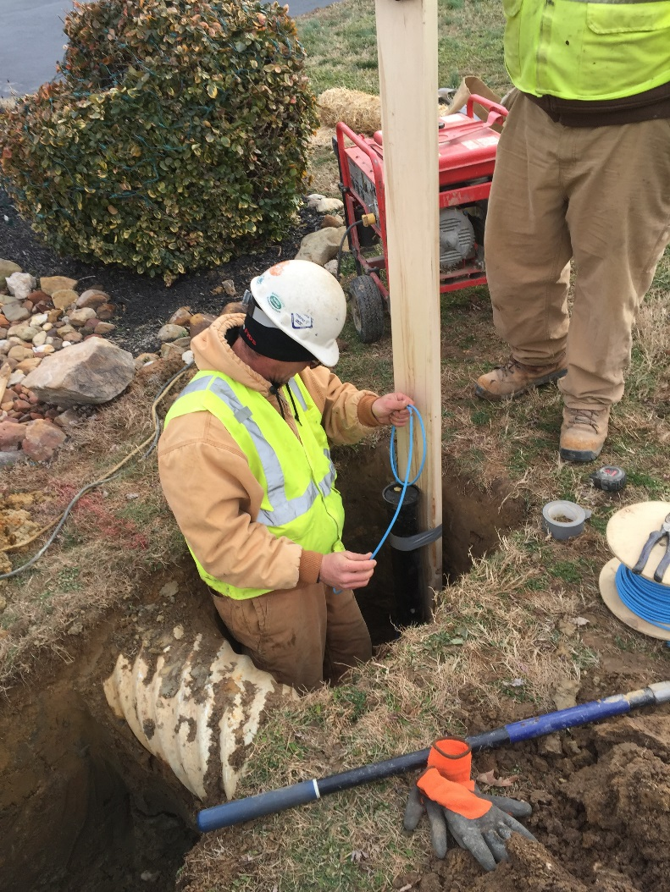
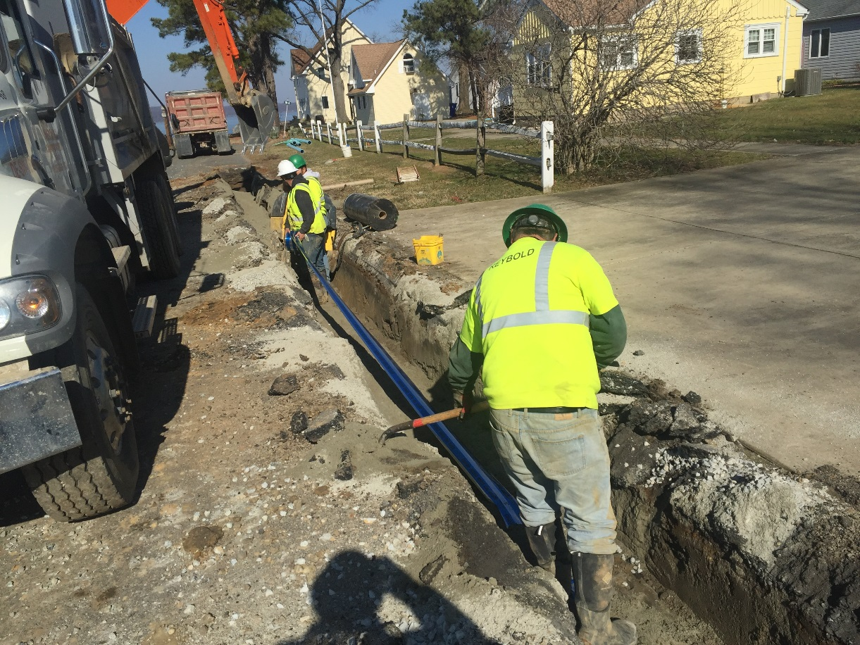
Phase II: Distribution System

Slide 55
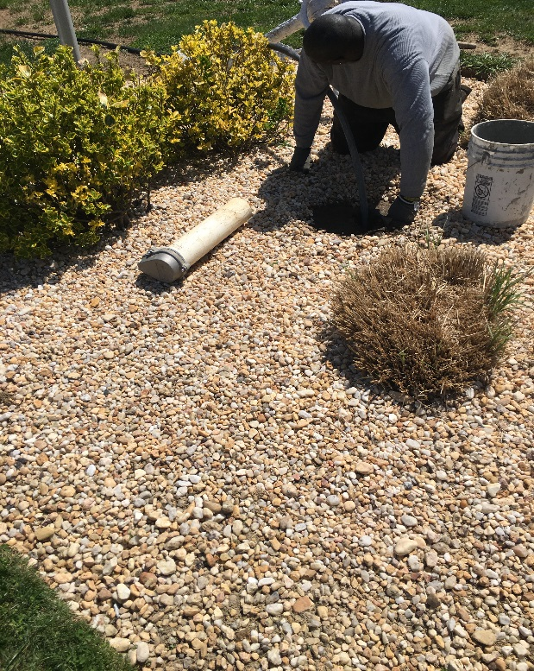
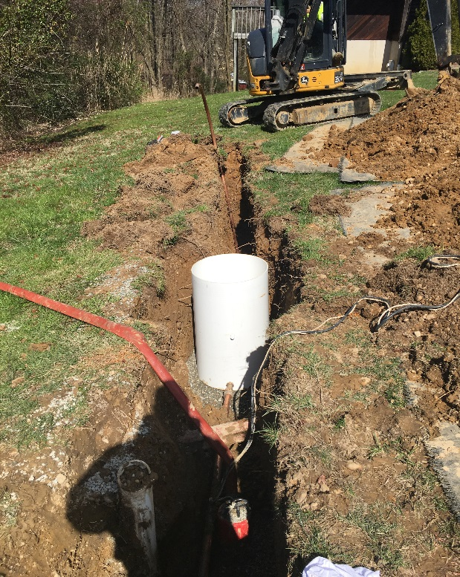
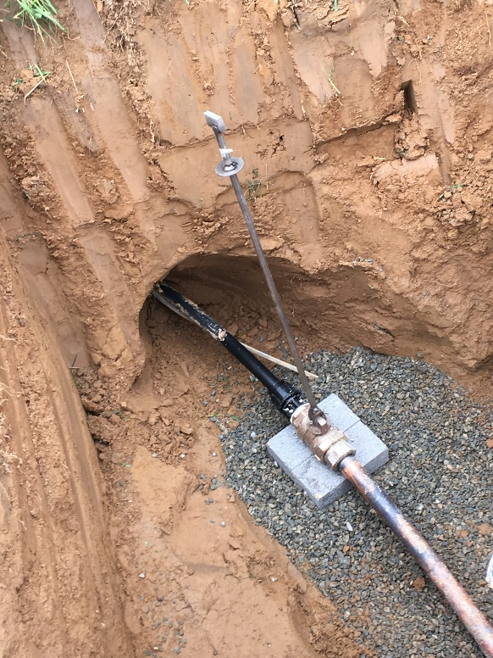
Phase III: On-lot Work

Slide 56
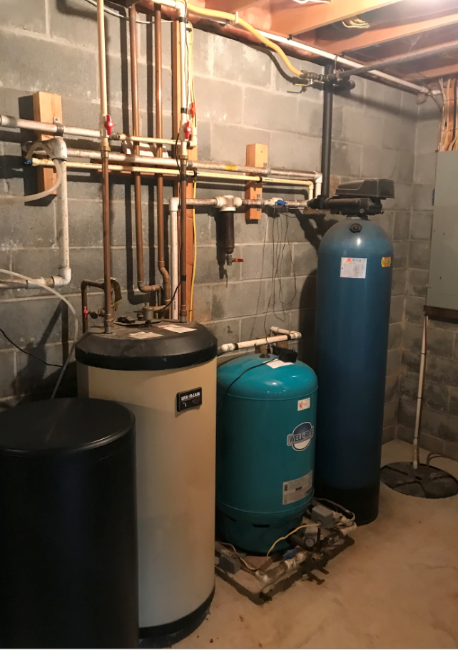
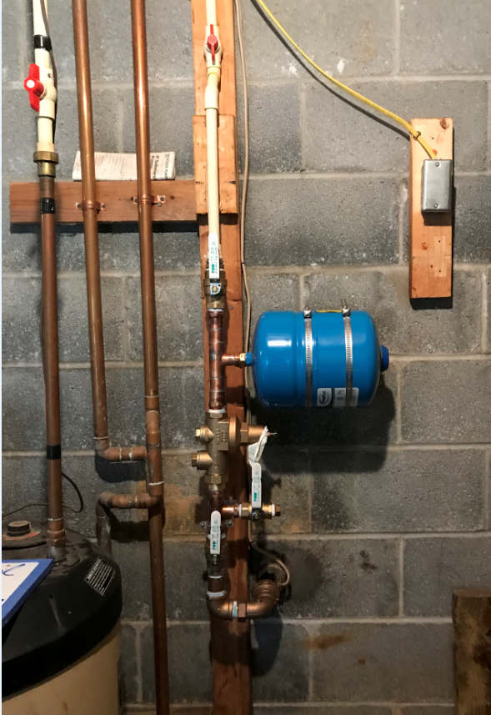
In-Home Connections
Pre-connection
Post-connection

Slide 57
Road Restoration

Slide 58
Environmental
Monitoring

Slide 59
Pearce Creek Monitoring
  Groundwater monitoring (required per WQC)
      Magothy and Patapsco aquifers are monitored within and adjacent to the DMCF site.
  Discharge monitoring (required per WQC)
      Water quality monitoring is conducted at the point where water is discharged into the Pearce Creek Lake.
      Discharge monitoring plan includes key parameters such as: flow volume/discharge rate, total suspended solids, pH, dissolved oxygen, nutrients, and metals.
  Exterior monitoring (voluntarily conducted by MPA)
      Exterior monitoring efforts ensure that the environmental conditions surrounding the DMCF remain unaffected by water being discharged from the facility.
      Monitoring parameters evaluate surface water and sediment quality, sediment toxicity, and benthic community structure.

Slide 60
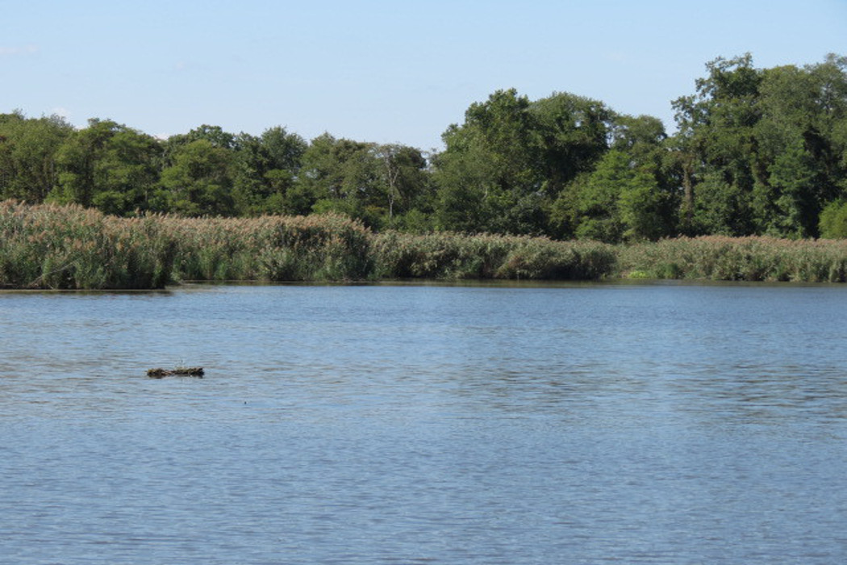
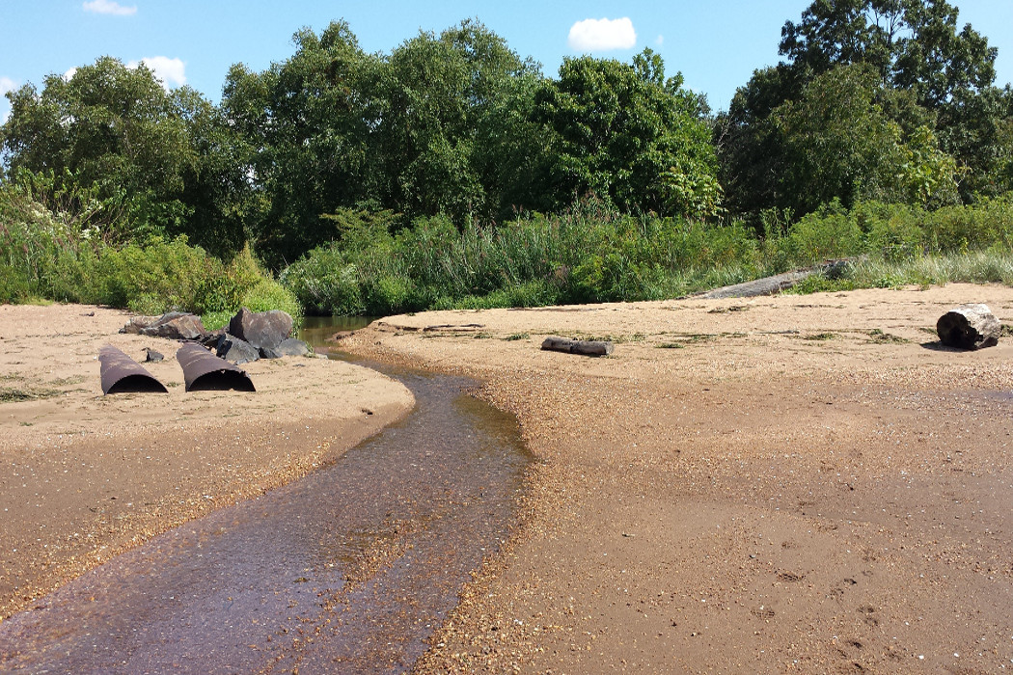
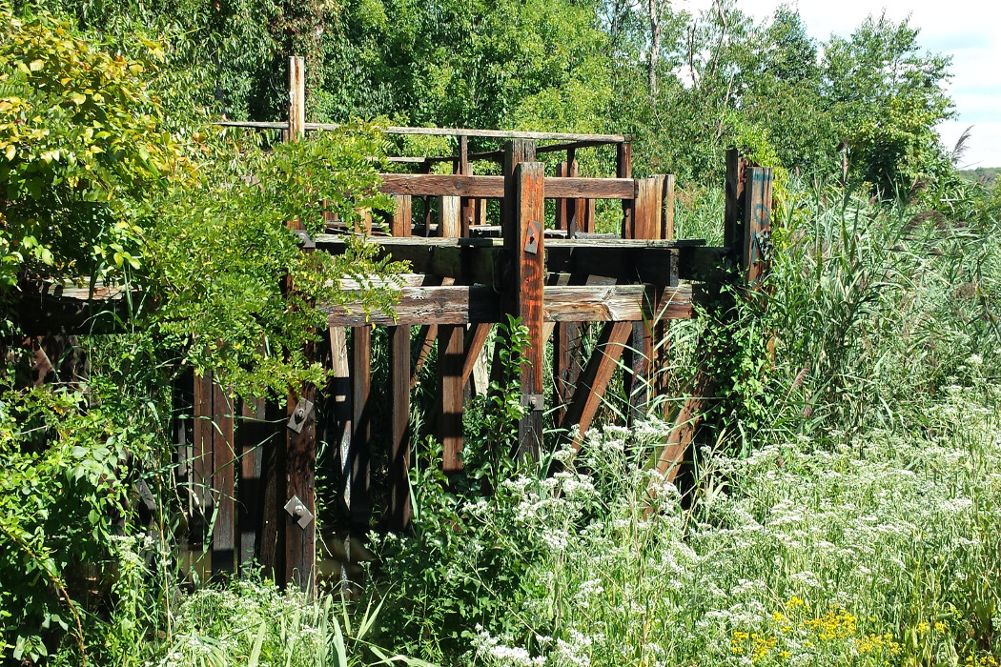
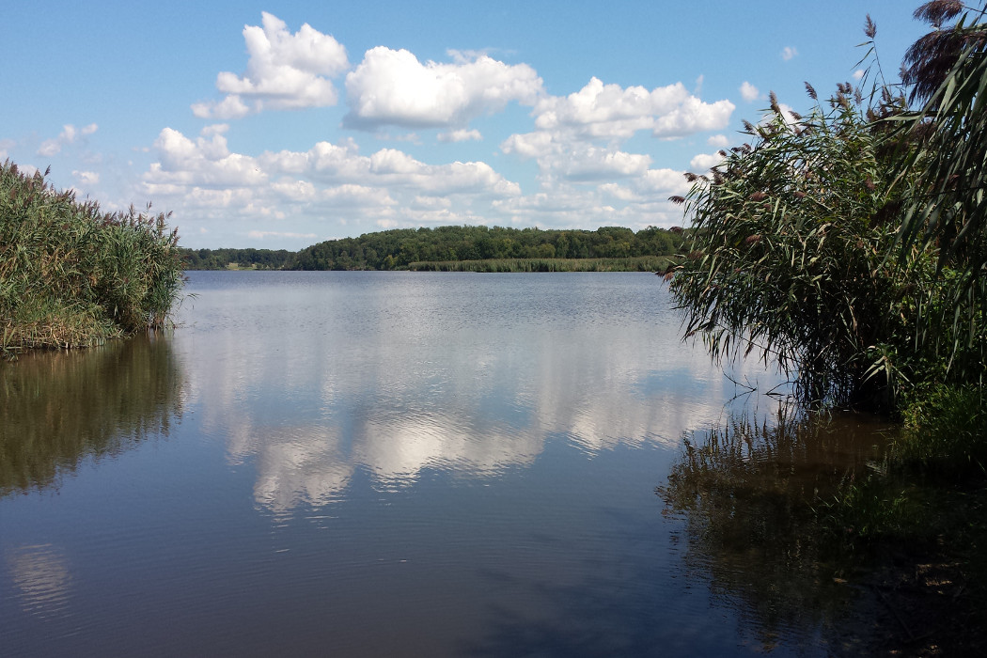
Pearce Creek Lake

Slide 61
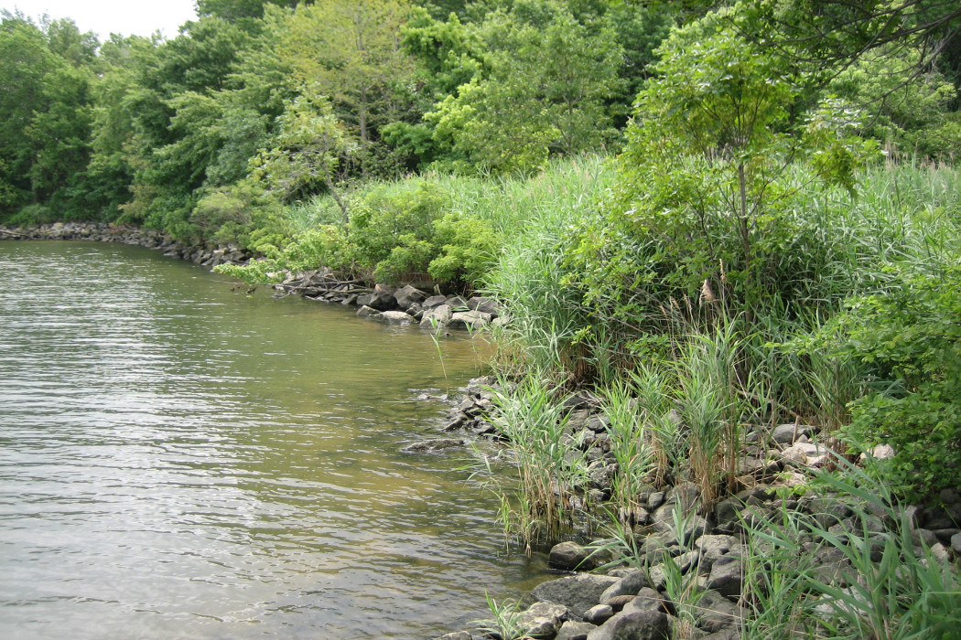
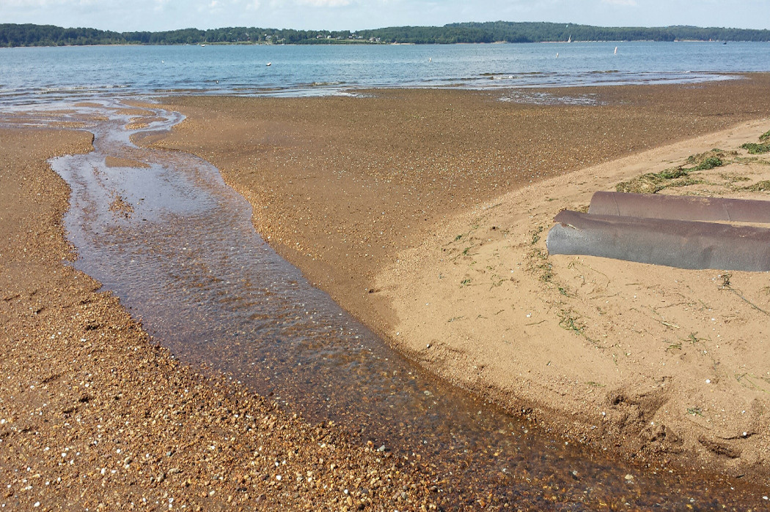
Elk River

Slide 62
Public Outreach and Stakeholder Engagement

Slide 63

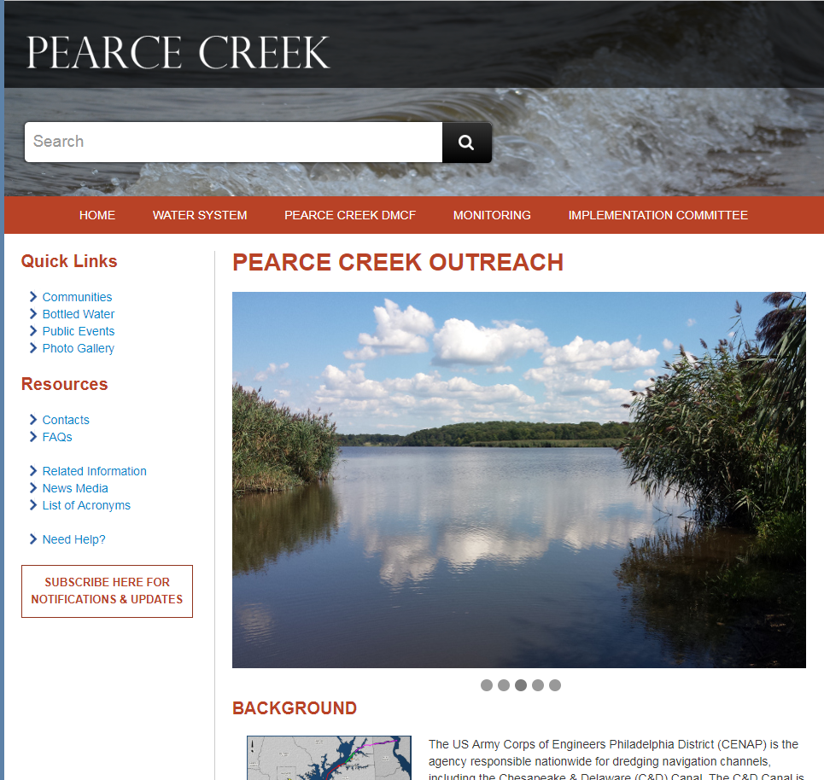
Public Outreach Initiatives
Pearce Creek Implementation Committee
Outreach Website: www.pearcecreekoutreach.com
Pearce Creek Newsletter
Open Houses and Public Meetings
Attendance and/or participation in community events and meetings
Mailings and Emails Notifications

Slide 64
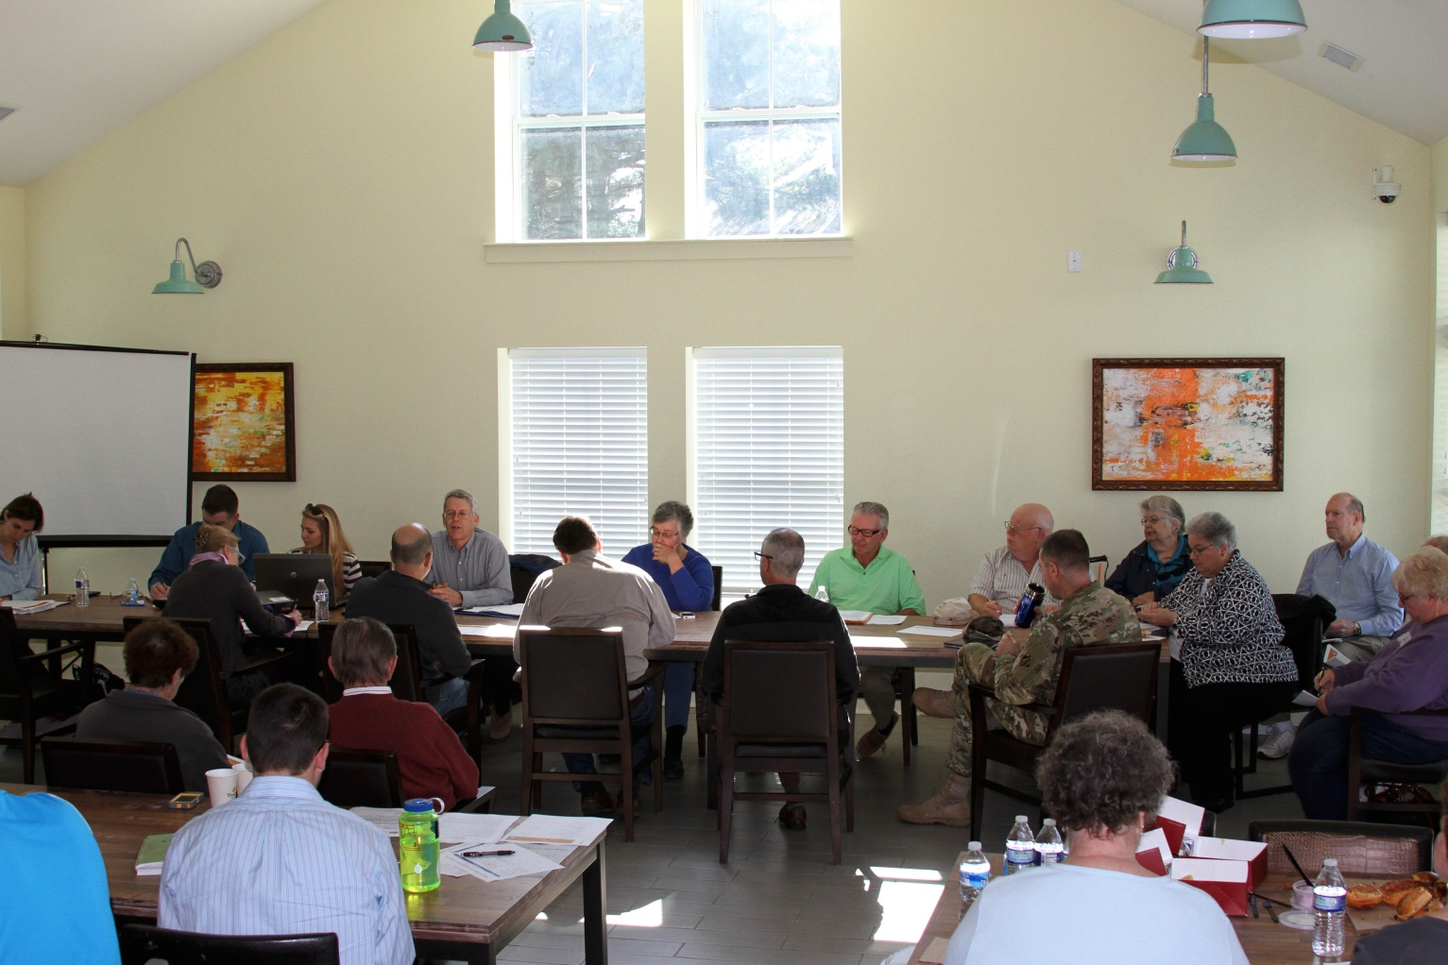
Public Outreach

Slide 65
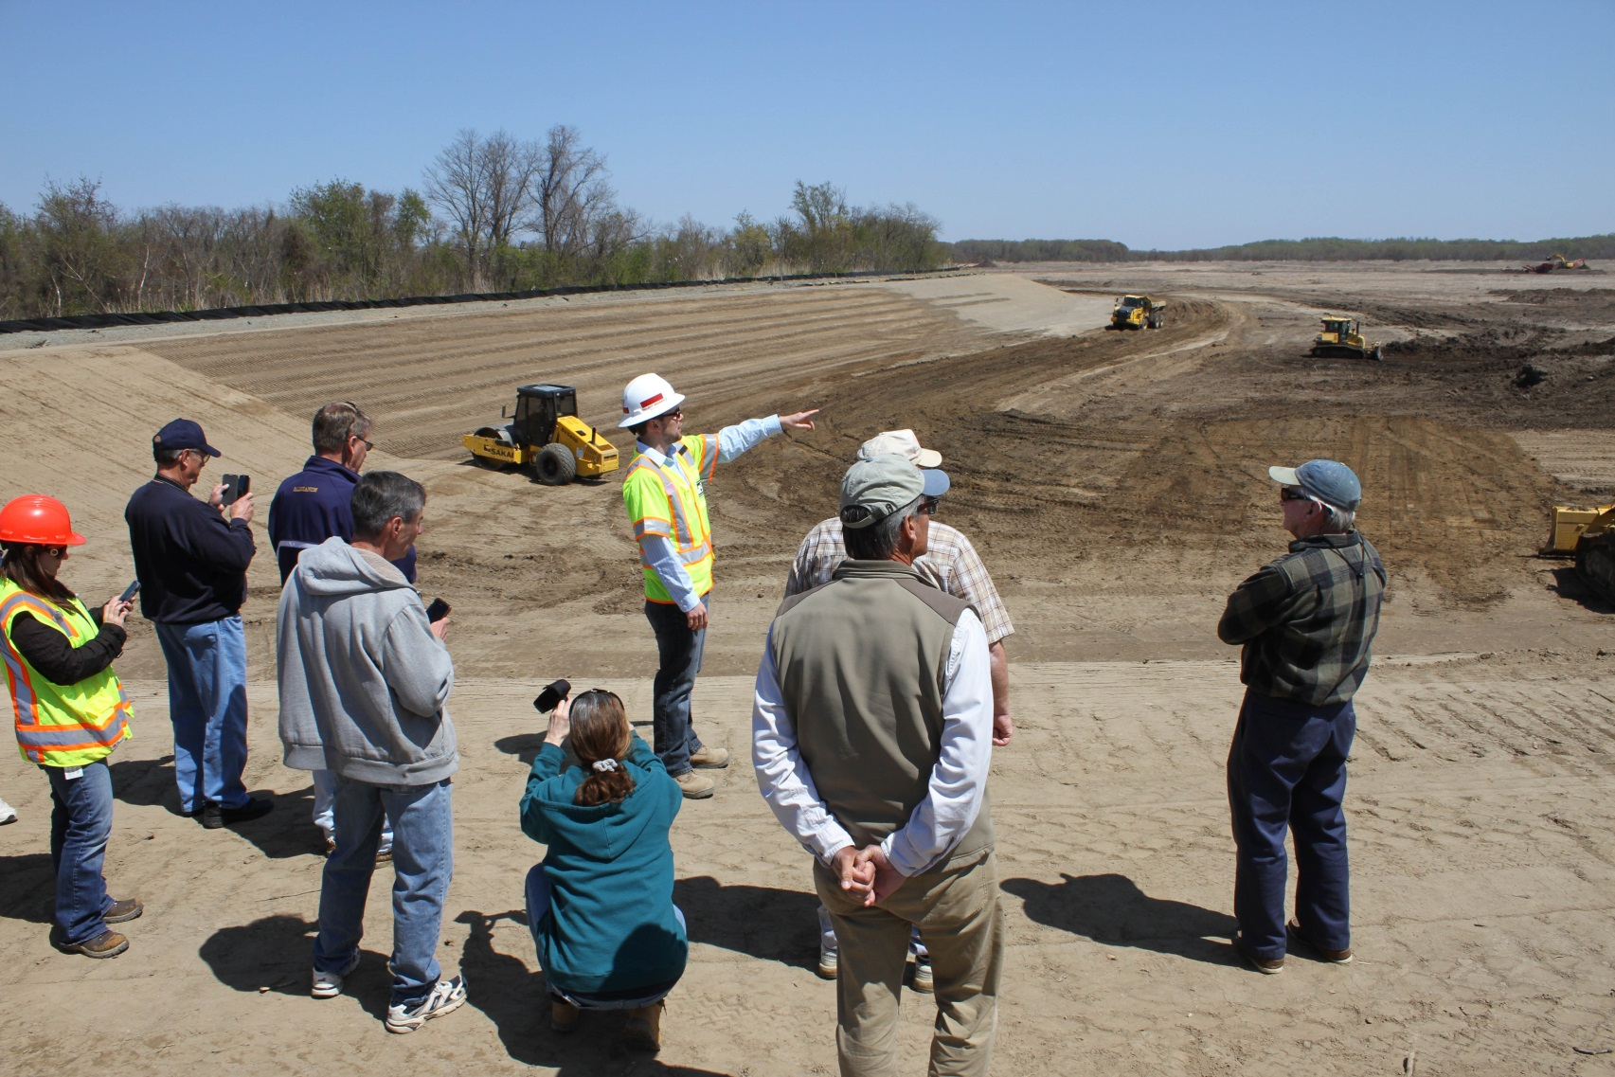
Public Site Visit

Slide 66

Elected Officials Site Visit

Slide 67



Open House Events

Slide 68

Conclusion
DCMF Reactivated
Dredging Completed
230 homes connected

Slide 69
Epilogue
Beneficial Re-use

Slide 70
Thank you
Questions

