Slide 1
Cecilton Pearce Creek Water Service Area
Status of Construction
and
What to Expect Next

Slide 2
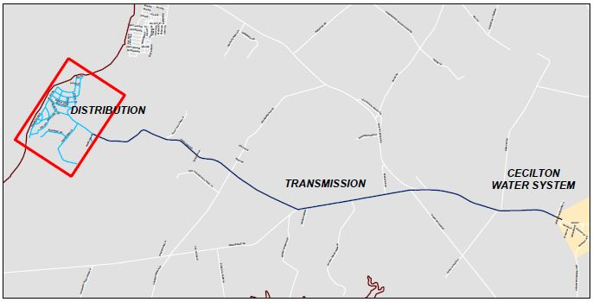
Pearce Creek Service Area: Project Scope
Generally Servicing: Sunset Pointe, West View Shores, & Bay View Estates

Slide 3
Current Project Status
Transmission Main Project (Eastern States Construction)
Start of Construction April 2016
Construction Duration – One Year
All pipe work is complete
All pipes have been pressure tested
Two injection stations are complete and in the process of being started up
What remains to be completed is the flushing of the new main, asphalt restoration, and general restoration

Slide 4
Project Status
Distribution System Project (Reybold Construction)
Start of Construction Mid May 2016
Construction Duration – One Year
All pipe work is complete
All pipes have been pressure tested
What remains to be completed is the flushing of the new main, asphalt restoration, and general restoration

Slide 5
Project Status
On-Lot System Project
Bid Opening March 16, 2017
Reybold Construction was the low bidder and was awarded the contract
Anticipated Notice to Proceed – May 2017
Construction Duration – 330 Days to Substantial Completion

Slide 6
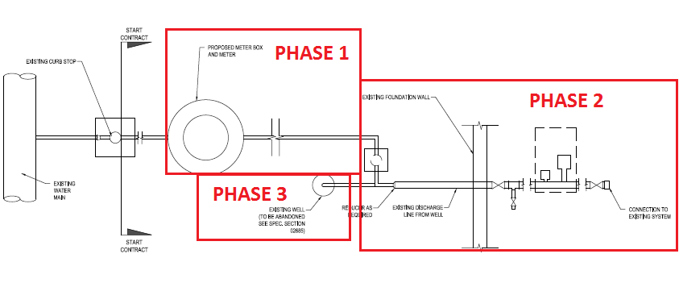
What to Expect During Construction
On-Lot System Project Phases
Phase 1: Work Outside of Home
Phase 2: Work Inside of Home
Phase 3: Well Abandonment

Slide 7
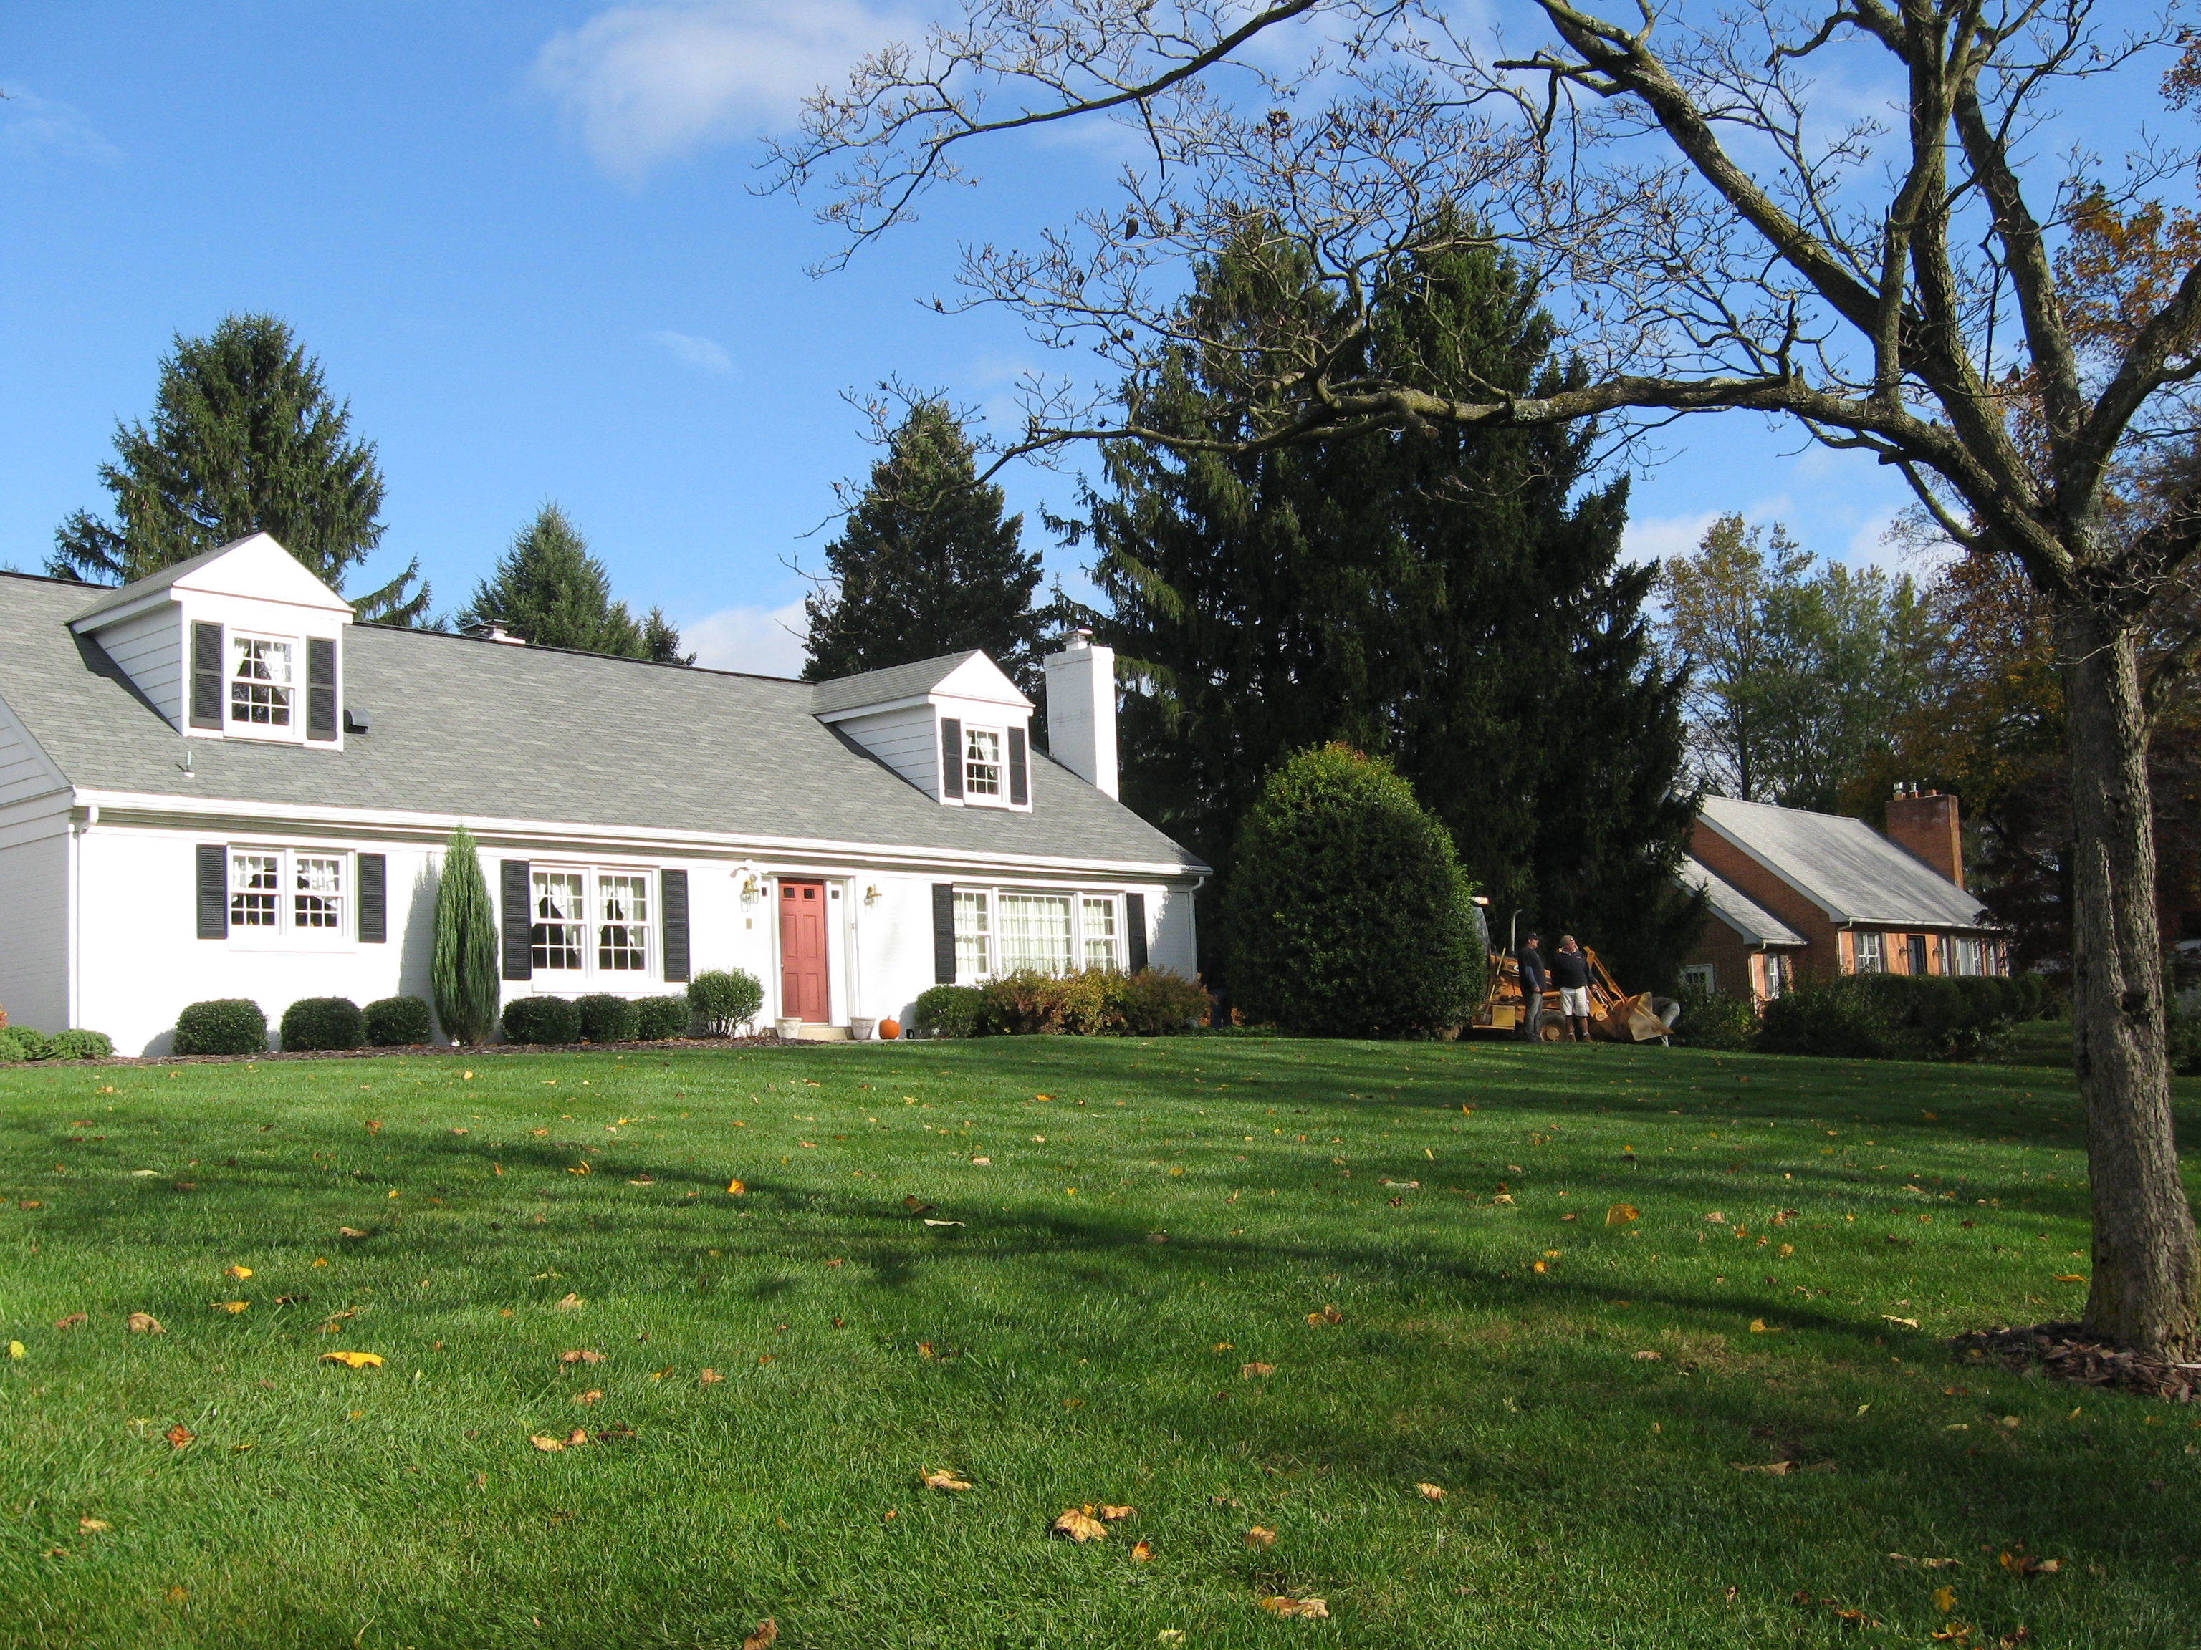
What to Expect During Construction
Phase 1: Work Outside of Home
Work cannot begin until we receive a signed access agreement (agreements are available today)
Reybold will notify you of work to take place on your property via door-hanger, email, and/or phone
You do not need to be home for this phase of work
Reybold will video tape existing conditions prior to the start of work

Slide 8
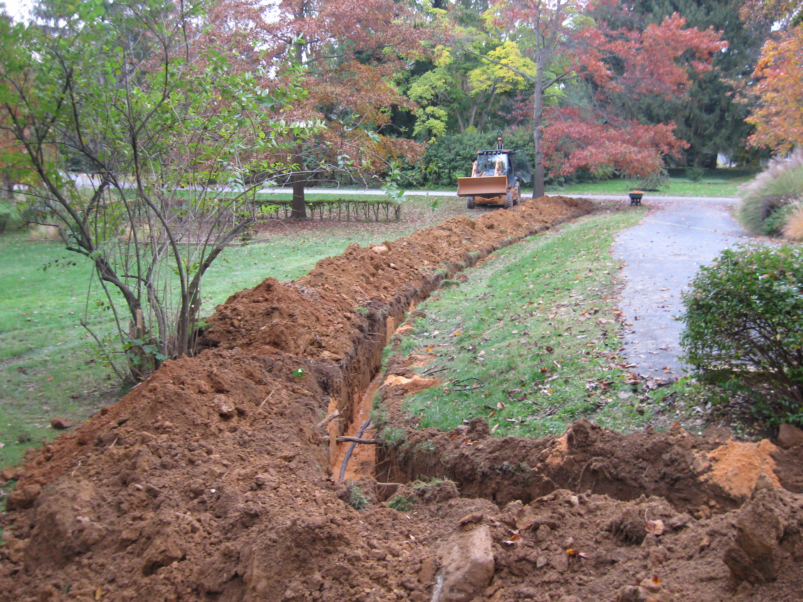
What to Expect During Construction
Phase 1: Work Outside of Home
Connect to existing curb stop, install meter crock, and run pipe to connection point generally adjacent to your existing well
Reybold may elect to complete this work on 10 to 30 homes at a time; No need to get into home at this time

Slide 9
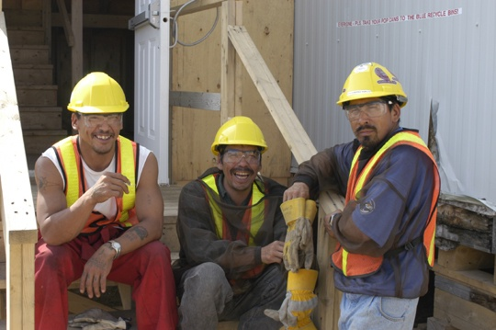
What to Expect During Construction
Phase 1: What Can You Do To Help?
Complete, review, and sign the Access Agreement and return it to AECOM (Copies are available today)
We cannot begin the work on your property without a signed agreement

Slide 10
What to Expect During Construction
Phase 2: Work Inside of Home
Reybold will contact you (first hang a notice at the house, following up with email and/or phone) and let you know your home is ready to be connected
Reybold will set a definitive date and time (preferably during regular work hours on weekdays)
Reybold will video tape existing conditions of the work area prior to the start of work
Reybold makes connection to your well discharge while simultaneously demolishing your existing treatment system and re-plumbing the interior of your home
At this point, you will be on the public water system

Slide 11
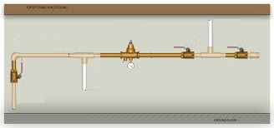
What to Expect During Construction
Phase 2: Work Inside of Home
Flushing will take place inside the home
Electrical demolition on anything specific to the well will be completed
We hope this is the only time we are in the house

Slide 12
What to Expect During Construction
Phase 2: What Can You Do To Help?
Respond to Reybold’s request to schedule the work
Anticipate 8 hours for the work to be completed, please plan to be home during the work
Please provide access to work area
Work Area

Slide 13
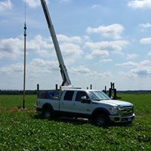
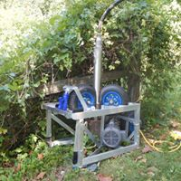
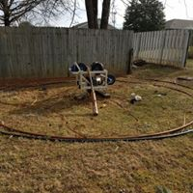
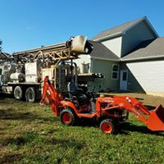
What to Expect During Construction
Phase 3: Well Abandonment
Reybold will wait for several properties to be connected prior to abandonment of existing wells
Reybold will notify you of work to take place on your property via door-hanger, email, and/or phone
You do not need to be home for this phase of work
Finally, Reybold will restore your property to original or better conditions

Slide 14
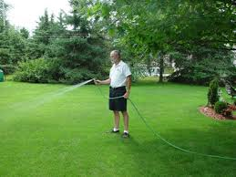
What to Expect During Construction
Phase 3: What Can You Do To Help?
Please help us to re-establish your grass

Slide 15
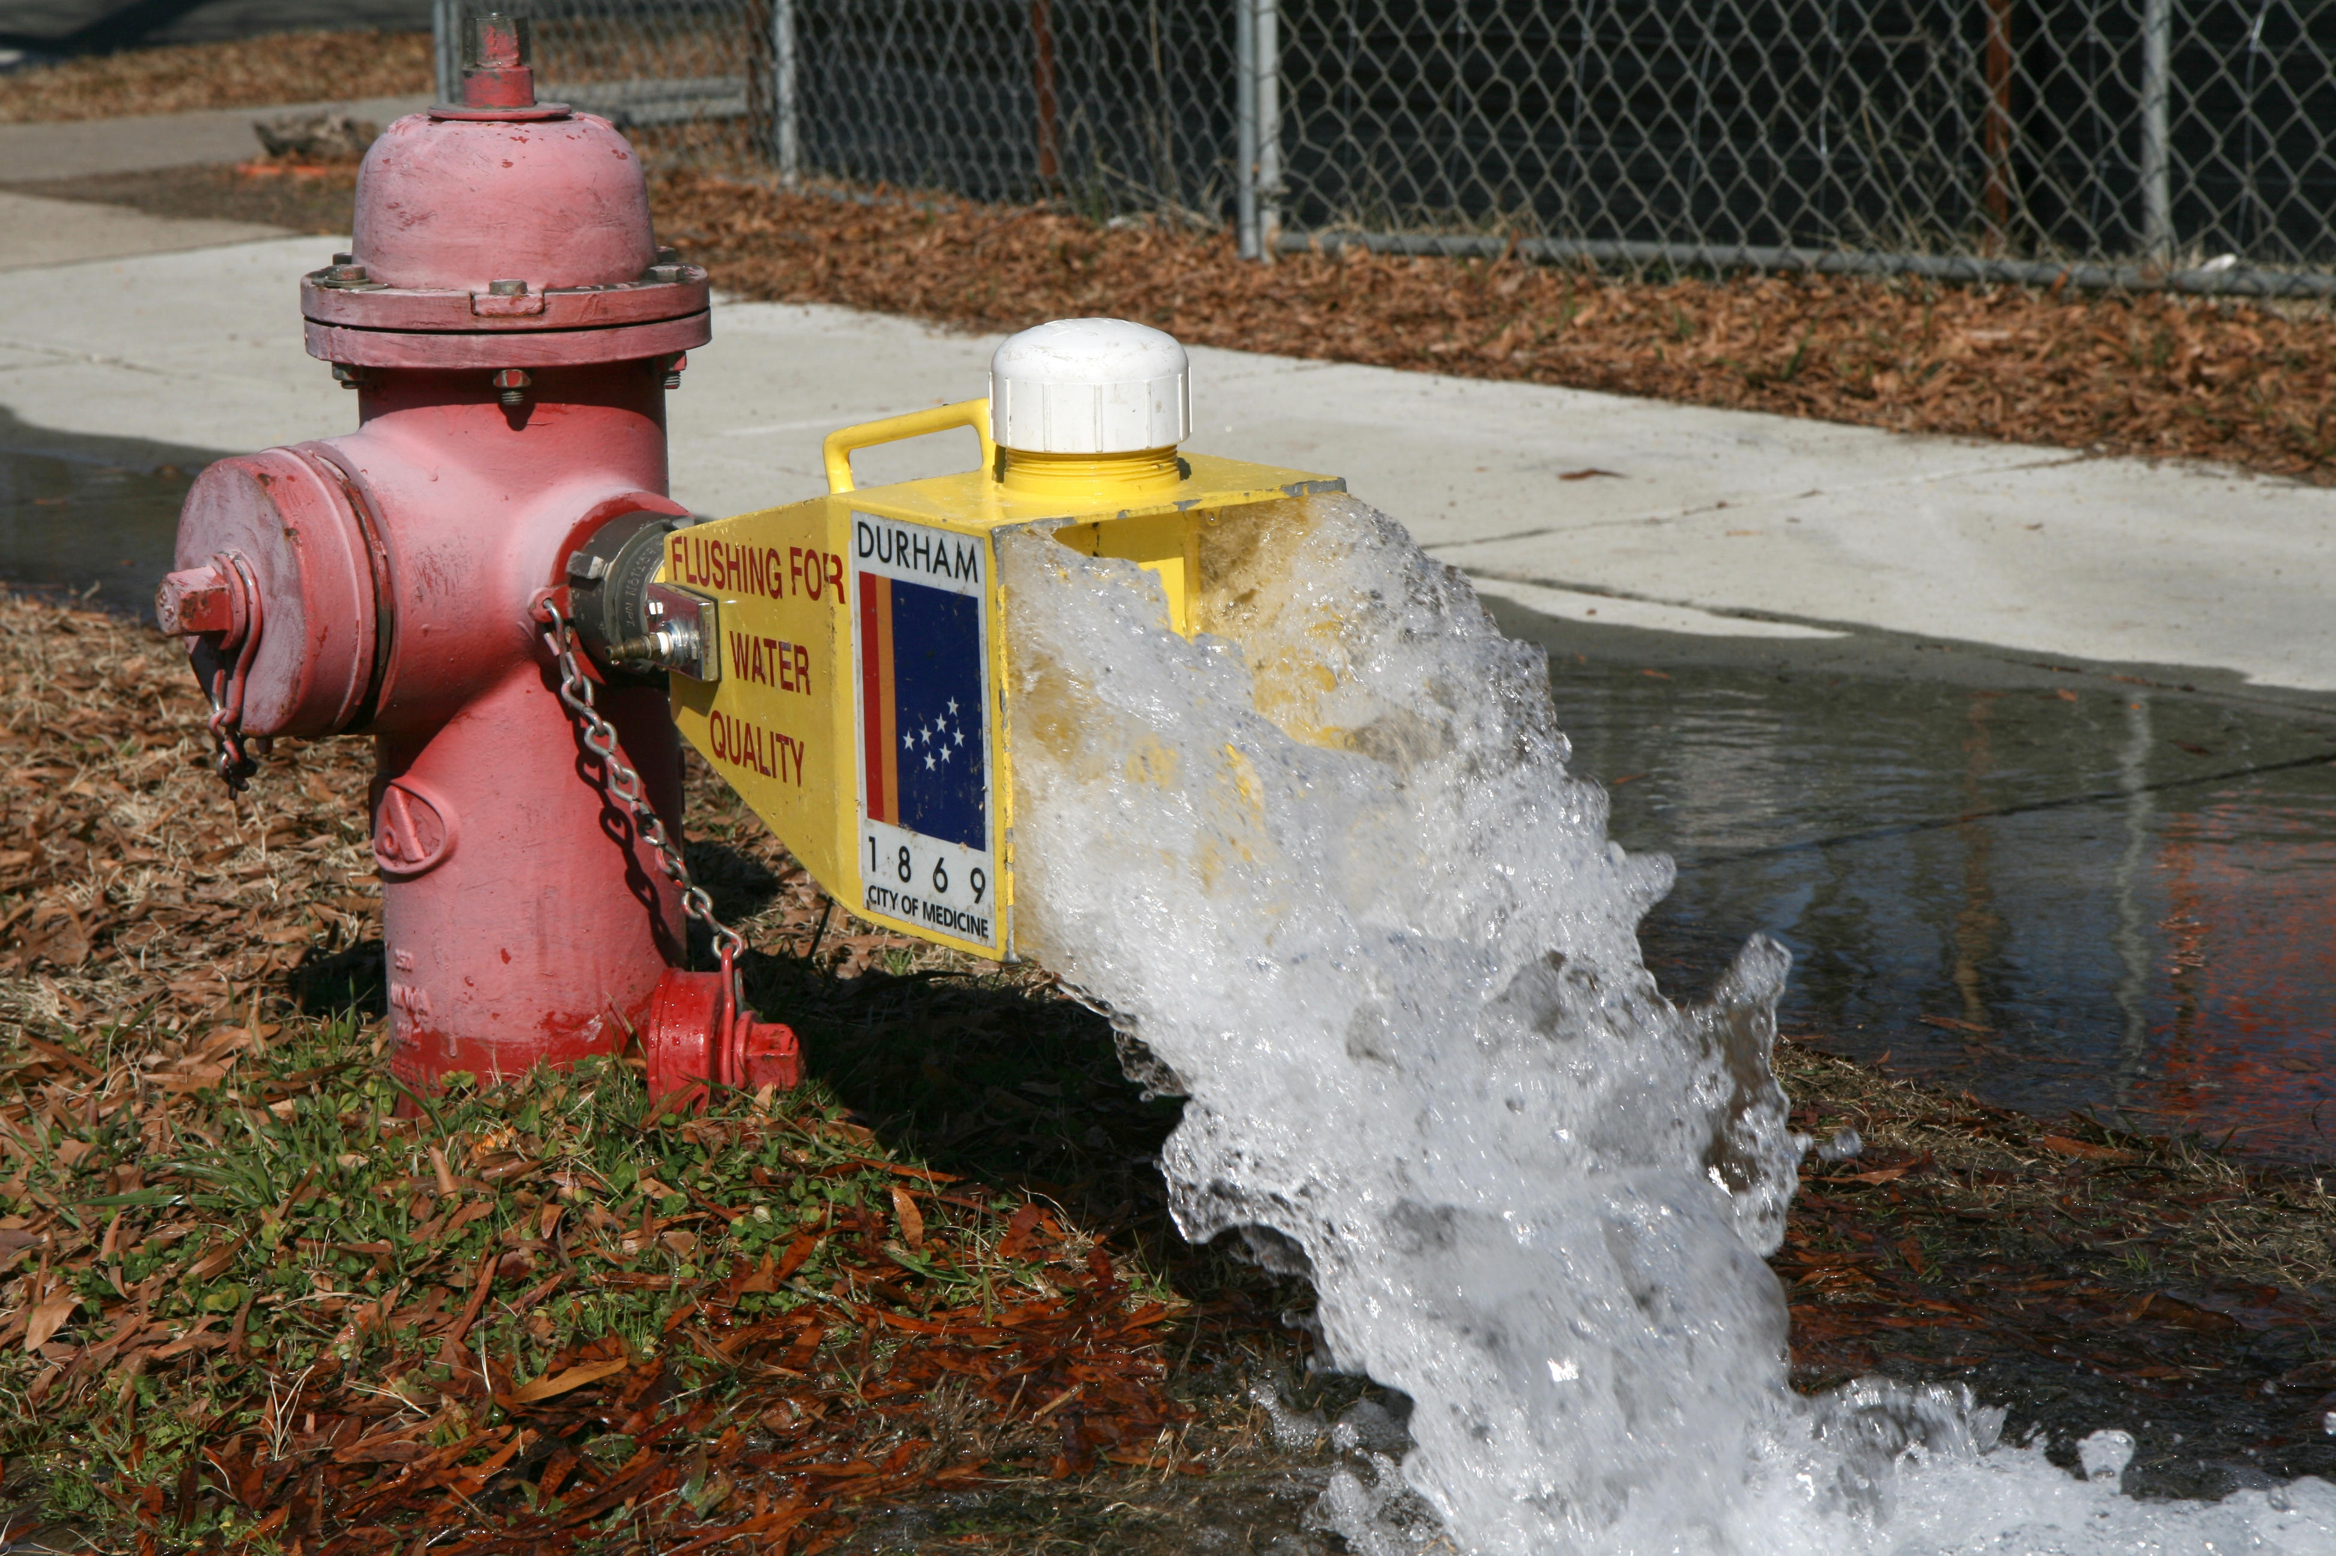
What to Expect During Construction
Miscellaneous
With few users initially, the system will still need regular flushing to keep the water in the pipes fresh for consumption

Slide 16
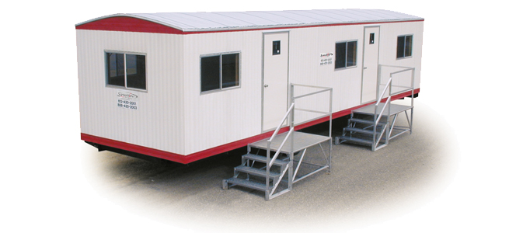
What to Expect During Construction
Miscellaneous
AECOM will have personnel on site full time during the work & available to assist with scheduling and answer questions

Slide 17
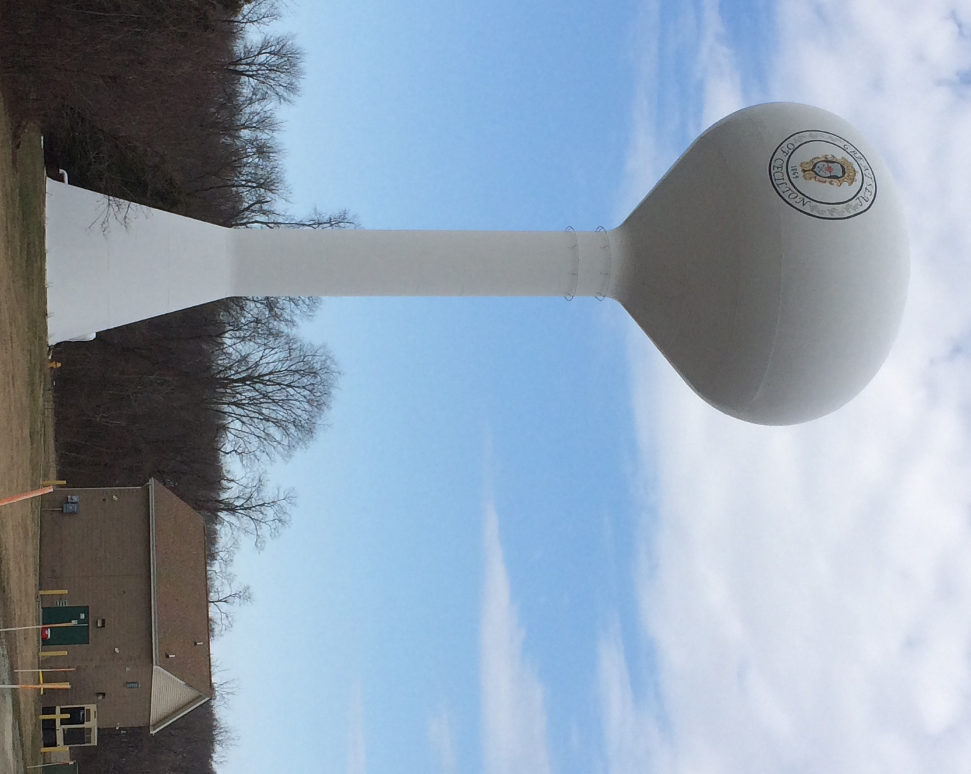
What to Expect During Construction
QUESTIONS?

Slide 18
What to Expect During Construction
THANK YOU
Christopher Rogers
Christopher.Rogers@aecom.com
302-781-5945
Gerald Katzmire
Gearld.Katzmire@aecom.com
302-781-5917

