Slide 1
What to Expect During Construction

Slide 2
Project Status
Transmission Main Project
Bid Opened on January 22, 2016
Apparent Low Bidder was Eastern States Construction
Anticipated Start of Construction March/April 2016
Anticipated Construction Duration – One Year
Subsequent to the Award, a Detailed Construction Schedule to be Provided by the Selected Contractor

Slide 3
Project Status
Distribution System Project
Bids to be Opened on February 19, 2016
Anticipated Start of Construction April 2016
Anticipated Construction Duration – One Year
Subsequent to the Award, a Detailed Construction Schedule to be Provided by the Selected Contractor

Slide 4
Project Status
On-Lot System Project
Contract Documents are being Finalized
Project Bidding and Start of Construction to Coincide as Close as Possible with Substantial Completion of the Distribution Project
Anticipated Construction Duration – Nine Months
Preliminary Projections for Project Completion – End of December 2017
Subsequent to the Award, a Detailed Construction Schedule to be Provided by the Selected Contractor

Slide 5
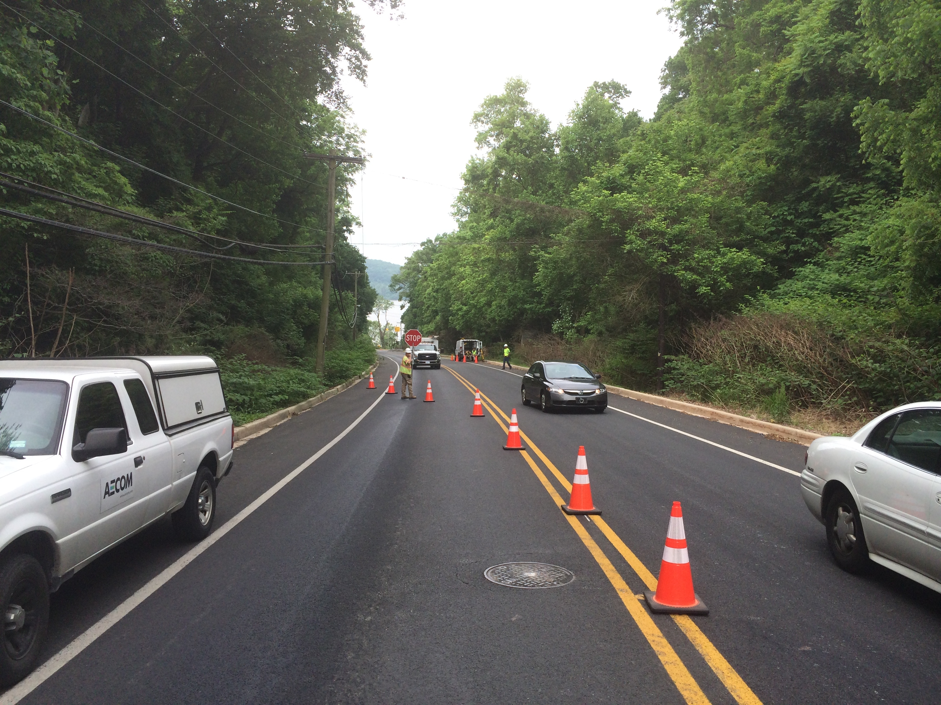
Distribution System – Concurrent with Transmission
Traffic Delays

Slide 6
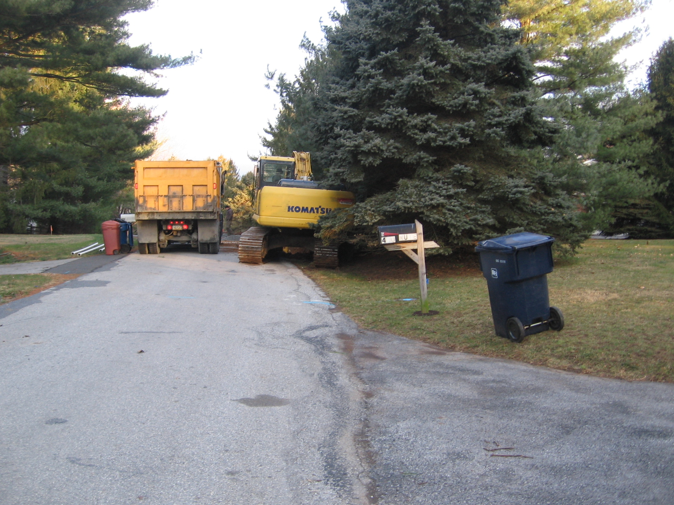
Distribution System – Concurrent with Transmission
Temporary Lane Closures

Slide 7
Distribution System – Pearce Creek Service Area
Documentation of Existing Conditions
Preconstruction Video
Used to Determine if Contractor is Responsible for Damage to Public or Private Property
If Damage Occurs, Contractor Must Restore to Original or Better Conditions

Slide 8
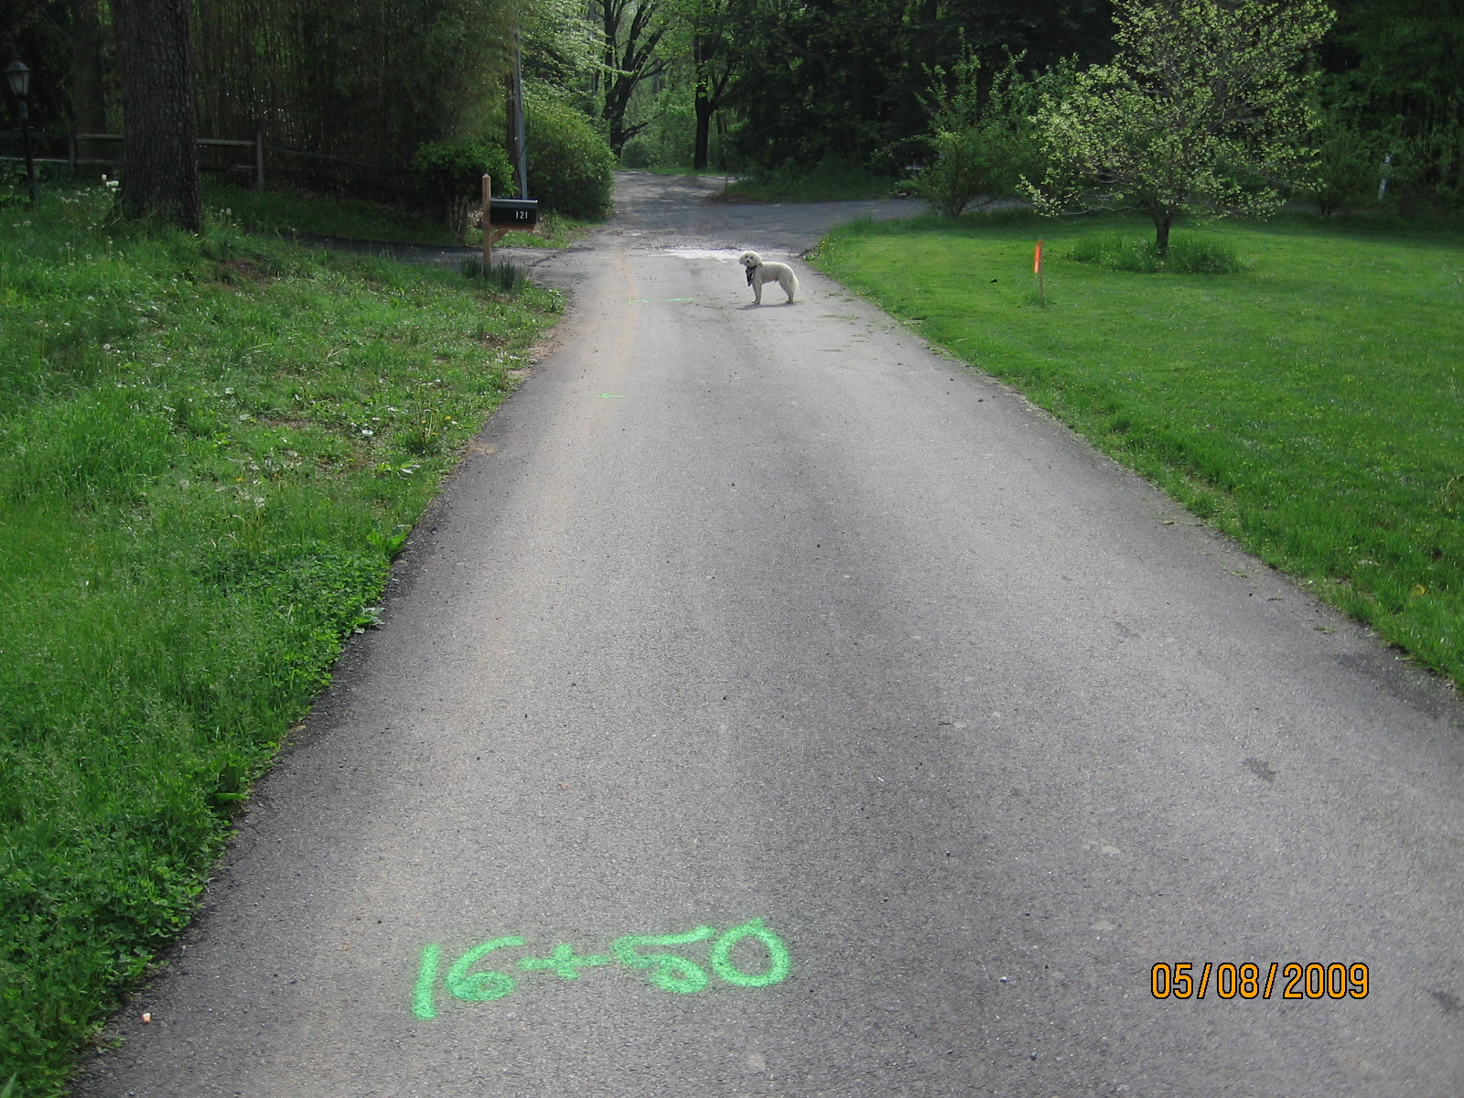
Distribution System – Pearce Creek Service Area
Construction Layout

Slide 9
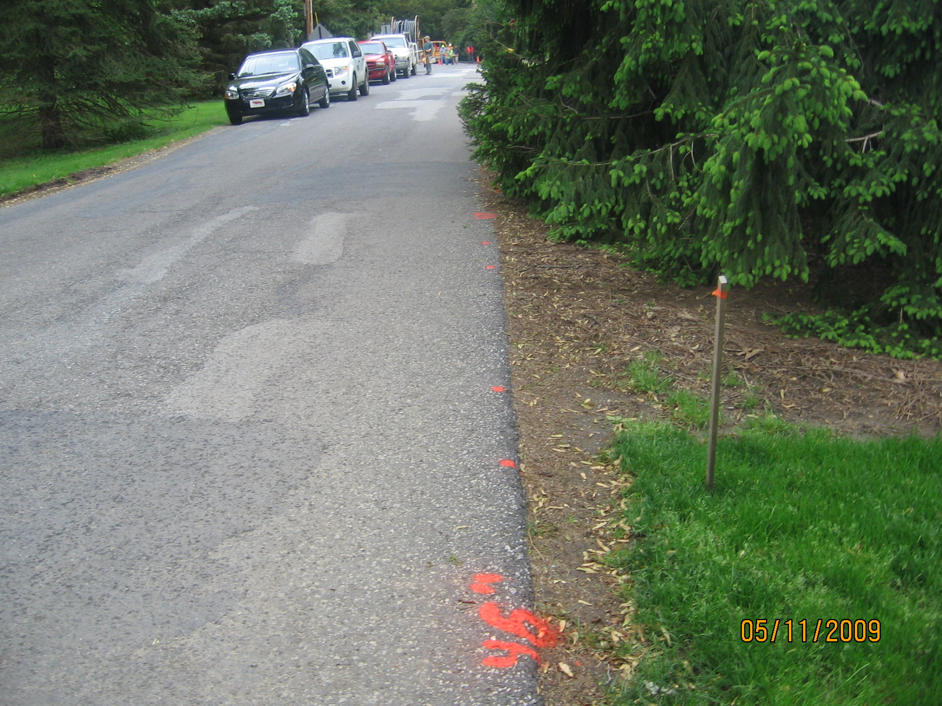
Distribution System – Pearce Creek Service Area
Layout, Stake at House Connection

Slide 10
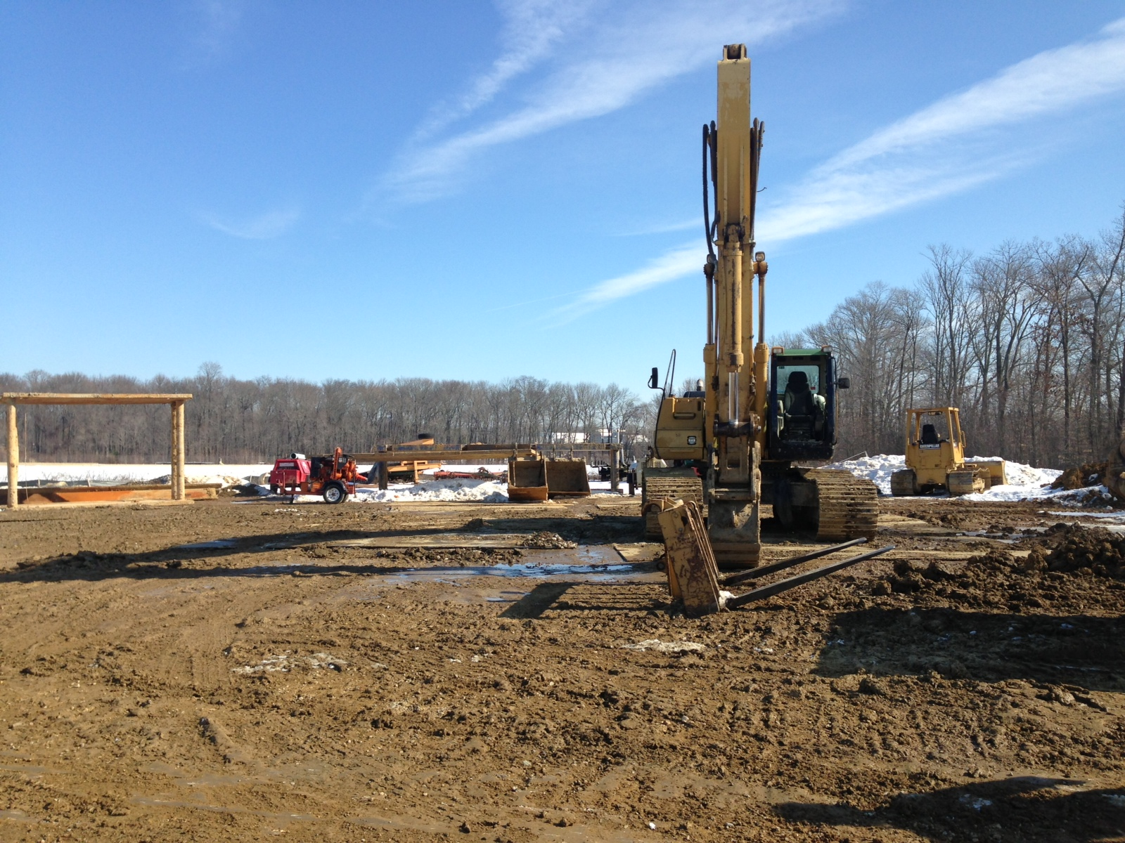
Distribution System – Pearce Creek Service Area
Laydown and Storage Area

Slide 11
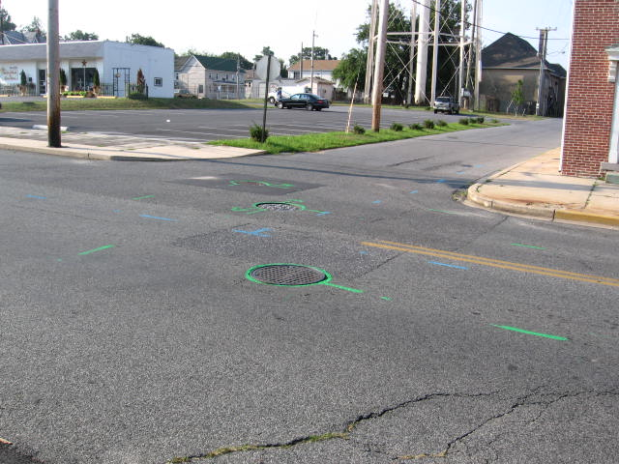
Distribution System – Pearce Creek Service Area
Utility Mark-Out “Paint on the Ground”

Slide 12
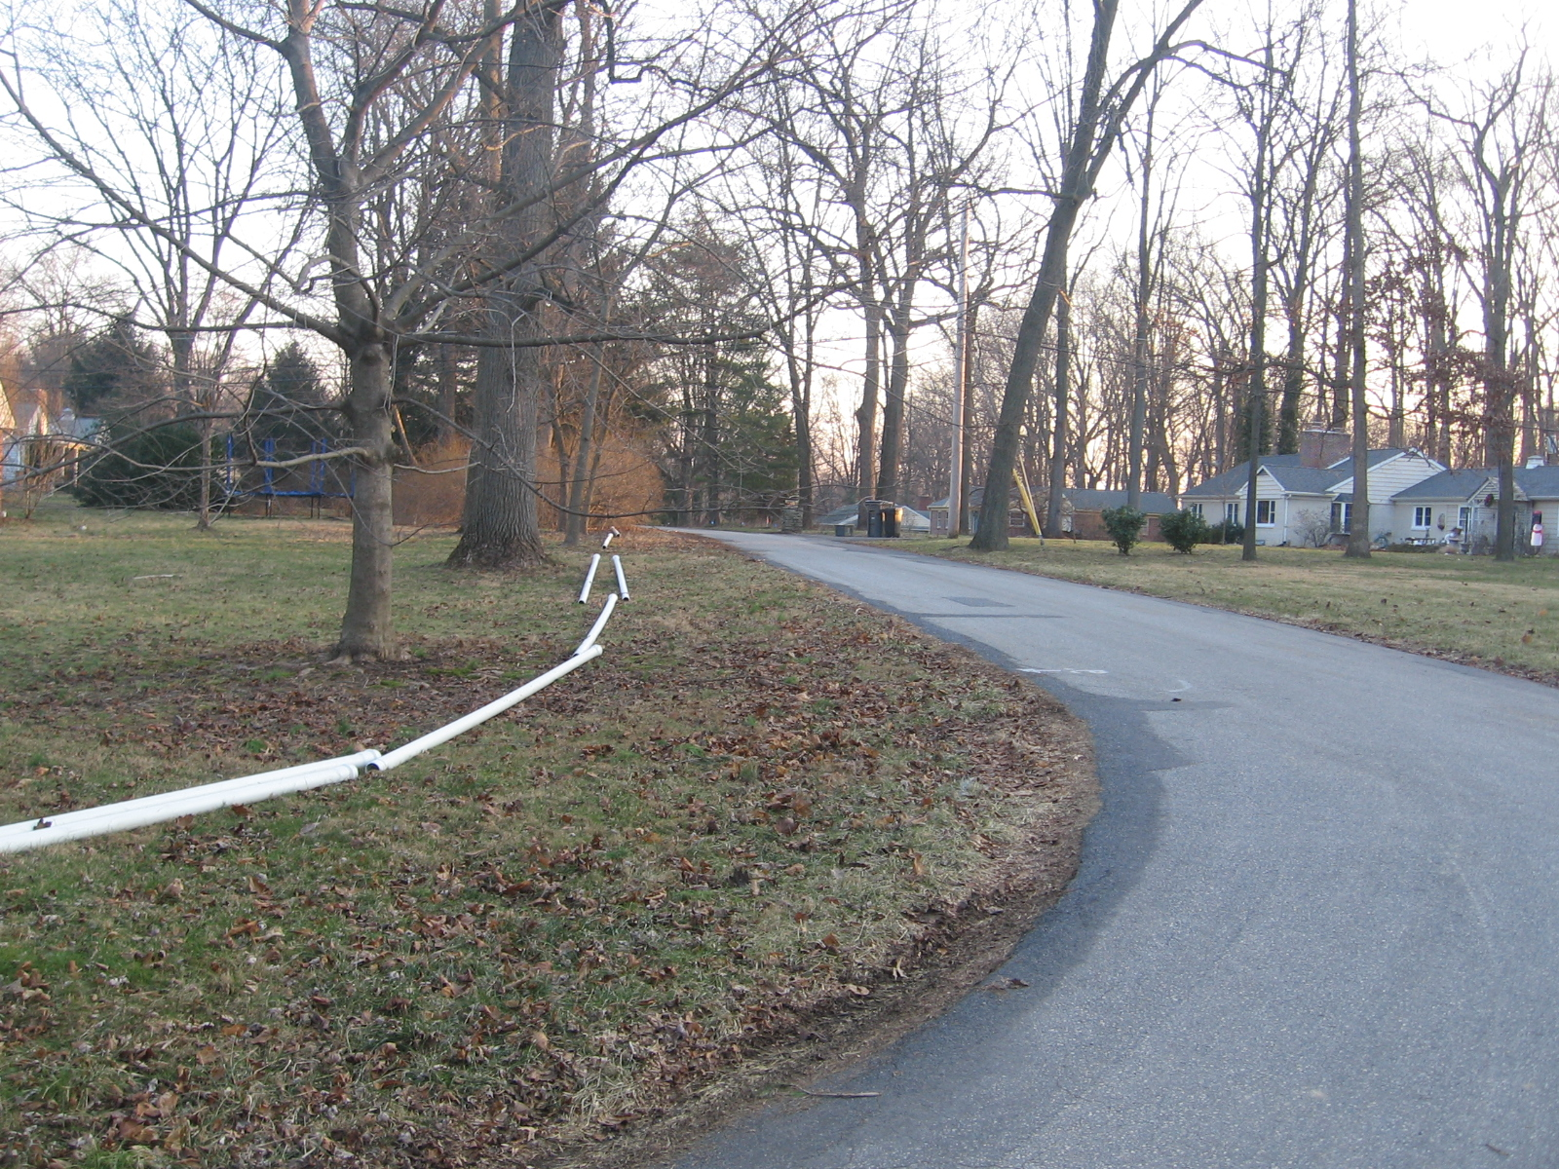
Distribution System – Pearce Creek Service Area
“Stringing Out Pipe”

Slide 13
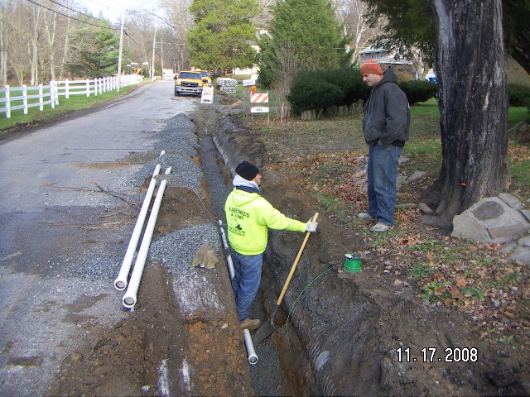
Distribution System – Pearce Creek Service Area
Excavating for Pipe – Off Road

Slide 14
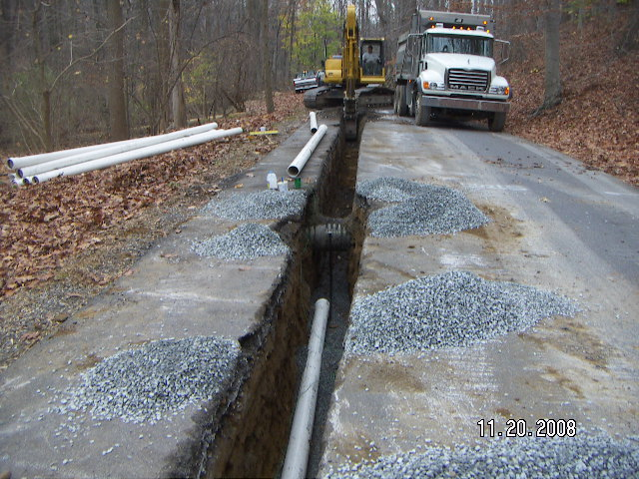
Distribution System – Pearce Creek Service Area
Excavating for Pipe – In Roadway

Slide 15
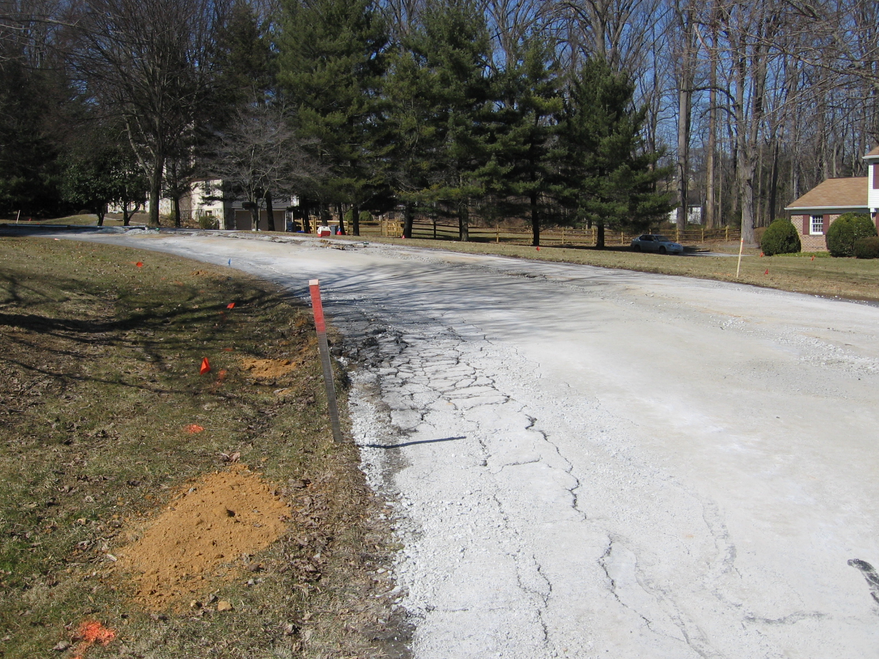
Distribution System – Pearce Creek Service Area
Damage to Existing Asphalt

Slide 16
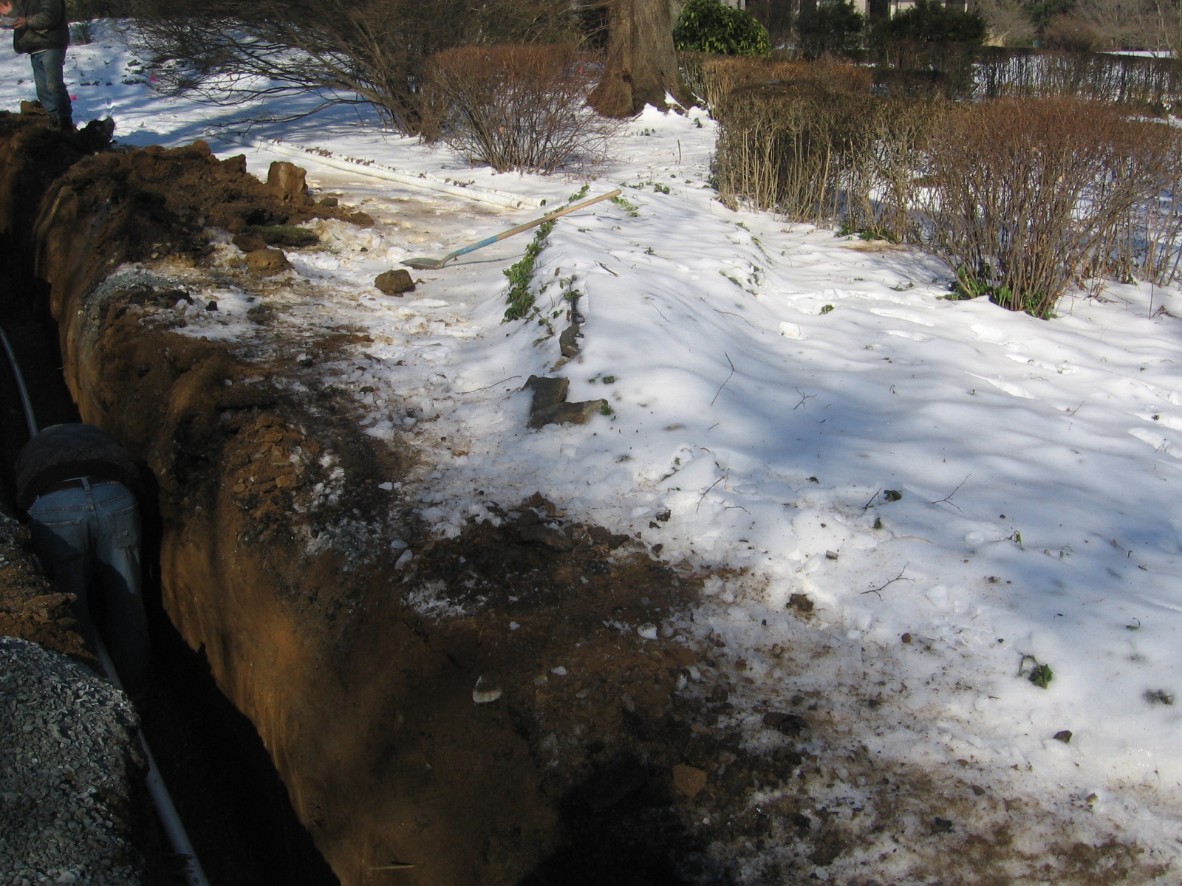
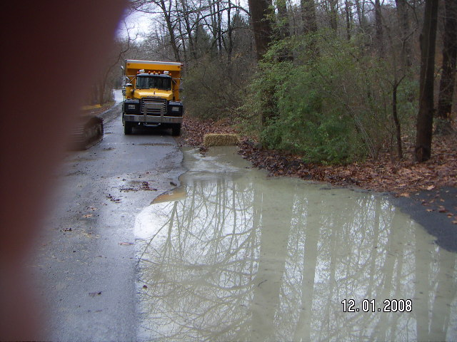
Distribution System – Pearce Creek Service Area
Year Round Work

Slide 17
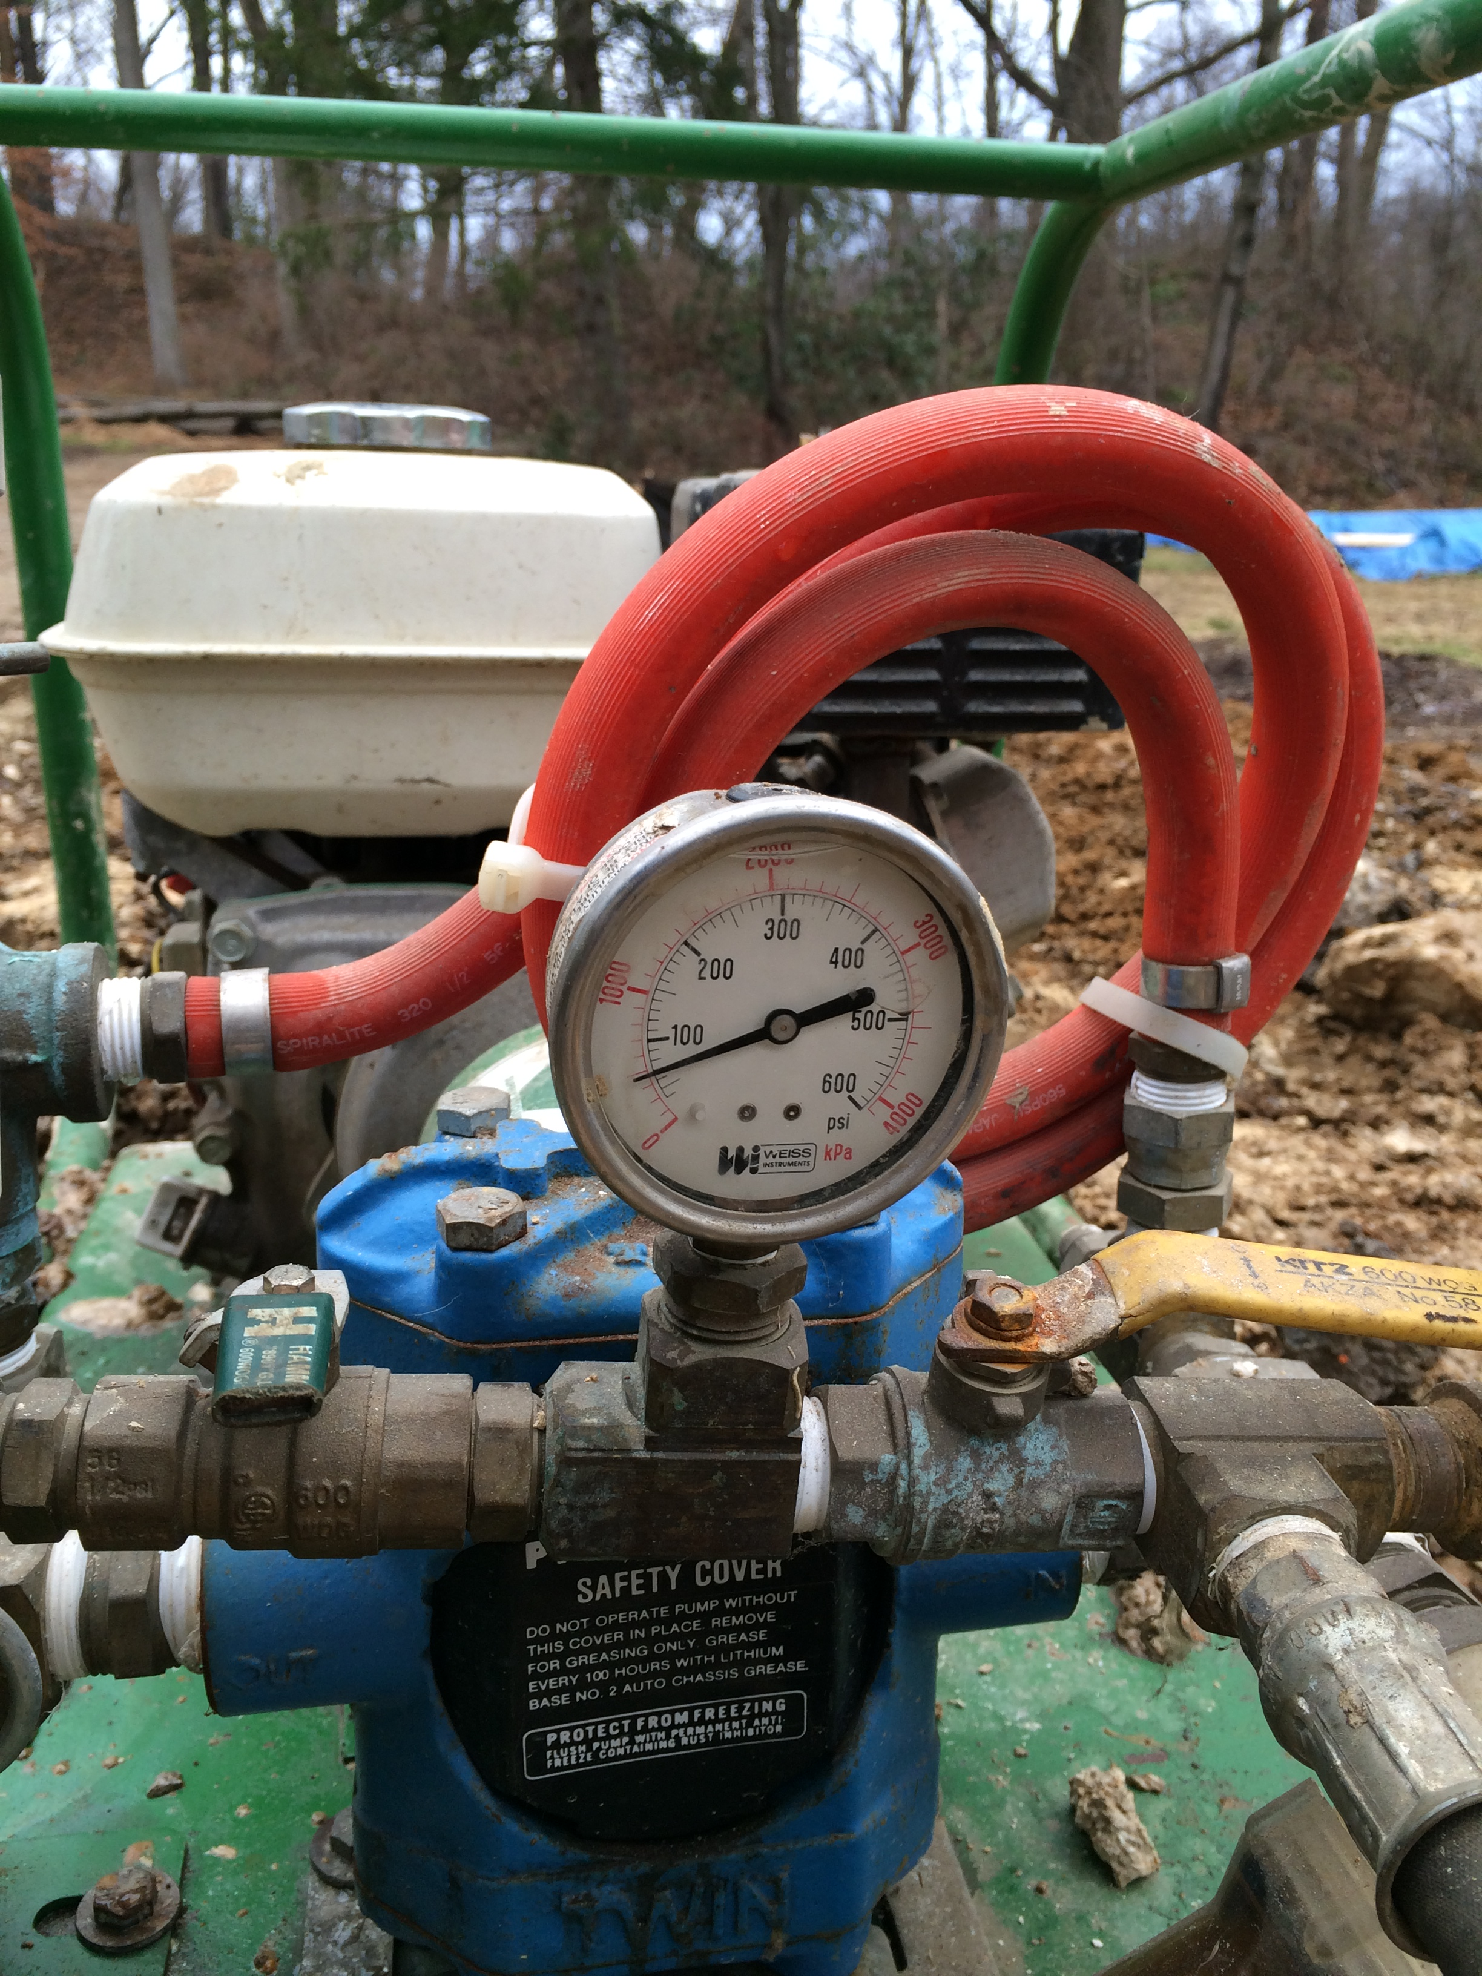
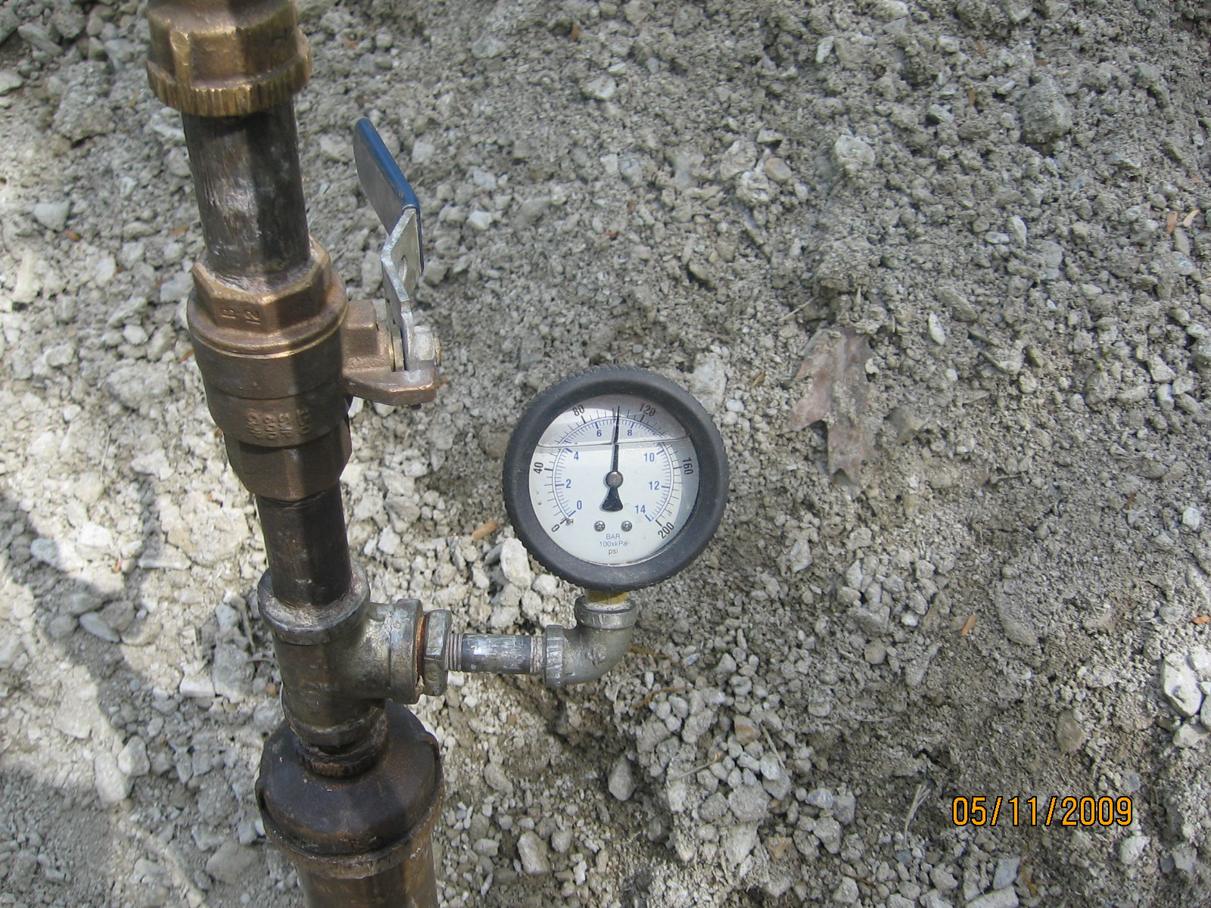
Distribution System – Pearce Creek Service Area
Pressure Testing / Disinfection / Flushing

Slide 18
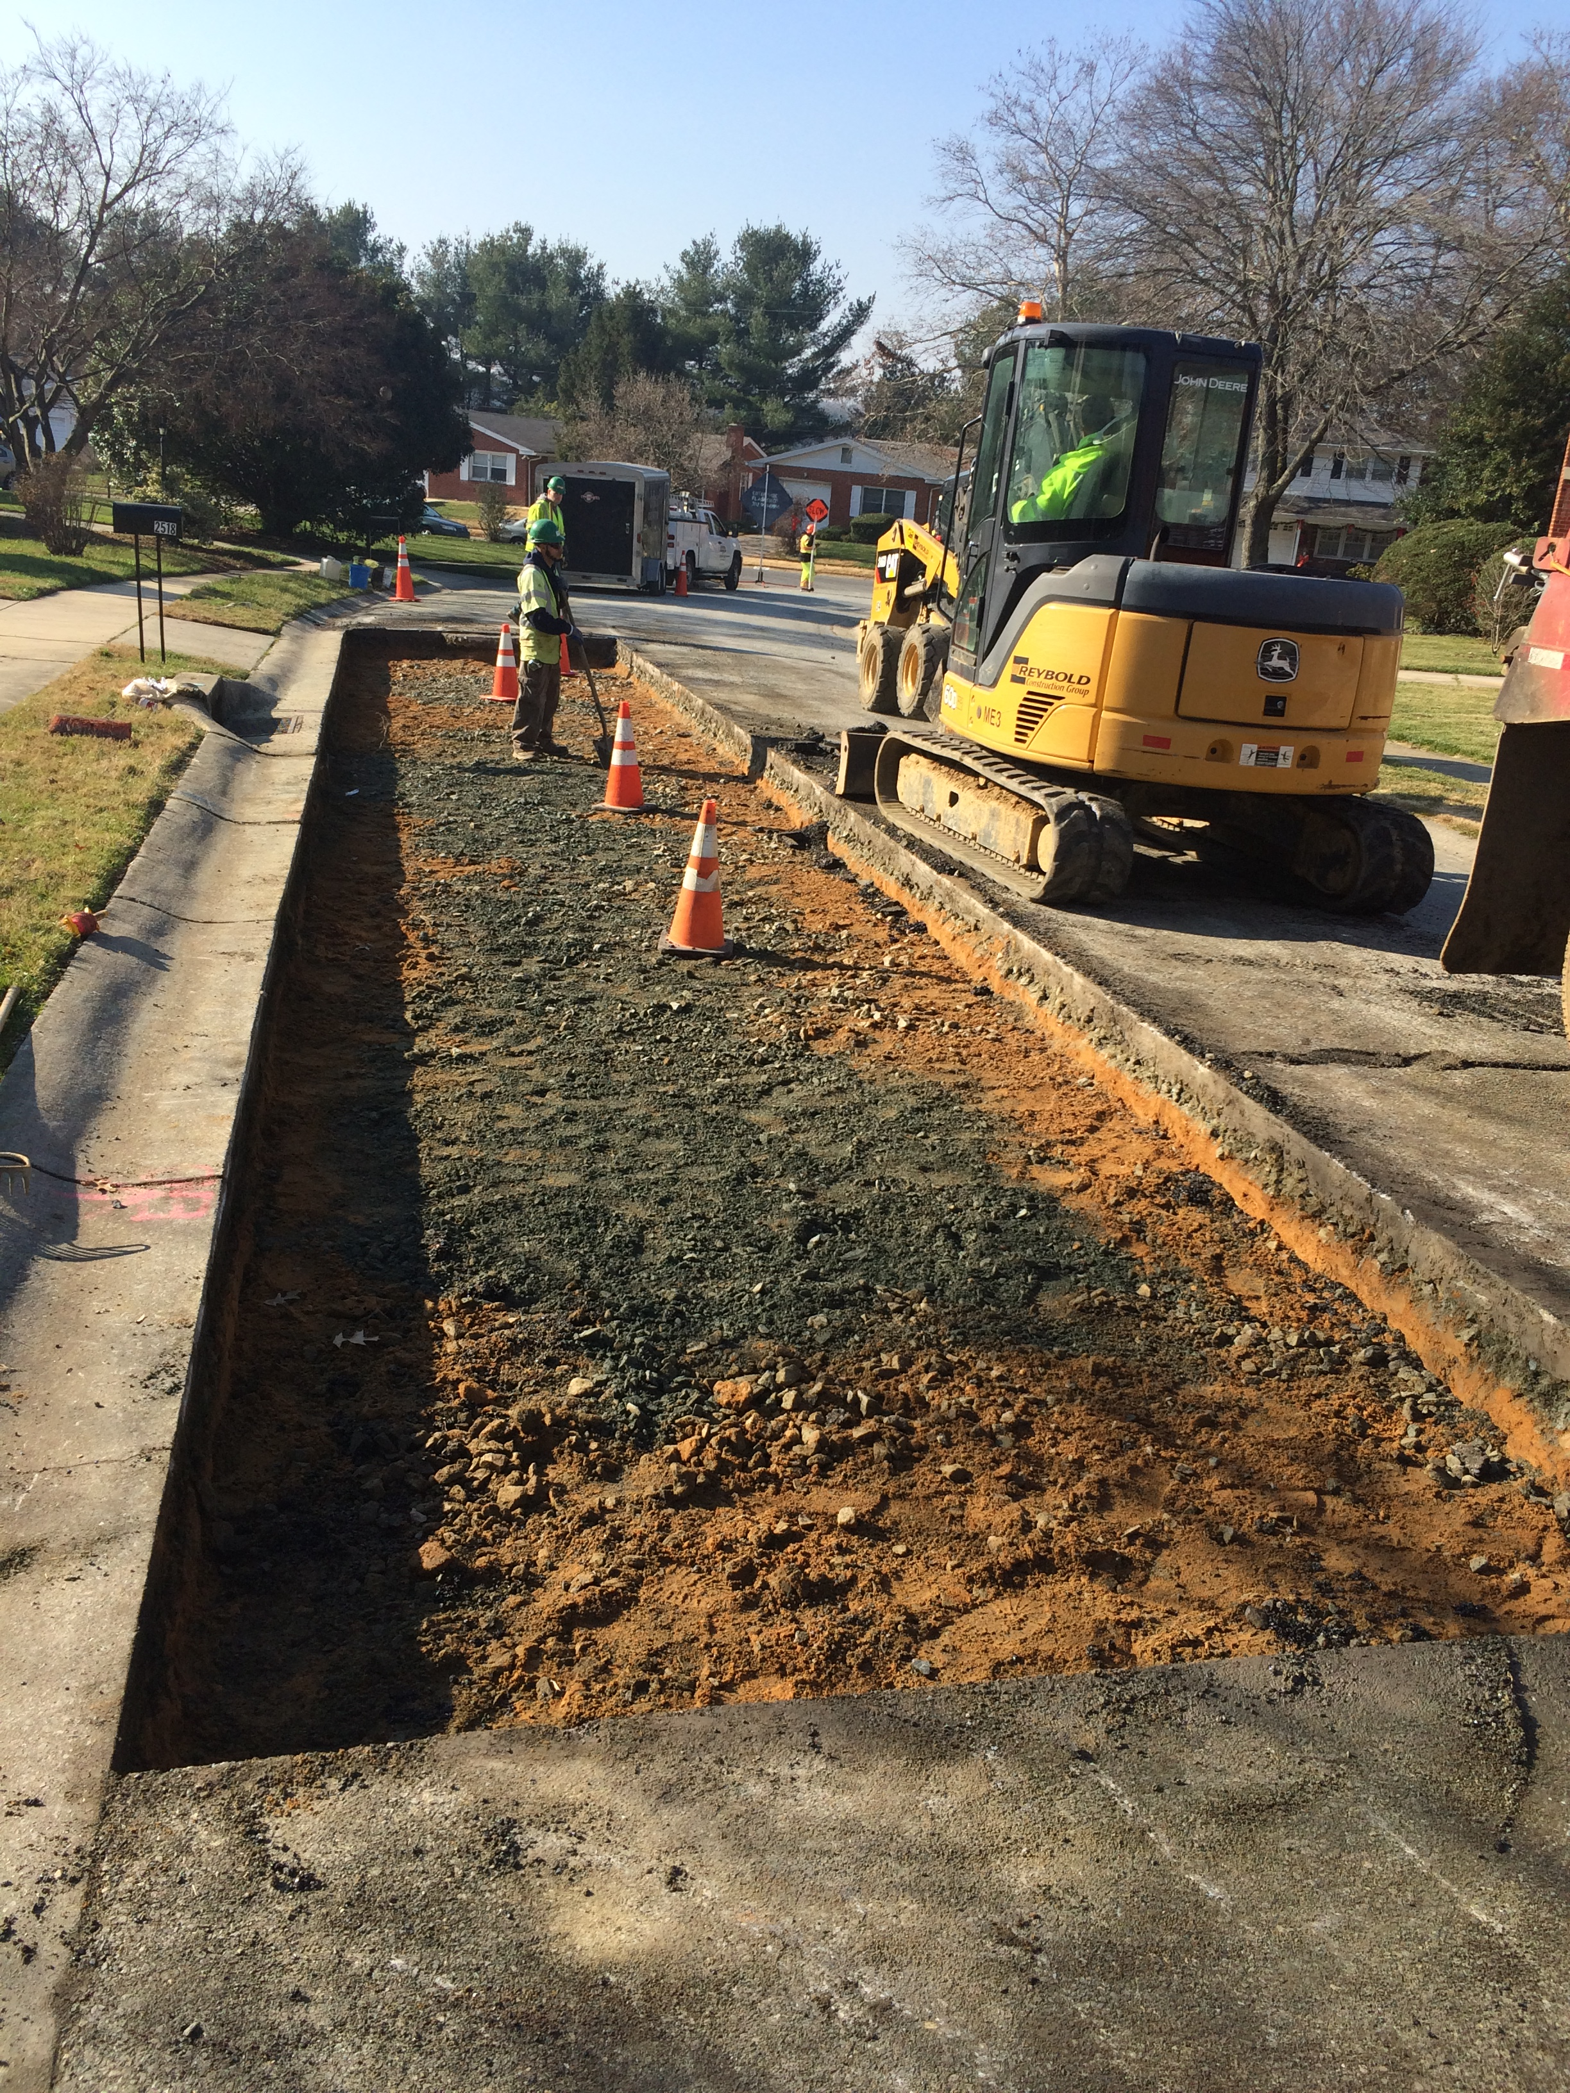
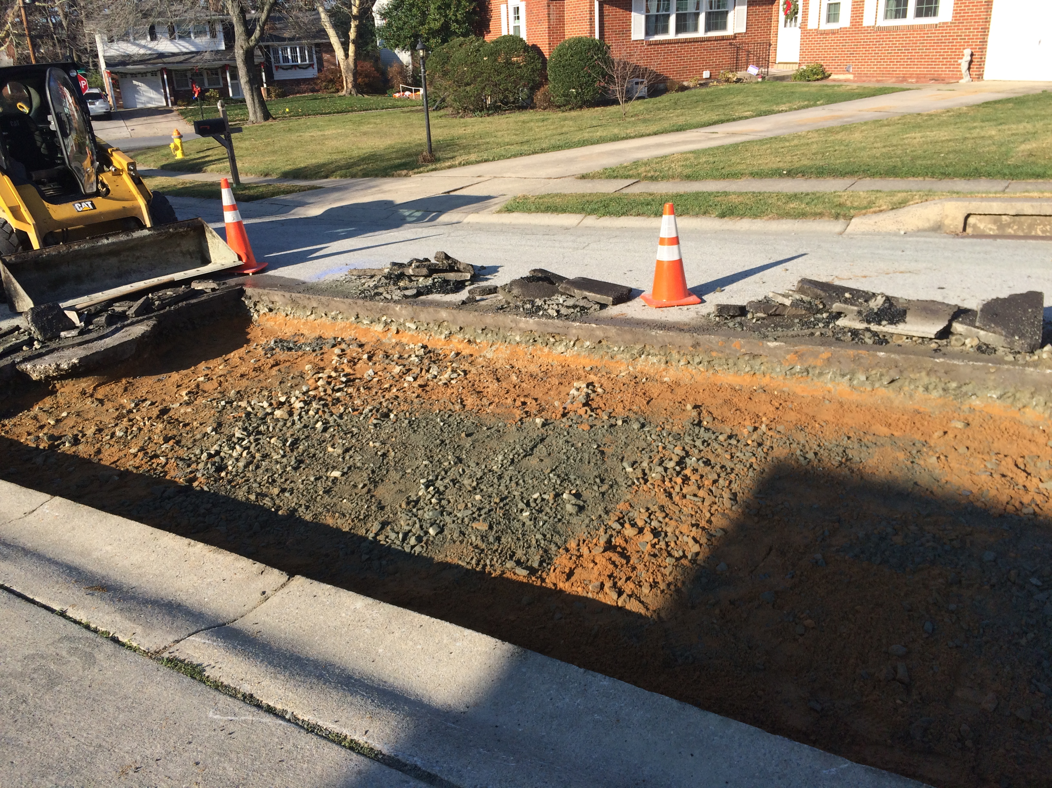
Distribution System – Pearce Creek Service Area
Asphalt Restoration – Box Out

Slide 19
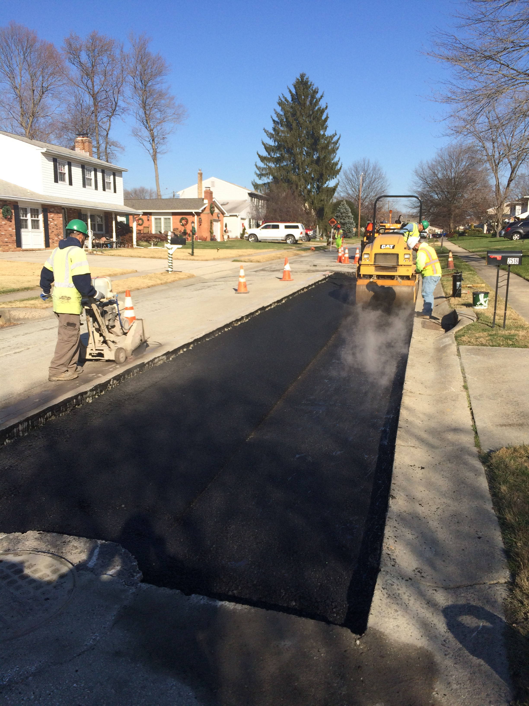
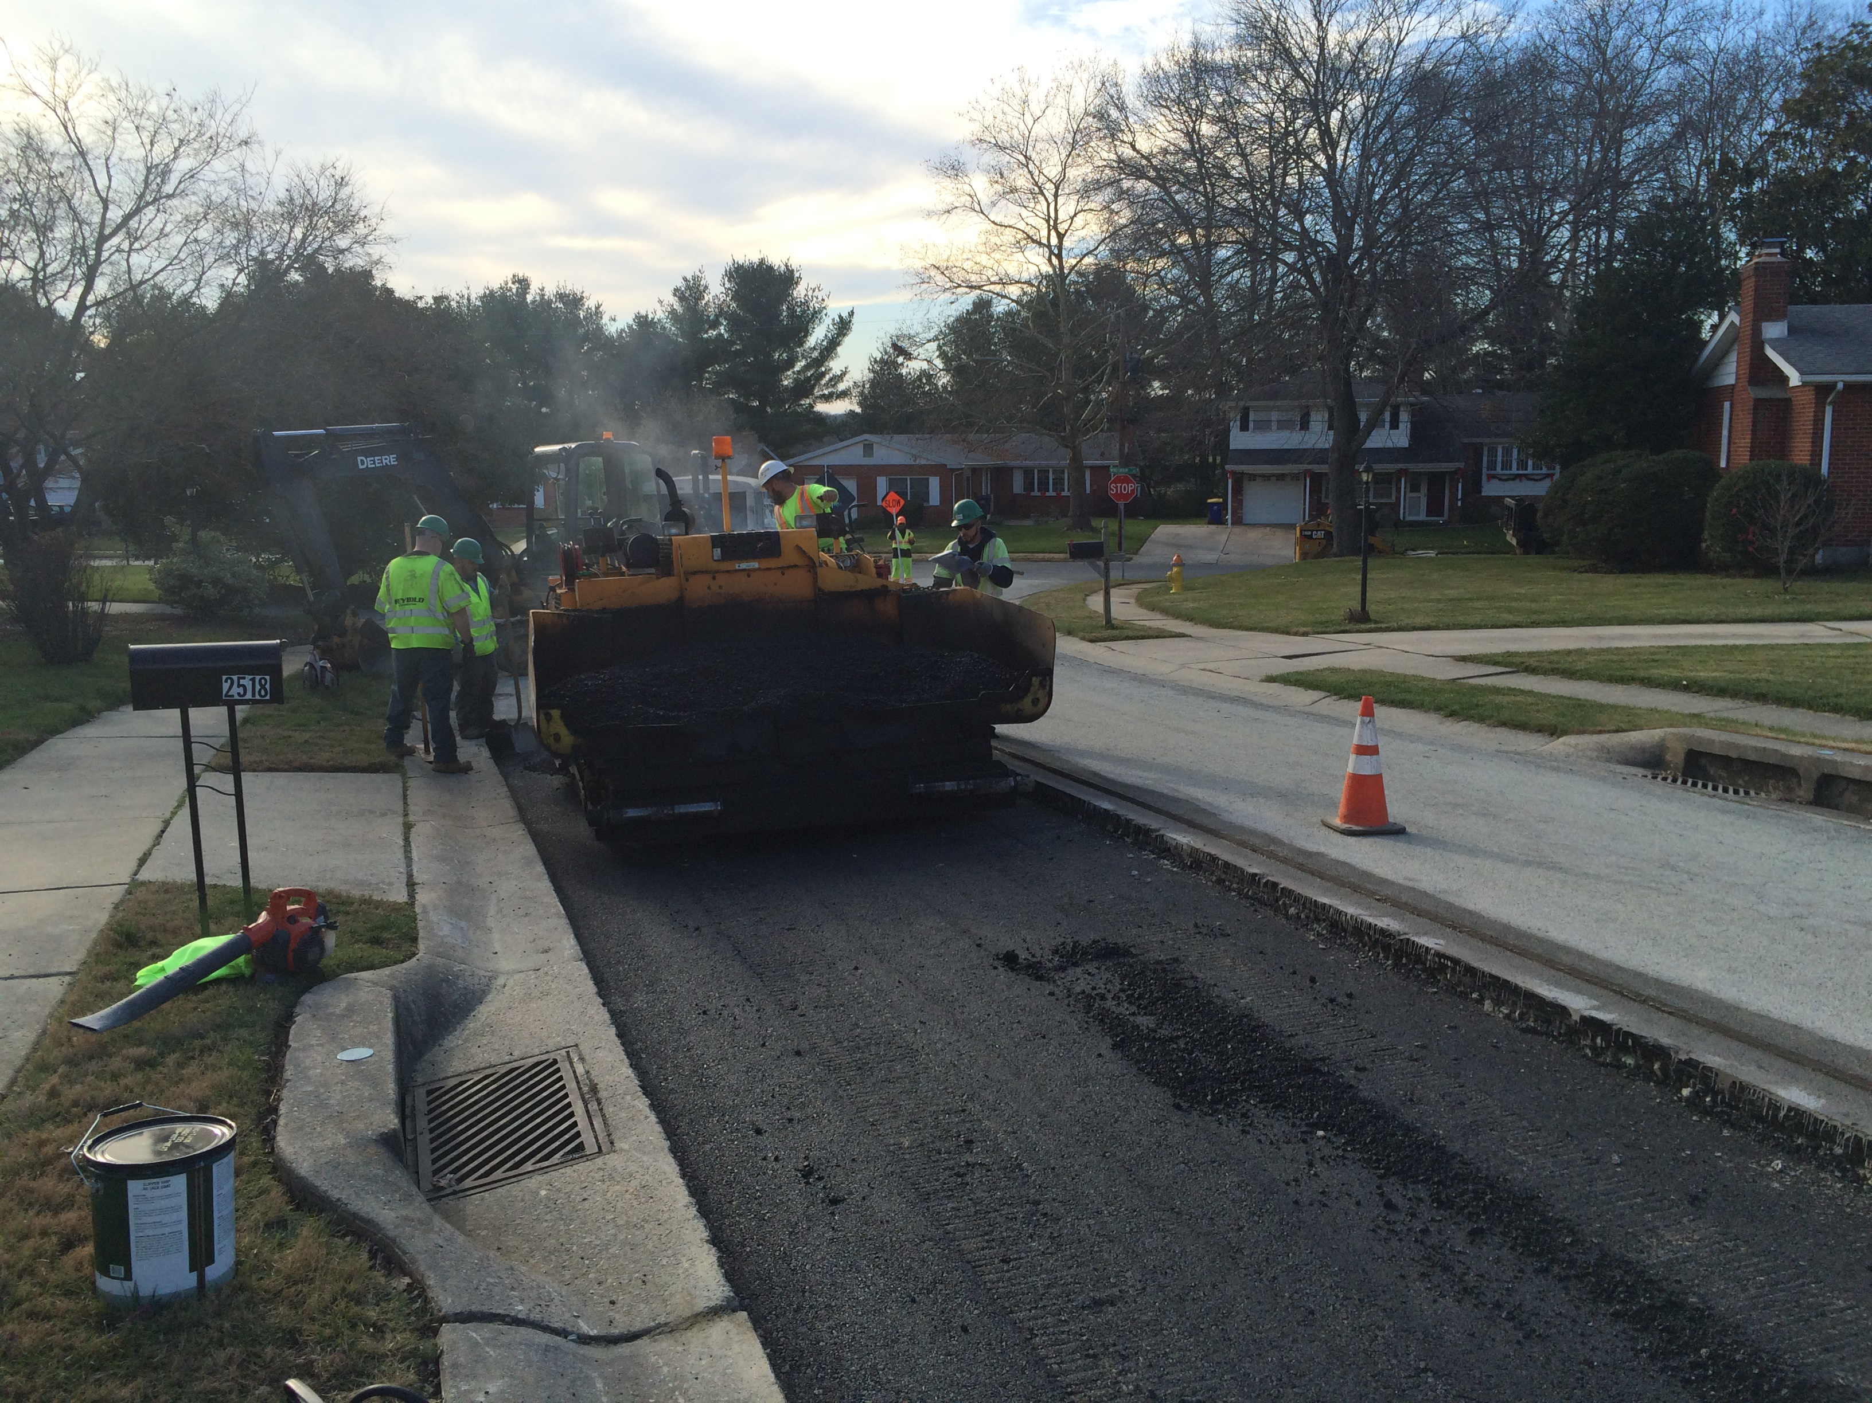
Distribution System – Pearce Creek Service Area
Asphalt Restoration - Patching

Slide 20
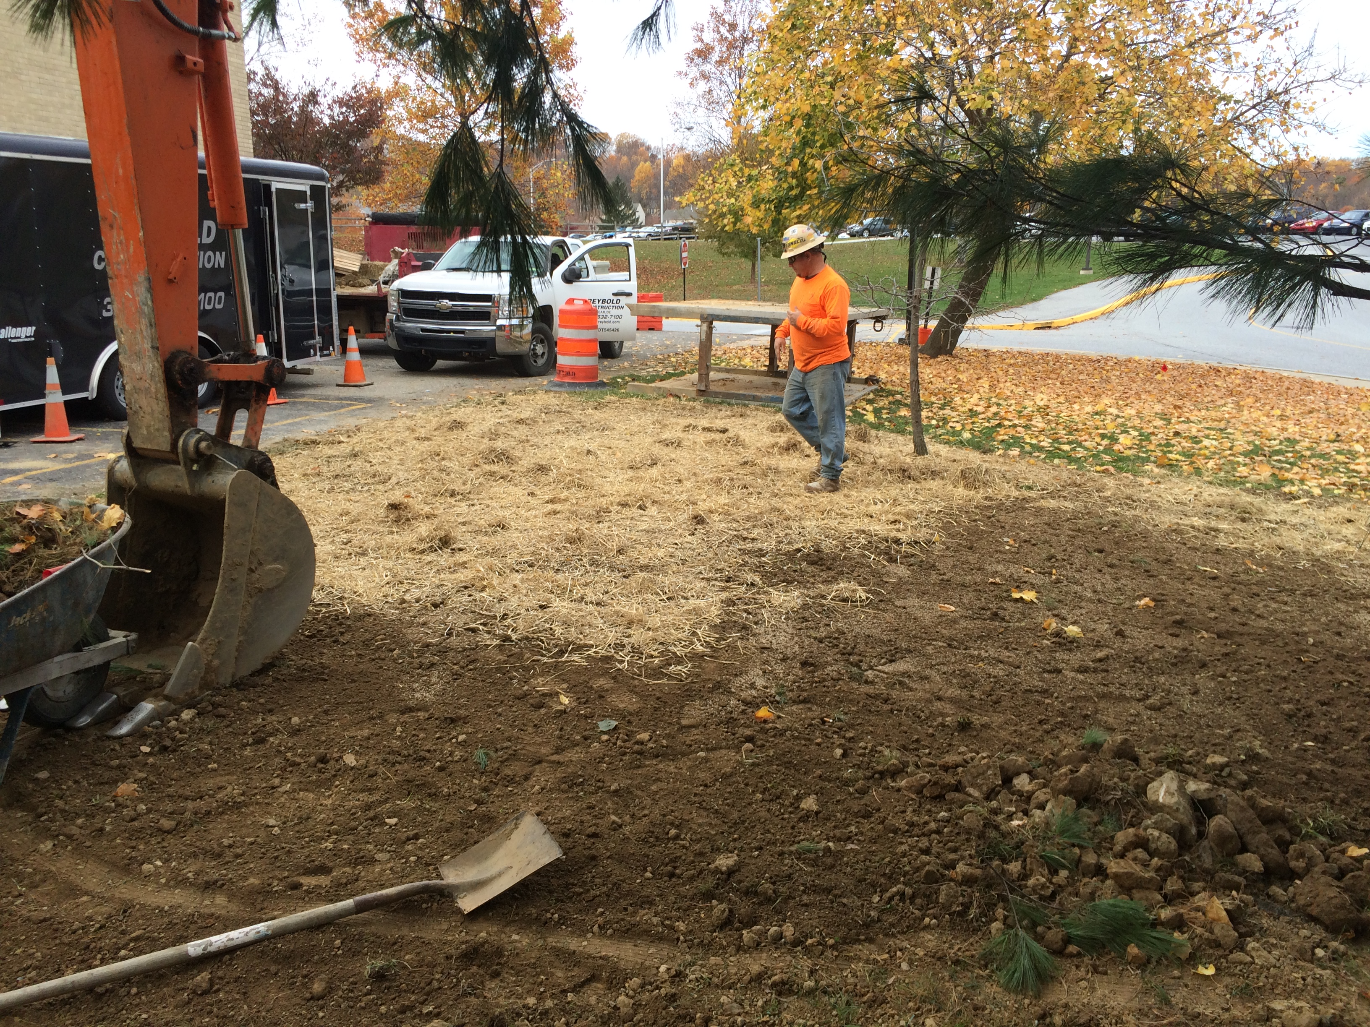
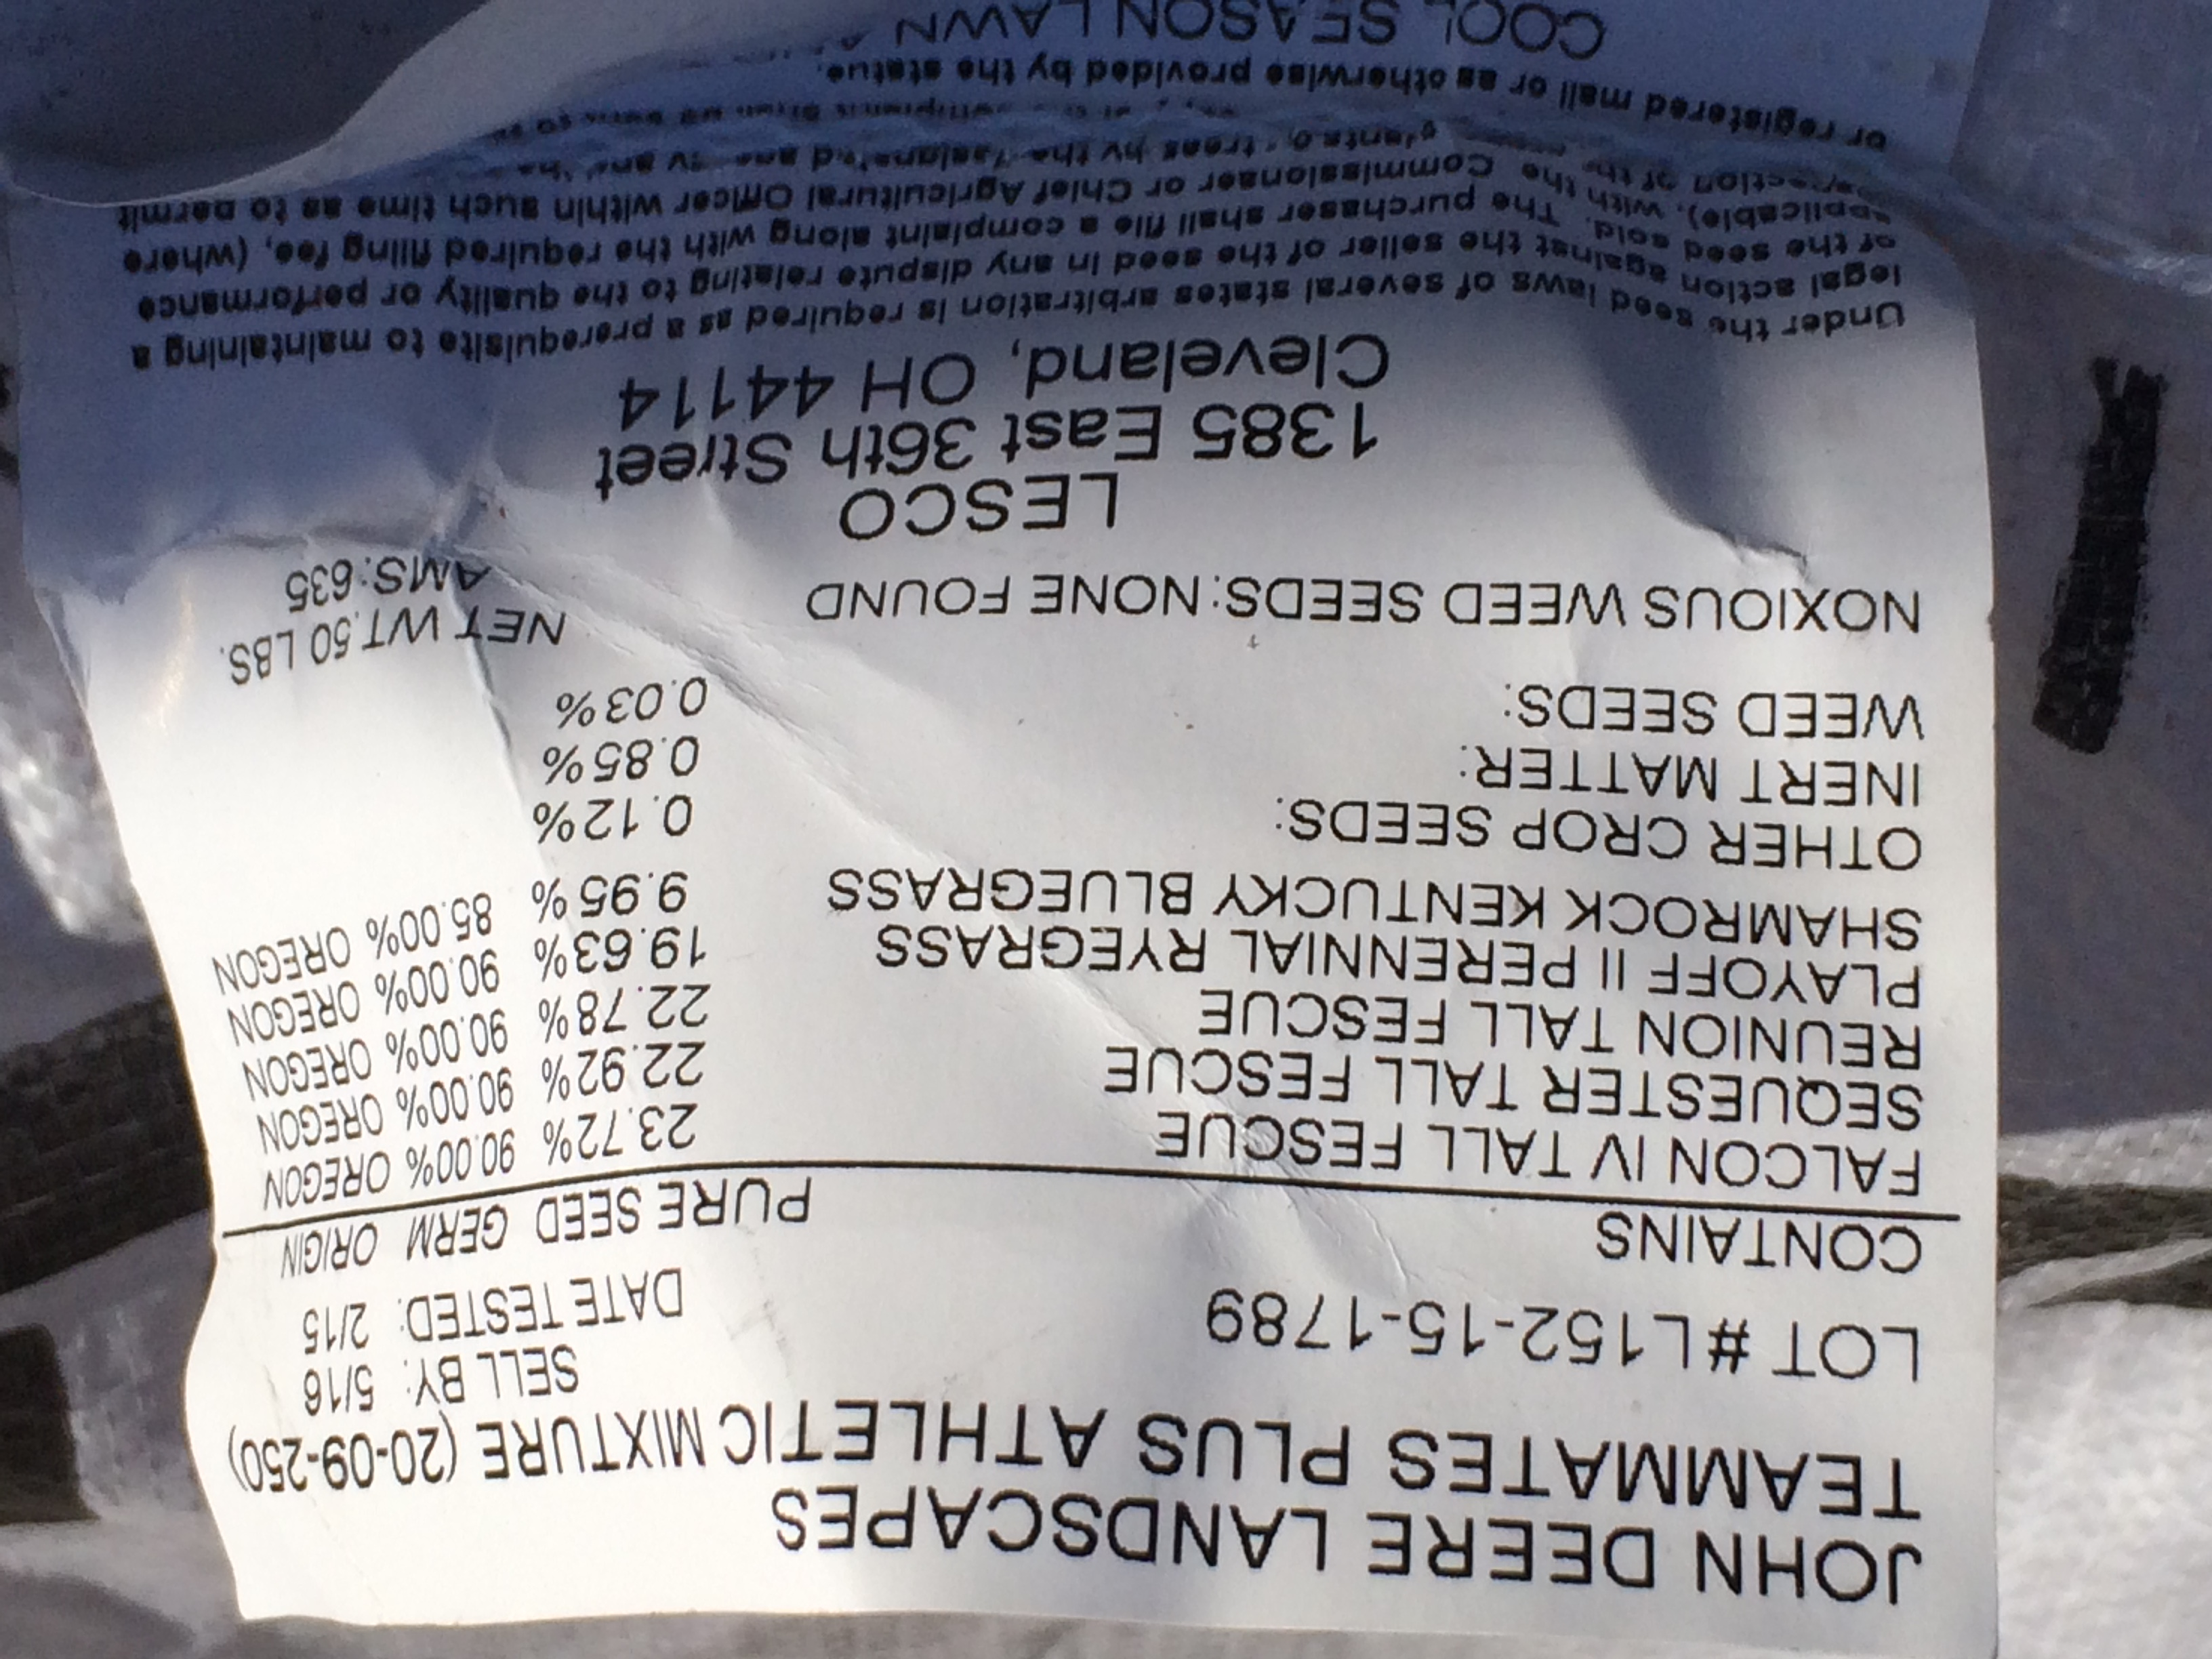
Distribution System – Pearce Creek Service Area
Grass Restoration – Seeding & Mulch

Slide 21
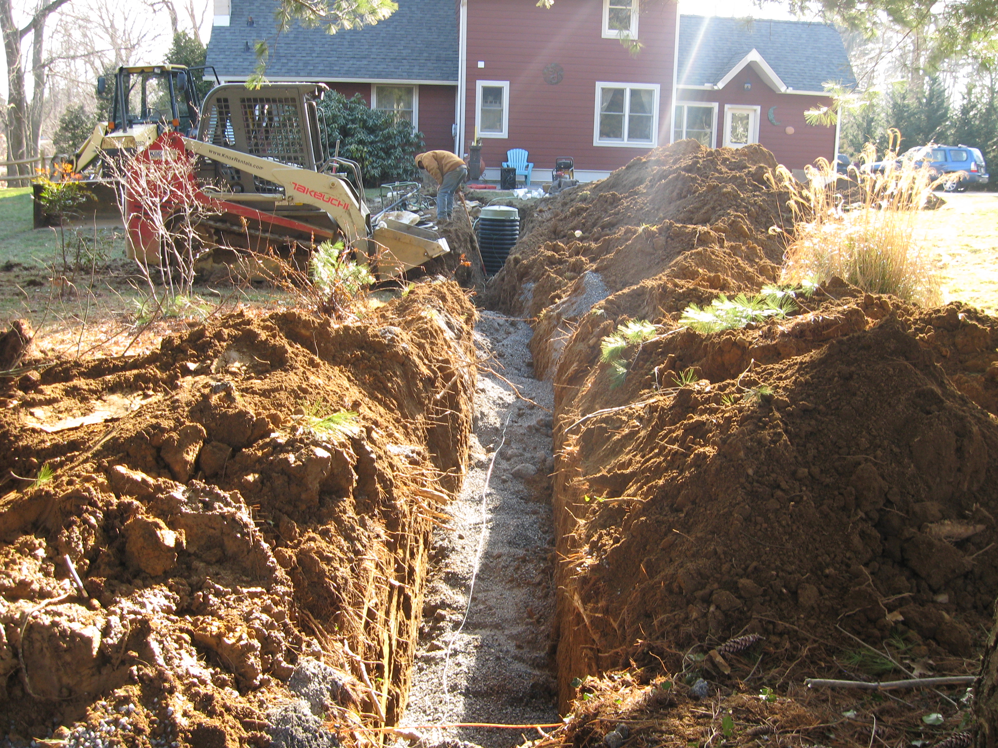
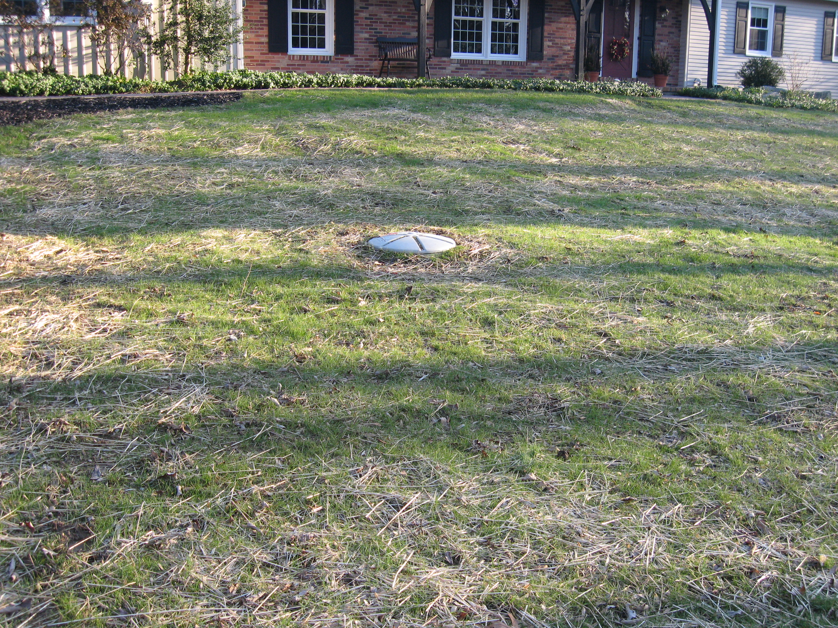
On-Lot Construction – More to Come

Slide 22
What to Expect During Construction
If you have any questions regarding the project please contact:
Christopher Rogers
Christopher.Rogers@aecom.com
302-781-5945
THANK YOU

